Slide 1

Operations and Project Management
ELCBUS 340
11 April 2018

Slide 2
Today’s Agenda
Class Administration – Littlefield Teams Verification
Discussion on Reading
Forecasting
Demand Patterns & Management
Forecast Error Measures
Forecasting Technique Parts I, II, and III
Criteria for Selecting a Time-Series Method
Solved Problems

Slide 3
50,000 Feet Overview of OPM
Managing Value Chains
Managing Processes
Using Operations
to Compete
Supply Chain Strategy
Process Strategy
Location
Operations As a
Competitive Weapon
Process Analysis
Inventory Management
Operations Strategy
Process Performance
& Quality
Forecasting
Forecasting
Project Management
Constraint Management
Sales & Operations
Planning
Process Layout
Resource Planning
Lean Systems
Scheduling
Notes:
Service vs. Manufacturing
Small vs. Medium vs. Large Firms
Industry type: hightech, healthcare, aerospace, IT, etc ….

Slide 4

What is a Forecast?
A prediction of future events used for planning purposes.

Slide 5
Forecasting as a Process
Adjust history file
1
Prepare initial forecasts
2
Consensus meetings and collaboration
3
Finalize
and communicate
6
Review by Operating Committee
5
Revise forecasts
4

Slide 6
Forecasting Principles
SOME PRINCIPLES FOR THE FORECASTING PROCESS
Better processes yield better forecasts
Demand forecasting is being done in virtually every company, either formally or informally. The challenge is to do it well—better than the competition
Better forecasts result in better customer service and lower costs, as well as better relationships with suppliers and customers
The forecast can and must make sense based on the big picture, economic outlook, market share, and so on
The best way to improve forecast accuracy is to focus on reducing forecast error
Bias is the worst kind of forecast error; strive for zero bias
Whenever possible, forecast at more aggregate levels. Forecast in detail only where necessary
Far more can be gained by people collaborating and communicating well than by using the most advanced forecasting technique or model

Slide 7

Adding Collaboration to the Process
Collaborative planning, forecasting, and replenishment (CPFR)
A process for supply chain integration that allows a supplier and its customers to collaborate on making the forecast.

Slide 8
Demand Patterns & Management

Slide 9
Demand Patterns
There are five basic time series patterns:
  Horizontal
  Trend
  Seasonal
  Cyclical
  Random
  A time series is the repeated observations of demand for a service or product in their order of occurrence. Time series plots are used to visualize Demand Patterns.

Slide 10
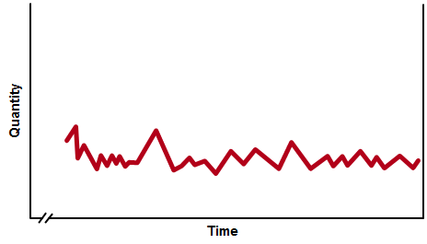
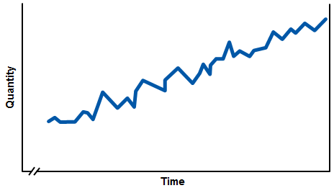
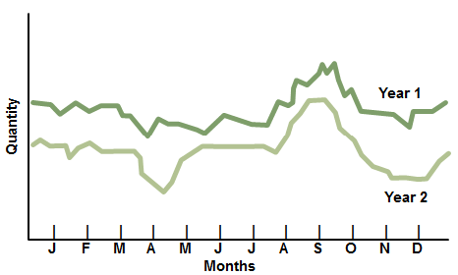
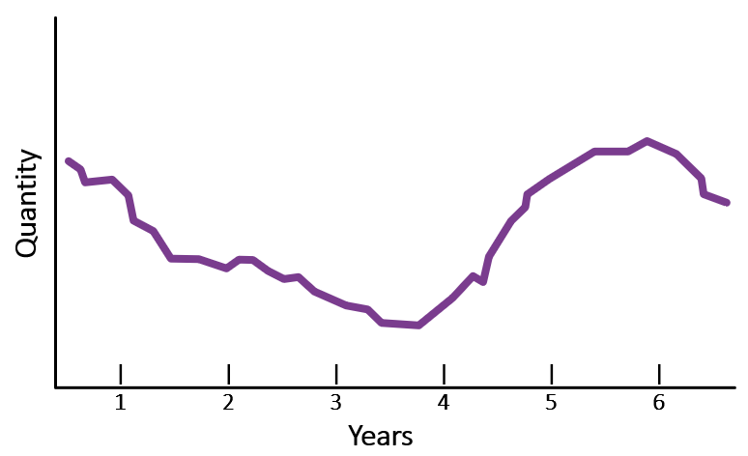
Demand Patterns
(a) Horizontal (b) Trend
(a) Seasonal (b) Cyclical

Slide 11
Demand Management
  The process of changing demand patterns using one or more demand options.
Demand Management Options:
Complementary Products
Promotional Pricing
Prescheduled Appointments
Reservations
Revenue Management
Backlogs
Backorders and Stockouts

Slide 12
Key Decisions for Making Forecasts
What?
How? (Forecasting Technique)
  Level of aggregation
  Units of measurement
  Judgment methods
  Causal methods
  Time-series analysis
  Trend projection using regression

Slide 13

Forecast Error Measures

Slide 14
Measures of Forecast Error
For any forecasting method, it is important to measure the accuracy of its forecasts.
Forecast error is simply the difference found by subtracting the forecast from actual demand for a given period, or
E_{t} = D_{t} – F_{t}
Where:
E_{t} = forecast error for period t
D_{t} = actual demand in period t
F_{t} = forecast for period t

Slide 15

Measures of Forecast Error
Cumulative sum of forecast errors (Bias)
Standard deviation
Σ(E_{t} – Ē)²
n – 1
CFE = ΣE_{t}
σ =
Average forecast error
Mean Absolute Deviation
CFE
n
Σ|E_{t} |
n
Ē=
MAD =
Mean Squared Error
Mean Absolute Percent Error
ΣE_{t}²
n
(Σ|E_{t} |/ D_{t})(100)
n
MSE =
MAPE =
Notes:
74

Slide 16
Example
The following table shows the actual sales of upholstered chairs for a furniture manufacturer and the forecasts made for each of the last eight months.
Calculate CFE, MSE, σ, MAD, and MAPE for this product.
Month t | Demand D_{t} | Forecast F_{t} | Error E_{t} |  |  | Error² E_{t}² |  |  | Absolute Error |E_{t}| |  |  | Absolute % Error (|E_{t}|/D_{t})(100)
1 | 200 | 225 |  | –25
2 | 240 | 220 |  | 20
3 | 300 | 285 |  | 15
4 | 270 | 290 |  | –20
5 | 230 | 250 |  | –20 |  |  | 400 |  |  | 20 |  |  | 8.7
6 | 260 | 240 |  | 20 |  |  | 400 |  |  | 20 |  |  | 7.7
7 | 210 | 250 |  | –40 |  |  | 1,600 |  |  | 40 |  |  | 19.0
8 | 275 | 240 |  | 35 |  |  | 1,225 |  |  | 35 |  |  | 12.7
 |  | Total |  | –15 |  |  | 5,275 |  |  | 195 |  |  | 81.3%

Slide 17
Example
The following table shows the actual sales of upholstered chairs for a furniture manufacturer and the forecasts made for each of the last eight months.
Calculate CFE, MSE, σ, MAD, and MAPE for this product.
Month t | Demand D_{t} | Forecast F_{t} | Error E_{t} |  |  | Error² E_{t}² |  |  | Absolute Error |E_{t}| |  |  | Absolute % Error (|E_{t}|/D_{t})(100)
1 | 200 | 225 |  | –25
2 | 240 | 220 |  | 20
3 | 300 | 285 |  | 15
4 | 270 | 290 |  | –20
5 | 230 | 250 |  | –20 |  |  | 400 |  |  | 20 |  |  | 8.7
6 | 260 | 240 |  | 20 |  |  | 400 |  |  | 20 |  |  | 7.7
7 | 210 | 250 |  | –40 |  |  | 1,600 |  |  | 40 |  |  | 19.0
8 | 275 | 240 |  | 35 |  |  | 1,225 |  |  | 35 |  |  | 12.7
 |  | Total |  | –15 |  |  | 5,275 |  |  | 195 |  |  | 81.3%
625 |  |  | 25 |  |  | 12.5%
400 |  |  | 20 |  |  | 8.3
225 |  |  | 15 |  |  | 5.0
400 |  |  | 20 |  |  | 7.4

Slide 18
Example
Using the formulas for the measures, we get:
Cumulative forecast error (mean bias):
CFE =
–15
Average forecast error (mean bias):
CFE
n
15
8
Ē =
= =
–1.875
Mean squared error:
ΣE_{t}²
n
5,275
8
MSE =
=
=
659.4

Slide 19
Example
Standard deviation:
Σ[E_{t} – (–1.875)]²
n – 1
σ =
= 27.4
Mean absolute deviation:
Σ|E_{t} |
n
195
8
MAD =
= = 24.4
Mean absolute percent error:
(Σ|E_{t} |/ D_{t})(100)
n
81.3%
8
MAPE =
= = 10.2%

Slide 20
Example
A Cumulative Forecast Error (CFE) of –15 indicates that the forecast has a slight bias to overestimate demand.
The Mean Square Error (MSE), σ, and Mean Absolute Deviation (MAD) statistics provide measures of forecast error variability.
A MAD of 24.4 means that the average forecast error was 24.4 units in absolute value.
The value of σ, 27.4, indicates that the sample distribution of forecast errors has a standard deviation of 27.4 units.
A Mean Absolute Percent Error (MAPE) of 10.2 percent implies that, on average, the forecast error was about 10 percent of actual demand.
These measures become more reliable as the number of periods of data increases.

Slide 21
Forecasting Techniques – Part I (Overview)
Judgment Methods
Casual Methods
Time-Series Analysis

Slide 22

Judgment Methods
Judgmental forecasts use contextual knowledge gained through experience and translate them into quantitative estimates.
  Salesforce estimates
  Executive opinion
  Market research
  Delphi method

Slide 23

Casual Methods
Causal Methods are a quantitative forecasting method that uses historical data on independent variables, such as promotional campaigns, economic conditions, and competitors’ actions to predict demand.

Slide 24

Time-Series Analysis
Time-Series Analysis is a statistical approach that relies heavily on historical demand data to project the future size of demand and recognizes trends and seasonal patterns.

Slide 25
Forecasting Techniques – Part II
Simple Moving Average
Weighted Moving Average
Exponential Smoothing

Slide 26
Time Series Methods
Naïve forecast
  The forecast for the next period equals the demand for the current period (Forecast = D_{t})
Horizontal Patterns: Estimating the average
  Simple moving average
  Weighted moving average
  Exponential smoothing

Slide 27
Simple Moving Averages
Specifically, the forecast for period t + 1 can be calculated at the end of period t (after the actual demand for period t is known) as
Sum of last n demands
n
D_{t} + D_{t-1} + D_{t-2} + … + D_{t-n+1}
n
F_{t+1} = =
where
D_{t} = actual demand in period t
n = total number of periods in the average
F_{t+1} = forecast for period t + 1

Slide 28
Simple Moving Averages - Example
a. Compute a three-week moving average forecast for the arrival of medical clinic patients in week 4. The numbers of arrivals for the past three weeks were as follows:
b. If the actual number of patient arrivals in week 4 is 415, what is the forecast error for week 4?
c. What is the forecast for week 5?
Week | Patient Arrivals
1 | 400
2 | 380
3 | 411

Slide 29
Simple Moving Averages - Example
Week | Patient Arrivals
1 | 400
2 | 380
3 | 411
a. The moving average forecast at the end of week 3 is:
411 + 380 + 400
3
F₄ =
= 397.0
b. The forecast error for week 4 is
E₄ = D₄ – F₄
= 415 – 397 = 18
c. The forecast for week 5 requires the actual arrivals from weeks 2 through 4, the three most recent weeks of data
415 + 411 + 380
3
F₅ =
= 402.0

Slide 30
Simple Moving Averages – Example 2
Estimating with Simple Moving Average using the following customer-arrival data:
Month | Customer arrival
1 | 800
2 | 740
3 | 810
4 | 790
Use a three-month moving average to forecast customer arrivals for month 5
D₄ + D₃ + D₂
3
790 + 810 + 740
3
F₅ =
=
= 780
Forecast for month 5 is 780 customer arrivals

Slide 31
Simple Moving Averages – Example 2
If the actual number of arrivals in month 5 is 805, what is the forecast for month 6?
Month | Customer arrival
1 | 800
2 | 740
3 | 810
4 | 790
D₅ + D₄ + D₃
3
805 + 790 + 810
3
F₆ =
=
= 801.667
Forecast for month 6 is 802 customer arrivals

Slide 32
Simple Moving Averages – Example 2
Forecast error is simply the difference found by subtracting the forecast from actual demand for a given period, or
E_{t} = D_{t} – F_{t}
Given the three-month moving average forecast for month 5, and the number of patients that actually arrived (805), what is the forecast error?
E₅ =
805 – 780
= 25
Forecast error for month 5 is 25

Slide 33
Weighted Moving Averages
In the weighted moving average method, each historical demand in the average can have its own weight, provided that the sum of the weights equals 1.0.
The average is obtained by multiplying the weight of each period by the actual demand for that period, and then adding the products together
F_{t+1} = W₁D₁ + W₂D₂ + … + W_{n}D_{t-n+1}

Slide 34
Weighted Moving Averages - Example
Using the customer arrival data in Example 2, let
W₁ = 0.50, W₂ = 0.30, and W₃ = 0.20. Use the weighted moving average method to forecast arrivals for month 5.
F₅ = W₁D₄ + W₂D₃ + W₃D₂
= 0.50(790) + 0.30(810) + 0.20(740)
= 786
Forecast for month 5 is 786 customer arrivals.
Given the number of customers that actually arrived (805),
what is the forecast error?
E₅ =
805 – 786
= 19
Forecast error for month 5 is 19.

Slide 35
Weighted Moving Averages - Example
If the actual number of arrivals in month 5 is 805, compute the forecast for month 6:
F₆ = W₁D₅ + W₂D₄ + W₃D₃
= 0.50(805) + 0.30(790) + 0.20(810)
= 801.5
Forecast for month 6 is 802 customer arrivals.

Slide 36
Exponential Smoothing
A sophisticated weighted moving average that calculates the average of a time series by implicitly giving recent demands more weight than earlier demands
Requires only three items of data
  The last period’s forecast
  The demand for this period
  A smoothing parameter, alpha (α), where 0 ≤ α ≤ 1.0
The equation for the forecast is
F_{t+1} = α(Demand this period) + (1 – α)(Forecast calculated last period)
= αD_{t} + (1 – α)F_{t}

Slide 37
Exponential Smoothing
The emphasis given to the most recent demand levels can be adjusted by changing the smoothing parameter.
Larger α values emphasize recent levels of demand and result in forecasts more responsive to changes in the underlying average.
Smaller α values treat past demand more uniformly and result in more stable forecasts.

Slide 38
Exponential Smoothing - Example
Reconsider the patient arrival data. It is now the end of week 3 so the actual arrivals is known to be 411 patients. Using α = 0.10, calculate the exponential smoothing forecast for week 4.
What was the forecast error for week 4 if the actual demand turned out to be 415?
What is the forecast for week 5?
Week | Patient Arrivals
1 | 400
2 | 380
3 | 411

Slide 39
Exponential Smoothing - Example
a. To obtain the forecast for week 4, using exponential smoothing with and the initial forecast of 390*, we calculate the average at the end of week 3 as:
F₄ =
0.10(411) + 0.90(390) = 392.1
Thus, the forecast for week 4 would be 392 patients.
* Here the initial forecast of 390 is the average of the first two weeks of demand. POM for Windows and OM Explorer, on the other hand, simply use the actual demand for the first week as the default setting for the initial forecast for period 1, and do not begin tracking forecast errors until the second period.

Slide 40
Exponential Smoothing - Example
Week | Patient Arrivals
2 | 380
3 | 411
4 | 415
b. The forecast error for week 4 is
E₄ =
415 – 392 = 23
c. The new forecast for week 5 would be
F₅ =
0.10(415) + 0.90(392.1) = 394.4
or 394 patients.

Slide 41
Forecasting Techniques – Part III
Trend Patterns Using Linear Regression
Multiplicative Seasonal Method

Slide 42
Linear Regression
A dependent variable is related to one or more independent variables by a linear equation
The independent variables are assumed to “cause” the results observed in the past
Simple linear regression model is a straight line
Y = a + bX
where
Y = dependent variable
X = independent variable
a = Y-intercept of the line
b = slope of the line

Slide 43
Linear Regression
Deviation,
or error
Regression
equation:
Y = a + bX
Y
Estimate of
Y from
regression
equation
Dependent variable
Actual
value
of Y
Value of X used
to estimate Y
X
Independent variable

Slide 44
Linear Regression
The sample correlation coefficient, r
  Measures the direction and strength of the relationship between the independent variable and the dependent variable.
  The value of r can range from –1.00 ≤ r ≤ 1.00
The sample coefficient of determination, r²
  Measures the amount of variation in the dependent variable about its mean that is explained by the regression line
  The values of r² range from 0.00 ≤ r² ≤ 1.00
The standard error of the estimate, s_{yx}
  Measures how closely the data on the dependent variable cluster around the regression line

Slide 45
Trend Patterns Using Regression
A trend in a time series is a systematic increase or decrease in the average of the series over time.
The forecast can be improved by calculating an estimate of the trend.
Trend Projection with Regression accounts for the trend with simple regression analysis.

Slide 46
Trend Patterns – Regression Example
Medanalysis, Inc., provides medical laboratory services
Managers are interested in forecasting the number of blood analysis requests per week
There has been a national increase in requests for standard blood tests.
The arrivals over the next 16 weeks are given in the Table on the next slide.
What is the forecasted demand for the next three periods?

Slide 47
Trend Patterns – Regression Example
Arrivals at Medanalysis, Inc.
Week | Arrivals | Week | Arrivals
1 | 28 | 9 | 61
2 | 27 | 10 | 39
3 | 44 | 11 | 55
4 | 37 | 12 | 54
5 | 35 | 13 | 52
6 | 53 | 14 | 60
7 | 38 | 15 | 60
8 | 57 | 16 | 75

Slide 48
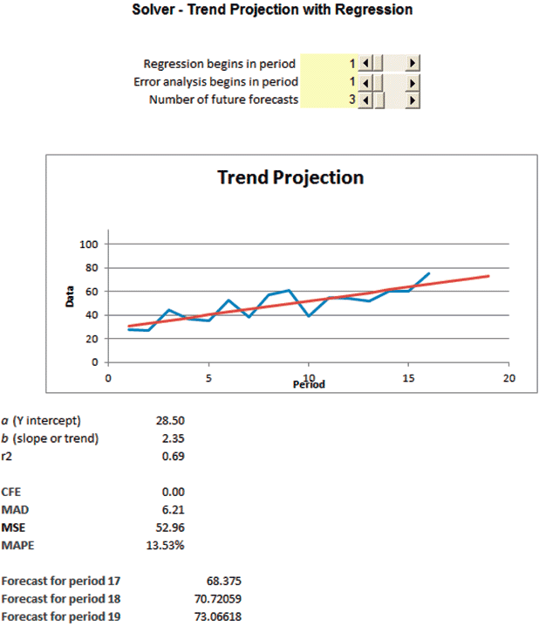
Trend Patterns – Regression Example

Slide 49
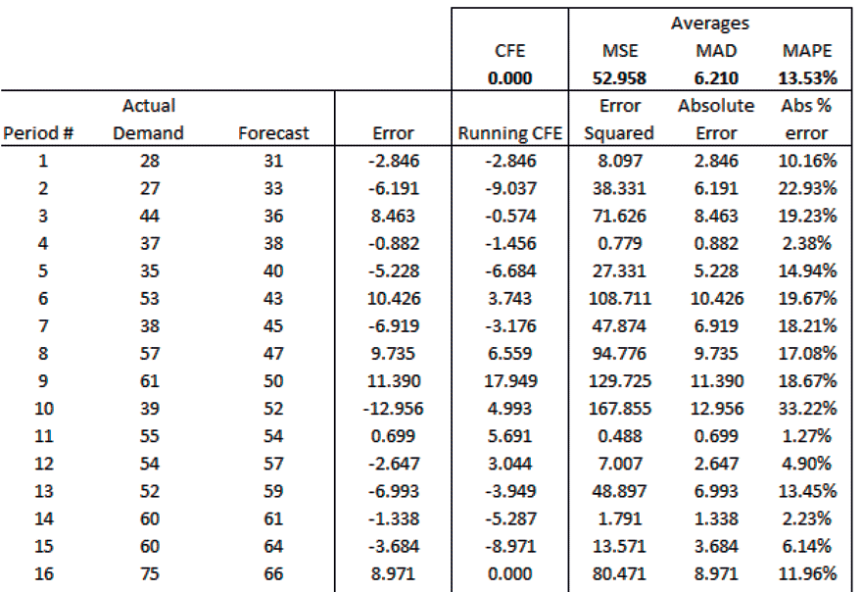
Trend Patterns – Regression Example

Slide 50
Trend Patterns – Regression Example 2
Use OM Explorer to project the following weekly demand data using trend projection with regression.
What is the forecasted demand for periods 11-14?
Week | Demand | Week | Demand
1 2 3 4 5 | 24 34 29 27 39 | 6 7 8 9 10 | 42 39 56 45 43

Slide 51
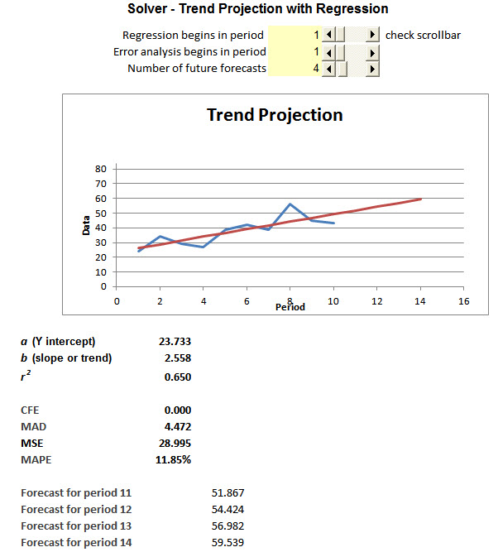
Trend Patterns – Regression Example 2

Slide 52
Trend Patterns – Regression Example 2

Slide 53
Seasonal Factors
Multiplicative seasonal method
  A method whereby seasonal factors are multiplied by an estimate of average demand to arrive at a seasonal forecast.
Additive seasonal method
  A method in which seasonal forecasts are generated by adding a constant to the estimate of average demand per season.

Slide 54
Multiplicative Seasonal Method
Multiplicative seasonal method
For each year, calculate the average demand for each season by dividing annual demand by the number of seasons per year.
For each year, divide the actual demand for each season by the average demand per season, resulting in a seasonal factor for each season.
Calculate the average seasonal factor for each season using the results from Step 2.
Calculate each season’s forecast for next year.

Slide 55
Multiplicative Seasonal Method - Example
The manager of the Stanley Steemer carpet cleaning company needs a quarterly forecast of the number of customers expected next year. The carpet cleaning business is seasonal, with a peak in the third quarter and a trough in the first quarter. The quarterly demand data from the past 4 years are on the next two slides.
The manager wants to forecast customer demand for each quarter of year 5, based on an estimate of total year 5 demand of 2,600 customers.
Notes:
60

Slide 56
Multiplicative Seasonal Method - Example
 | YEAR 1 |  | YEAR 2
Q | Demand | Seasonal Factor (1) | Demand | Seasonal Factor (2)
1 | 45 | 45/250 = 0.18 | 70 | 70/300 = 0.23
2 | 335 | 335/250 = 1.34 | 370 | 370/300 = 1.23
3 | 520 | 520/250 = 2.08 | 590 | 590/300 = 1.97
4 | 100 | 100/250 = 0.40 | 170 | 170/300 = 0.57
Total | 1,000 |  | 1,200
Average | 1,000/4 = 250 |  | 1,200/4 = 300

Slide 57
Multiplicative Seasonal Method - Example
 | YEAR 3 |  | YEAR 4
Q | Demand | Seasonal Factor (3) | Demand | Seasonal Factor (4)
1 | 100 | 100/450 = 0.22 | 100 | 100/550 = 0.18
2 | 585 | 585/450 = 1.30 | 725 | 725/550 = 1.32
3 | 830 | 830/450 = 1.84 | 1160 | 1160/550 = 2.11
4 | 285 | 285/450 = 0.63 | 215 | 215/550 = 0.39
Total | 1,800 |  | 2,200
Average | 1,800/4 = 450 |  | 2,200/4 = 550

Slide 58
Multiplicative Seasonal Method - Example
Average Seasonal Factor
Quarterly Forecasts
Quarter | Average Seasonal Factor
1 | 0.2043
2 | 1.2979
3 | 2.0001
4 | 0.4977
Quarter | Forecast
1 | 650 x 0.2043 = 132.795
2 | 650 x 1.2979 = 843.635
3 | 650 x 2.001 = 1,300.06
4 | 650 x 0.4977 = 323.505
Notes:
60

Slide 59
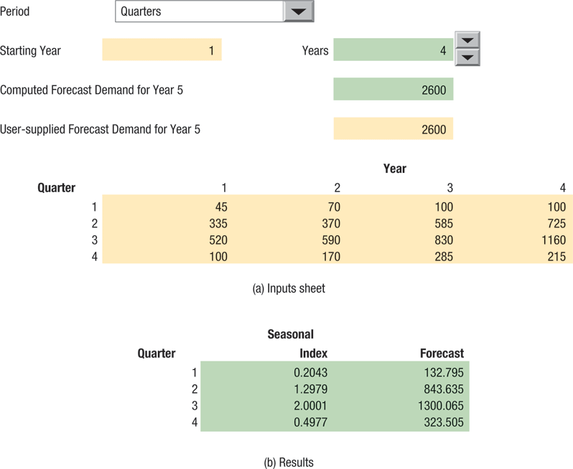
Multiplicative Seasonal Method - Example
Figure 8.7

Slide 60
Multiplicative Seasonal Method – Example 2
Suppose the multiplicative seasonal method is being used to forecast customer demand. The actual demand and seasonal indices are shown below.
 | Year 1 |  |  |  |  |  | Year 2 |  |  |  |  |  | Average Index
Quarter | Demand |  |  | Index |  |  | Demand |  |  | Index
1 |  | 100 |  |  | 0.40 |  |  | 192 |  |  | 0.64 |  | 0.52
2 |  | 400 |  |  | 1.60 |  |  | 408 |  |  | 1.36 |  | 1.48
3 |  | 300 |  |  | 1.20 |  |  | 384 |  |  | 1.28 |  | 1.24
4 |  | 200 |  |  | 0.80 |  |  | 216 |  |  | 0.72 |  | 0.76
Average |  | 250 |  |  |  |  |  | 300

Slide 61
Multiplicative Seasonal Method – Example 2
Quarter | Average Index
1 | 0.52
2 | 1.48
3 | 1.24
4 | 0.76
1400 units ÷ 4 quarters = 350 units
Forecast for Quarter 1 =
0.52(350) ≈ 182 units
Forecast for Quarter 2 =
1.48(350) ≈ 518 units
Forecast for Quarter 3 =
1.24(350) ≈ 434 units
Forecast for Quarter 4 =
0.76(350) ≈ 266 units

Slide 62
Multiplicative Seasonal Method – Example 2
Quarter | Average Index
1 | 0.52
2 | 1.48
3 | 1.24
4 | 0.76
If the projected demand for Year 3 is 1320 units, what is the forecast for each quarter of that year?
1320 units ÷ 4 quarters = 330 units
Forecast for Quarter 1 =
0.52(330) ≈ 172 units
Forecast for Quarter 2 =
1.48(330) ≈ 488 units
Forecast for Quarter 3 =
1.24(330) ≈ 409 units
Forecast for Quarter 4 =
0.76(330) ≈ 251 units

Slide 63
Time Series-Method Selection

Slide 64
Time-Series Method Selection Criteria
Criteria:
  Minimizing bias (CFE)
  Minimizing MAPE, MAD, or MSE
  Maximizing r² for trend projections using regression
  Using a holdout sample analysis
  Using a tracking signal
  Meeting managerial expectations of changes in the components of demand.
  Minimizing the forecast errors in recent periods.

Slide 65
Choosing a Time-Series Method
Using Statistical Criteria:
  For more stable demand patterns, use lower α values or larger n values to emphasize historical experience.
  For more dynamic demand patters, use higher α values or smaller n values.

Slide 66
Choosing a Time-Series Method
Holdout sample
  Actual demands from the more recent time periods in the time series that are set aside to test different models developed from the earlier time periods.

Slide 67
Tracking Signals
A measure that indicates whether a method of forecasting is accurately predicting actual changes in demand.
CFE
MAD
CFE
MAD_{t}
Tracking signal =
or
Each period, the CFE and MAD are updated to reflect current error, and the tracking signal is compared to some predetermined limits.

Slide 68
Tracking Signals
The MAD can be calculated as the simple average of all absolute errors or as a weighted average determined by the exponential smoothing method
MAD_{t} = α|E_{t}| + (1 – α)MAD_{t-1}
If forecast errors are normally distributed with a mean of 0, the relationship between σ and MAD is simple
σ = ( π /2)(MAD) ≅ 1.25(MAD)
MAD = 0.7978σ ≅ 0.8σ where π = 3.1416

Slide 69
Tracking Signals
+2.0 –
+1.5 –
+1.0 –
+0.5 –
0 –
–0.5 –
–1.0 –
–1.5 –
Out of control
Control limit
Tracking signal
Control limit
| | | | |
0 5 10 15 20 25
Observation number
Figure 8.8
Notes:
86
This slide completes Figure 13.9 and shows the use of a tracking signal.

Slide 70
Solved Problems

Slide 71
Solved Problem 1
Chicken Palace periodically offers carryout five-piece chicken dinners at special prices. Let Y be the number of dinners sold and X be the price. Based on the historical observations and calculations in the following table, determine the regression equation, correlation coefficient, and coefficient of determination. How many dinners can Chicken Palace expect to sell at $3.00 each?
Observation | Price (X) |  |  | Dinners Sold (Y)
1 |  | $2.70 |  |  | 760
2 |  | $3.50 |  |  | 510
3 |  | $2.00 |  |  | 980
4 |  | $4.20 |  |  | 250
5 |  | $3.10 |  |  | 320
6 |  | $4.05 |  |  | 480
Total |  | $19.55 |  |  | 3,300
Average |  | $ 3.26 |  |  | 550

Slide 72
Solved Problem 1
We use the computer to calculate the best values of a, b, the correlation coefficient, and the coefficient of determination
a = 1,454.60
b = –277.63
r = –0.84
r ² = 0.71
The regression line is
Y = a + bX =
1,454.60 – 277.63X
For an estimated sales price of $3.00 per dinner
Y = a + bX =
1,454.60 – 277.63(3.00)
= 621.71 or 622 dinners

Slide 73
Solved Problem 2
The Polish General’s Pizza Parlor is a small restaurant catering to patrons with a taste for European pizza. One of its specialties is Polish Prize pizza. The manager must forecast weekly demand for these special pizzas so that he can order pizza shells weekly. Recently, demand has been as follows:
Week | Pizzas | Week | Pizzas
June 2 | 50 | June 23 | 56
June 9 | 65 | June 30 | 55
June 16 | 52 | July 7 | 60
a. Forecast the demand for pizza for June 23 to July 14 by using the simple moving average method with n = 3 then using the weighted moving average method with and weights of 0.50, 0.30, and 0.20, with 0.50.
b. Calculate the MAD for each method.

Slide 74
Solved Problem 2
a. The simple moving average method and the weighted moving average method give the following results:
Current Week | Simple Moving Average Forecast for Next Week | Weighted Moving Average Forecast for Next Week
June 16
June 23
June 30
July 7
52 + 65 + 50
3
= 55.7 or 56
[(0.5 × 52) + (0.3 × 65) + (0.2 × 50)] = 55.5 or 56
56 + 52 + 65
3
= 57.7 or 58
[(0.5 × 56) + (0.3 × 52) + (0.2 × 65)] = 56.6 or 57
55 + 56 + 52
3
= 54.3 or 54
[(0.5 × 55) + (0.3 × 56) + (0.2 × 52)] = 54.7 or 55
60 + 55 + 56
3
= 57.0 or 57
[(0.5 × 60) + (0.3 × 55) + (0.2 × 56)] = 57.7 or 58

Slide 75
Solved Problem 2
b. The mean absolute deviation is calculated as follows:
 |  | Simple Moving Average |  | Weighted Moving Average
Week | Actual Demand | Forecast for This Week | Absolute Errors |E_{t}| | Forecast for This Week | Absolute Errors |E_{t}|
June 23 | 56 | 56 |  | 56
June 30 | 55 | 58 |  | 57
July 7 | 60 | 54 |  | 55
|56 – 56| = 0
|56 – 56| = 0
|55 – 58| = 3
|55 – 57| = 2
|60 – 54| = 6
|60 – 55| = 5
0 + 3 + 6
3
0 + 2 + 2
3
MAD = = 3
MAD = = 2.3
For this limited set of data, the weighted moving average method resulted in a slightly lower mean absolute deviation. However, final conclusions can be made only after analyzing much more data.

Slide 76
Solved Problem 3
The monthly demand for units manufactured by the Acme Rocket Company has been as follows:
Month | Units | Month | Units
May | 100 | September | 105
June | 80 | October | 110
July | 110 | November | 125
August | 115 | December | 120
a. Use the exponential smoothing method to forecast June to January. The initial forecast for May was 105 units; α = 0.2.
b. Calculate the absolute percentage error for each month from June through December and the MAD and MAPE of forecast error as of the end of December.
c. Calculate the tracking signal as of the end of December. What can you say about the performance of your forecasting method?

Slide 77
Solved Problem 3
a.
Current Month, t | Calculating Forecast for Next Month F_{t+1} = αD_{t} + (1 – α)F_{t} | Forecast for Month t + 1
May |  | June
June |  | July
July |  | August
August |  | September
September |  | October
October |  | November
November |  | December
December |  | January
0.2(100) + 0.8(105)
= 104.0 or 104
0.2(80) + 0.8(104.0)
= 99.2 or 99
0.2(110) + 0.8(99.2)
= 101.4 or 101
0.2(115) + 0.8(101.4)
= 104.1 or 104
0.2(105) + 0.8(104.1)
= 104.3 or 104
0.2(110) + 0.8(104.3)
= 105.4 or 105
0.2(125) + 0.8(105.4)
= 109.3 or 109
0.2(120) + 0.8(109.3)
= 111.4 or 111

Slide 78
Solved Problem 3
b.
Month, t | Actual Demand, D_{t} |  |  | Forecast, F_{t} |  |  | Error, E_{t} = D_{t} – F_{t} |  |  | Absolute Error, |E_{t}| |  |  | Absolute Percent Error, (|E_{t}|/D_{t})(100)
June |  | 80 |  |  | 104
July |  | 110 |  |  | 99
August |  | 115 |  |  | 101
September |  | 105 |  |  | 104
October |  | 110 |  |  | 104
November |  | 125 |  |  | 105
December |  | 120 |  |  | 109
Total |  | 765
–24
24
30.0%
11
 |  | 11
 |  | 10.0
14 |  |  | 14 |  |  | 12.0
1 |  |  | 1 |  |  | 1.0
6 |  |  | 6 |  |  | 5.5
20 |  |  | 20 |  |  | 16.0
11 |  |  | 11 |  |  | 9.2
39 |  |  | 87 |  |  | 83.7%
Σ|E_{t} |
n
87
7
(Σ|E_{t} |/D_{t})(100)
n
83.7%
7
MAD =
= = 12.4
MAPE =
= = 11.96%

Slide 79
Solved Problem 3
c. As of the end of December, the cumulative sum of forecast errors (CFE) is 39. Using the mean absolute deviation calculated in part (b), we calculate the tracking signal:
CFE
MAD
39
12.4
Tracking signal =
= = 3.14
The probability that a tracking signal value of 3.14 could be generated completely by chance is small. Consequently, we should revise our approach. The long string of forecasts lower than actual demand suggests use of a trend method.

Slide 80
Solved Problem 4
The Northville Post Office experiences a seasonal pattern of daily mail volume every week. The following data for two representative weeks are expressed in thousands of pieces of mail:
Day | Week 1 |  |  | Week 2
Sunday |  | 5 |  |  | 8
Monday |  | 20 |  |  | 15
Tuesday |  | 30 |  |  | 32
Wednesday |  | 35 |  |  | 30
Thursday |  | 49 |  |  | 45
Friday |  | 70 |  |  | 70
Saturday |  | 15 |  |  | 10
Total |  | 224 |  |  | 210
a. Calculate a seasonal factor for each day of the week.
b. If the postmaster estimates 230,000 pieces of mail to be sorted next week, forecast the volume for each day.

Slide 81
Solved Problem 4
 | Week 1 |  |  |  | Week 2
Day | Mail Volume |  |  | Seasonal Factor (1) | Mail Volume |  |  | Seasonal Factor (2) | Average Seasonal Factor [(1) + (2)]/2
Sunday |  | 5 |  |  |  | 8
Monday |  | 20 |  |  |  | 15
Tuesday |  | 30 |  |  |  | 32
Wednesday |  | 35 |  |  |  | 30
Thursday |  | 49 |  |  |  | 45
Friday |  | 70 |  |  |  | 70
Saturday |  | 15 |  |  |  | 10
Total |  | 224 |  |  |  | 210
Average | 224/7 = 32 |  |  |  | 210/7 = 30
5/32 = 0.15625
8/30 = 0.26667
0.21146
20/32 = 0.62500
15/30 = 0.50000
0.56250
30/32 = 0.93750
32/30 = 1.06667
1.00209
35/32 = 1.09375
30/30 = 1.00000
1.04688
49/32 = 1.53125
45/30 = 1.50000
1.51563
70/32 = 2.18750
70/30 = 2.33333
2.26042
15/32 = 0.46875
10/30 = 0.33333
0.40104

Slide 82
Solved Problem 4
b. The average daily mail volume is expected to be 230,000/7 = 32,857 pieces of mail. Using the average seasonal factors calculated in part (a), we obtain the following forecasts:
Day | Calculations | Forecast
Sunday
Monday
Tuesday
Wednesday
Thursday
Friday
Saturday
 | Total
0.21146(32,857) =
6,948
0.56250(32,857) =
18,482
1.00209(32,857) =
32,926
1.04688(32,857) =
34,397
1.51563(32,857) =
49,799
2.26042(32,857) =
74,271
0.40104(32,857) =
13,177
230,000

