Slide 1
Operations and Project Management BBUS 340 25 April 2018

Slide 2
Today’s Agenda
Class Administration – Littlefield, Midterm Grades, Lean Reflection
Lean Systems
Waste
Value Added
5S
TPS - Toyota Way – 14 Principles
Kanban
Value Stream Mapping
Organizational Considerations

Slide 3
50,000 Feet Overview of OPM
Managing Value Chains
Managing Processes
Using Operations to Compete
Supply Chain Strategy
Process Strategy
Location
Operations As a
Competitive Weapon
Process Analysis
Inventory Management
Operations Strategy
Process Performance & Quality
Forecasting
Constraint Management
Sales & Operations Planning
Project Management
Constraint Management
Process Layout
Resource Planning
Lean Systems
Scheduling

Slide 4
LEAN Systems

Slide 5
Learning Objectives
Describe
Understand
Understand value stream mapping and its role in waste reduction
Explain
Explain the implementation issues associated with the application of lean systems
Identify the characteristics and strategic advantages of lean systems
Describe how lean systems can facilitate the continuous improvement of processes
Identify

Slide 6
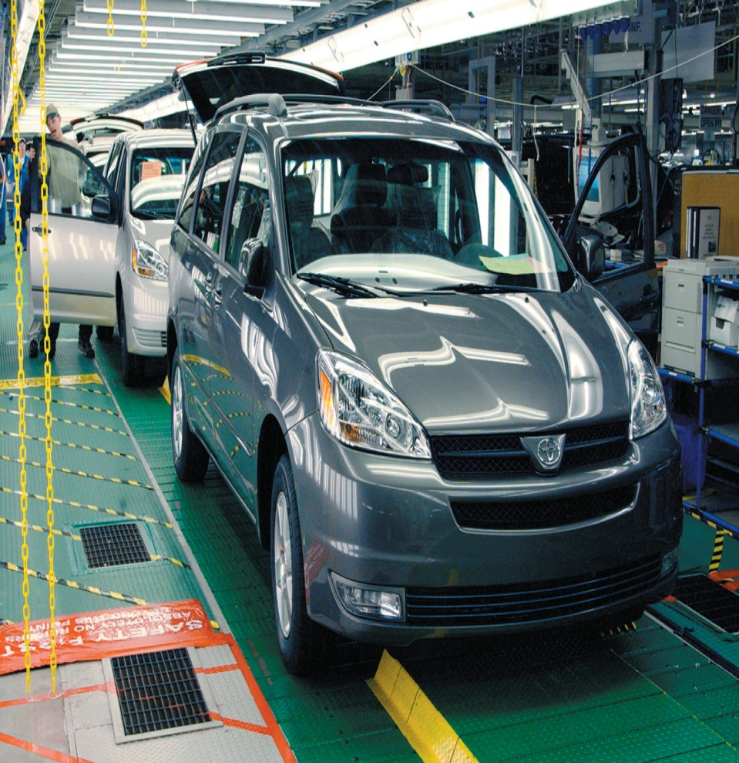
What is a Lean System?
Lean Systems
Operations systems that maximize the value added of each activity by removing waste.

Slide 7
Just-in-Time Philosophy
Eliminate waste or muda by cutting excess capacity or inventory and removing non-value-added activities.
A JIT system organizes the resources, information flows, and decision rules that enable a firm to realize the benefits of JIT principles.

Slide 8
Eight Types of Waste or Muda TIMWOOUD
Transportation
Inventory
Motion
Waiting
Over Processing
Over Production
Underutilization of Employees
Defects

Slide 9
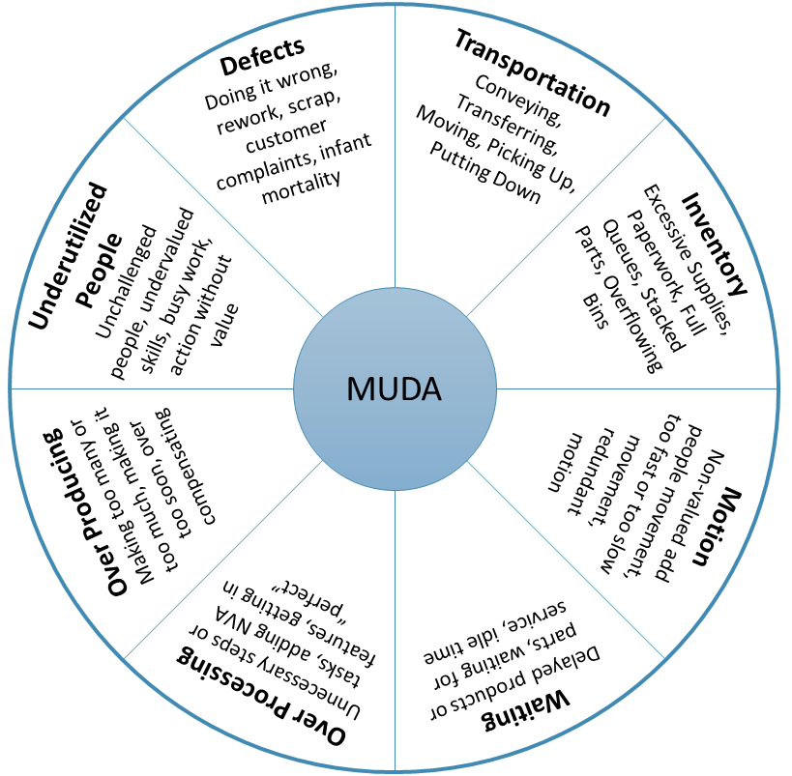
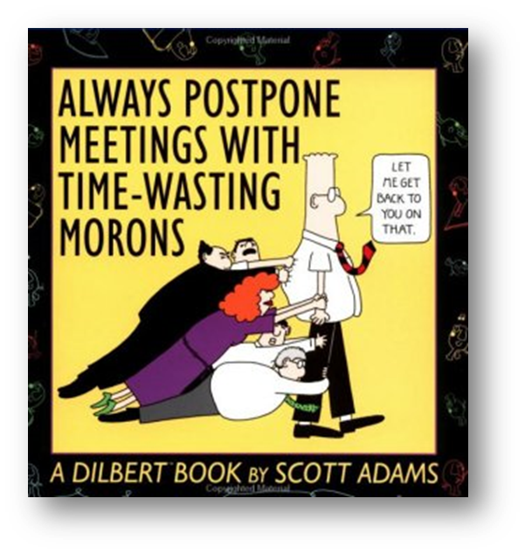
Waste Wheel TIMWOOUD

Slide 10
Value Added
All tasks in the process must add value to the end product or service.
How do you decide what value added means?
Customers define output requirements – this is what you use to understand what adds value.
Customer willing pay for it
Transformative
Done right the first time
Notes:
[Explain]
A process must add value.
A process transforms inputs into outputs – if the process added no value, then the process is useless.
<Demonstrate>
Grab a marker or piece of paper declare:
My process has one input, this marker.
Hand the marker to any class member and then ask them to hand it back.
My process has two steps, hand the marker to <name>
And <name> hands it back.
My process outputs this marker.
[Ask]
What value did my process add? Answer: none – because the marker wasn’t transformed.
Have you ever experienced a process like this? Answer: most people will say yes – consider transactional “paper” processes.
What could we have done to transform the marker? Answer: if the customer paid to have their markers refilled, then we could have had <name> fill the marker – the process would then add value.
[Explain]
Customer’s define value – it is essentially what they are willing to pay for.
[Next Slide]
Let’s consider another simple example.
Reference: Image: http://leadingagent.net/blog/?p=628

Slide 11
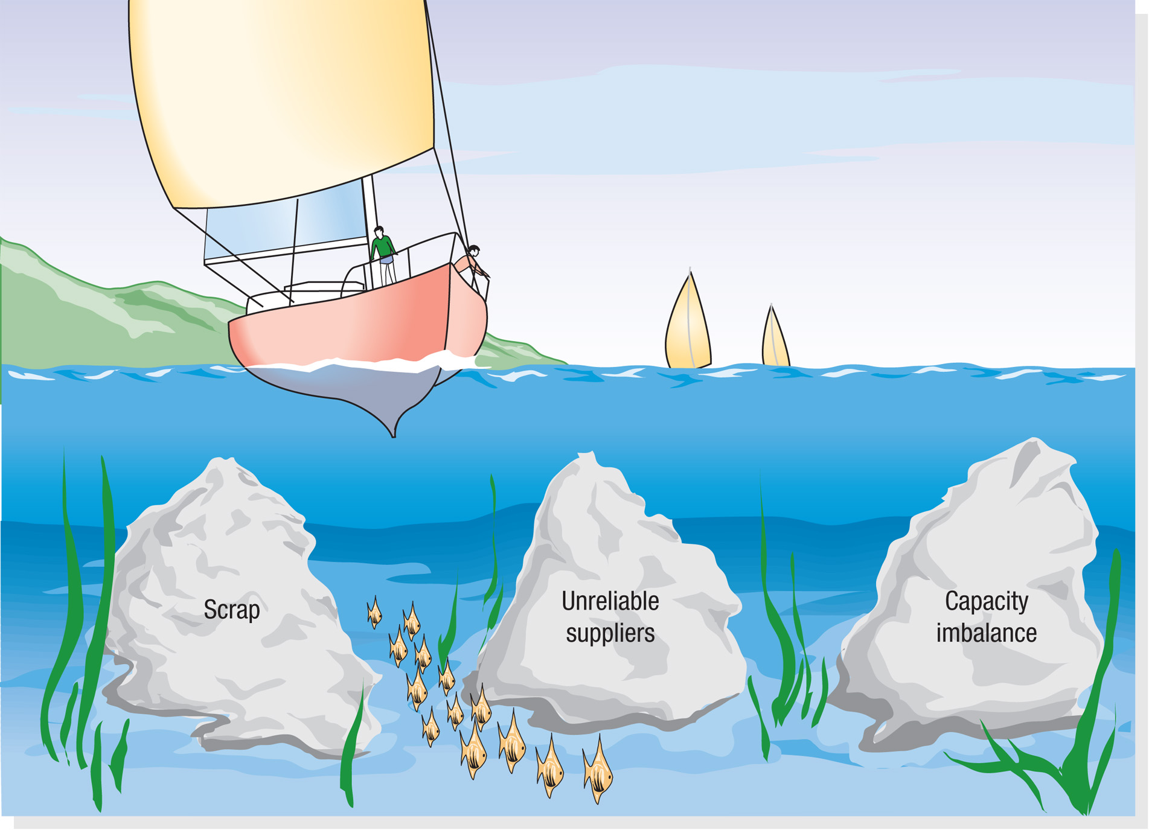
Continuous Improvement
Kaizen
Excess capacity or inventory hide underlying problems with the processes that produce the service or product

Slide 12
Supply Chain Considerations
Characteristics of lean systems that are related to creating and managing material flows in a supply chain are:
Close Supplier Ties
Small Lot Sizes
Single-digit setup

Slide 13
Process Considerations
Pull Method of Workflow
Customer demand activates the production of the service or item.

Slide 14
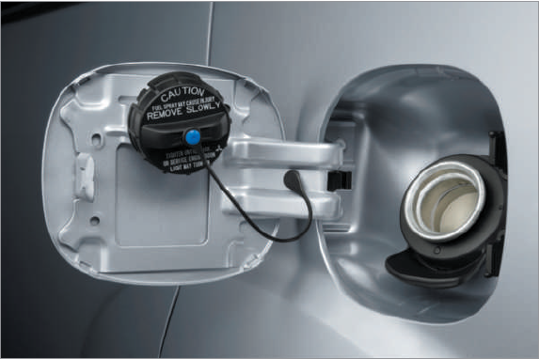
Process Considerations
Quality at the Source
Jidoka – stopping the process when something is wrong and fixing the problems before sending the product forward.
Poka-Yoke – mistake proofing aimed at designing fail-safe systems

Slide 15
Process Considerations
Uniform Workstation Loads
Takt time
Cycle time needed to match production rate to demand
Heijunka
The leveling of production load by both volume and product mix.
Mixed-model assembly
Type of assembly that produces a mix of models in smaller lots
Standardized Components and Work Methods

Slide 16
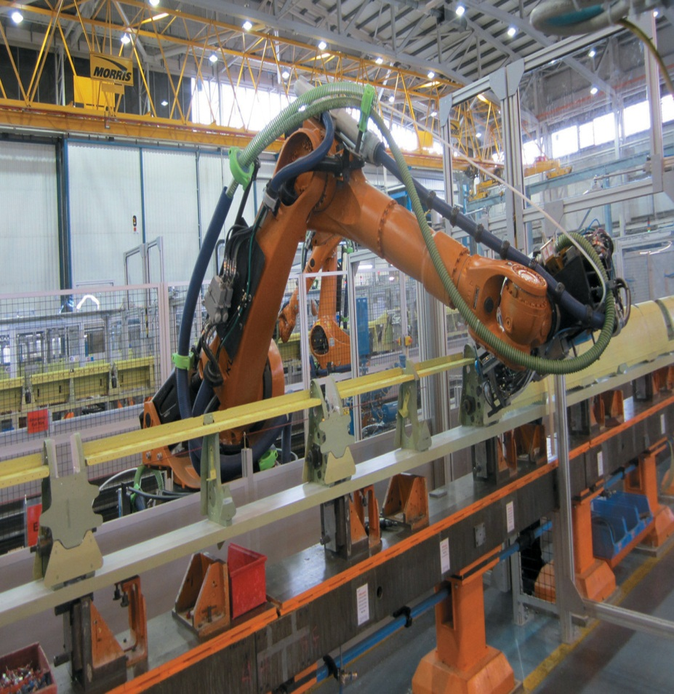
Process Considerations
Flexible Workforce
Automation
Total Preventative Maintenance
5S

Slide 17
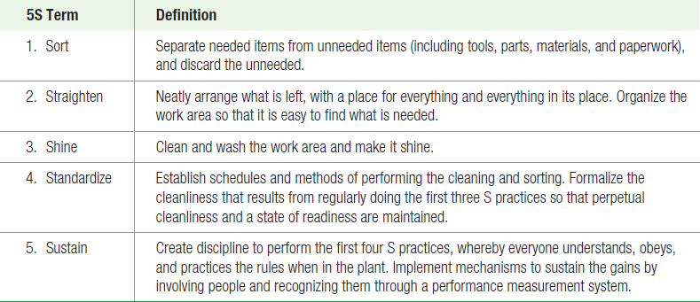
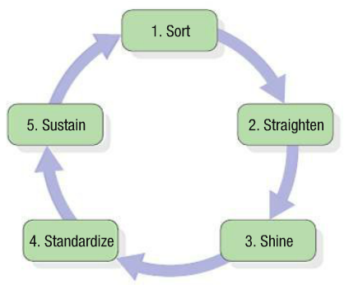
5S
Seiri
Seiton
Seiso
Seiketsu
Shitsuke

Slide 18
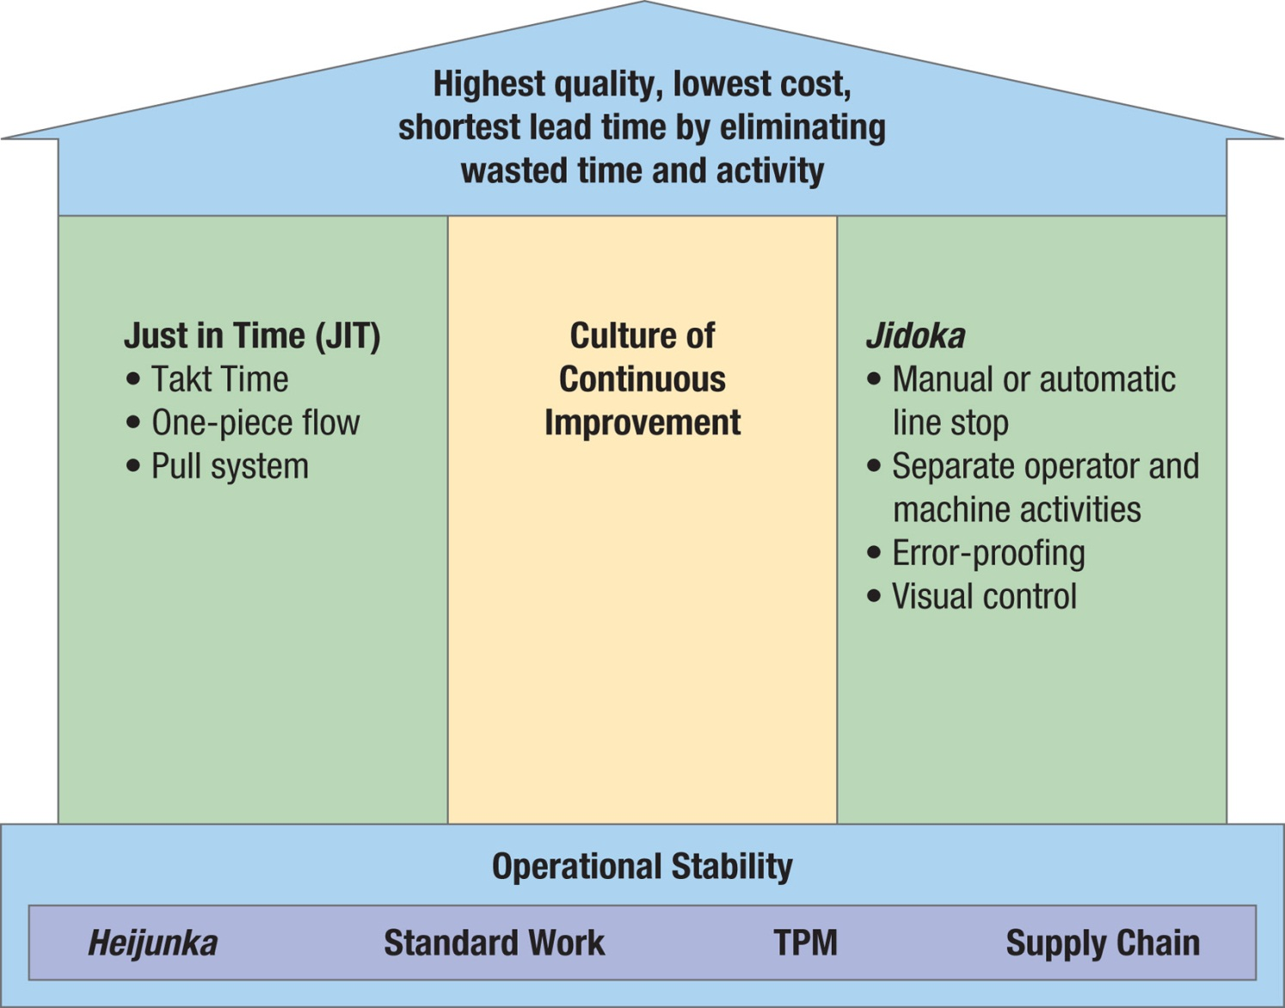
House of Toyota

Slide 19
Toyota Way – 14 Principles
I. Long Term Philosophy
Base your management decisions on a long-term philosophy, even at the expense of short-term financial goals.
III. Add Value to the Organization by Developing Your People
Grow leaders who thoroughly understand the work, live the philosophy, and teach it to others.
Develop exceptional people and teams who follow your company’s philosophy.
Respect your extended network of partners and suppliers by challenging them and helping them improve.
II. Right Processes Produce Right Results
Create a continuous process flow to bring problems to the surface.
Use “pull” systems to avoid overproduction.
Level out the workload (heijunka). (Work like the tortoise, not the hare).
Build a culture of stopping to fix problems, to get quality right the first time.
Standardized tasks and processes are the foundation for continuous improvement and employee empowerment.
Use visual control so no problems are hidden.
Use only reliable, thoroughly tested technology that serves your people and processes.
IV. Continuously Solving Root Problems Drives Organizational Learning
Go and see for yourself to thoroughly understand the situation (genchi genbutsu).
Make decisions slowly by consensus, thoroughly considering all options; implement decisions rapidly (nemawashi).
Be a learning organization through relentless reflection (hansei) and continuous improvement (kaizen).
Notes:
[Explain]
Section I: Long-Term Philosophy
Principle 1. Base your management decisions on a long-term philosophy, even at the expense of short-term financial goals.
Have a philosophical sense of purpose that supersedes any short-term decision making. Work, grow, and align the whole organization toward a common purpose that is bigger than making money. Understand your place in the history of the company and work to bring the company to the next level. Your philosophical mission is the foundation for all the other principles.
Generate value for the customer, society, and the economy—it is your starting point. Evaluate every function in the company in terms of its ability to achieve this.
Be responsible. Strive to decide your own fate. Act with self-reliance and trust in your own abilities. Accept responsibility for your conduct and maintain and improve the skills that enable you to produce added value.
Section II: The Right Process Will Produce the Right Results
Principle 2. Create a continuous process flow to bring problems to the surface.
Redesign work processes to achieve high value-added, continuous flow. Strive to cut back to zero the amount of time that any work project is sitting idle or waiting for someone to work on it.
Create flow to move material and information fast as well as to link processes and people together so that problems surface right away.
Make flow evident throughout your organizational culture. It is the key to a true continuous improvement process and to developing people.
Principle 3. Use “pull” systems to avoid overproduction.
Provide your downstream customers in the production process with what they want, when they want it, and in the amount they want. Material replenishment initiated by consumption is the basic principle of just-in-time.
Minimize your work in process and warehousing of inventory by stocking small amounts of each product and frequently restocking based on what the customer actually takes away.
Be responsive to the day-by-day shifts in customer demand rather than relying on computer schedules and systems to track wasteful inventory.
Principle 4. Level out the workload (heijunka). (Work like the tortoise, not the hare.)
Eliminating waste is just one-third of the equation for making lean successful. Eliminating overburden to people and equipment and eliminating unevenness in the production schedule are just as important—yet generally not understood at companies attempting to implement lean principles.
Work to level out the workload of all manufacturing and service processes as an alternative to the stop/start approach of working on projects in batches that is typical at most companies.
Principle 5. Build a culture of stopping to fix problems, to get quality right the first time.
Quality for the customer drives your value proposition.
Use all the modern quality assurance methods available.
Build into your equipment the capability of detecting problems and stopping itself. Develop a visual system to alert team or project leaders that a machine or process needs assistance. Jidoka (machines with human intelligence) is the foundation for “building in” quality.
Build into your organization support systems to quickly solve problems and put in place countermeasures.
Build into your culture the philosophy of stopping or slowing down to get quality right the first time to enhance productivity in the long run.
Principle 6. Standardized tasks and processes are the foundation for continuous improvement and employee empowerment.
Use stable, repeatable methods everywhere to maintain the predictability, regular timing, and regular output of your processes. It is the foundation for flow and pull.
Capture the accumulated learning about a process up to a point in time by standardizing today’s best practices. Allow creative and individual expression to improve upon the standard; then incorporate it into the new standard so that when a person moves on you can hand off the learning to the next person.
Principle 7. Use visual control so no problems are hidden.
Use simple visual indicators to help people determine immediately whether they are in a standard condition or deviating from it.
Avoid using a computer screen when it moves the worker’s focus away from the workplace.
Design simple visual systems at the place where the work is done, to support flow and pull.
Reduce your reports to one piece of paper whenever possible, even for your most important financial decisions.
Principle 8. Use only reliable, thoroughly tested technology that serves your people and processes.
Use technology to support people, not to replace people. Often it is best to work out a process manually before adding technology to support the process.
New technology is often unreliable and difficult to standardize and therefore endangers “flow.” A proven process that works generally takes precedence over new and untested technology.
Conduct actual tests before adopting new technology in business processes, manufacturing systems, or products.
Reject or modify technologies that conflict with your culture or that might disrupt stability, reliability, and predictability.
Nevertheless, encourage your people to consider new technologies when looking into new approaches to work. Quickly implement a thoroughly considered technology if it has been proven in trials and it can improve flow in your processes.
Section III: Add Value to the Organization by Developing Your People
Principle 9. Grow leaders who thoroughly understand the work, live the philosophy, and teach it to others.
Grow leaders from within, rather than buying them from outside the organization.
Do not view the leader’s job as simply accomplishing tasks and having good people skills. Leaders must be role models of the company’s philosophy and way of doing business.
A good leader must understand the daily work in great detail so he or she can be the best teacher of your company’s philosophy.
Principle 10. Develop exceptional people and teams who follow your company’s philosophy.
Create a strong, stable culture in which company values and beliefs are widely shared and lived out over a period of many years.
Train exceptional individuals and teams to work within the corporate philosophy to achieve exceptional results. Work very hard to reinforce the culture continually.
Use cross-functional teams to improve quality and productivity and enhance flow by solving difficult technical problems. Empowerment occurs when people use the company’s tools to improve the company.
Make an ongoing effort to teach individuals how to work together as teams toward common goals. Teamwork is something that has to be learned.
Principle 11. Respect your extended network of partners and suppliers by challenging them and helping them improve.
Have respect for your partners and suppliers and treat them as an extension of your business.
Challenge your outside business partners to grow and develop. It shows that you value them. Set challenging targets and assist your partners in achieving them.
Section IV: Continuously Solving Root Problems Drives Organizational Learning
Principle 12. Go and see for yourself to thoroughly understand the situation (genchi genbutsu).
Solve problems and improve processes by going to the source and personally observing and verifying data rather than theorizing on the basis of what other people or the computer screen tell you.
Think and speak based on personally verified data.
Even high-level managers and executives should go and see things for themselves, so they will have more than a superficial understanding of the situation.
Principle 13. Make decisions slowly by consensus, thoroughly considering all options; implement decisions rapidly (nemawashi).
Do not pick a single direction and go down that one path until you have thoroughly considered alternatives. When you have picked, move quickly and continuously down the path.
Nemawashi is the process of discussing problems and potential solutions with all of those affected, to collect their ideas and get agreement on a path forward. This consensus process, though time-consuming, helps broaden the search for solutions, and once a decision is made, the stage is set for rapid implementation.
Principle 14. Become a learning organization through relentless reflection (hansei) and continuous improvement (kaizen).
Once you have established a stable process, use continuous improvement tools to determine the root cause of inefficiencies and apply effective countermeasures.
Design processes that require almost no inventory. This will make wasted time and resources visible for all to see. Once waste is exposed, have employees use a continuous improvement process (kaizen) to eliminate it.
Protect the organizational knowledge base by developing stable personnel, slow promotion, and very careful succession systems.
[Next Slide]
Harvard Business Review Study by Spear and Bowen
[Reference]
The Toyota Way Fieldbook – A practical guide for implementing Toyota’s 4Ps
Summary: http://icos.groups.si.umich.edu/Liker04.pdf
eBook: http://waterveritas.files.wordpress.com/2012/07/book-lss-toyota-way.pdf

Slide 20
The four rules of TPS:
All work is highly specified in its content, sequence, timing and outcome.
Each worker knows who provides what to him/her and when.
Every product and service flows along a simple, specified path.
Any improvement to processes, worker/machine connections or flow path must be made in concert with the scientific method, under the guidance of a teacher, at the lowest level possible.
Toyota Production System
Harvard Business Review, Sept/Oct 1999
Notes:
[Explain]
Steven Spear and H. Kent Bowen studied the TPS system for four years at over 40 plants in the US, Europe and Japan. Some operating to the TPS, some not.
The authors ‘claim’ that the TPS operates according to ‘unwritten’ rules, and attempt to make clear what those rules are in this article.
They suggest the ‘rules’ include three rules of design, i.e. how to set up the TPS operations
And one rule focused on improvement, i.e. how to evolve the TPS over time.
The rules are the opinion of the authors – and provide an easy to understand conceptual perspective on what drives the execution of the TPS.
All work is highly specified in its content, sequence, timing, and outcome.
Employees follow a well-defined sequence of steps for a particular job. This specificity enables people to see and address deviations immediately—encouraging continual learning and improvement.
Example:
Installing the right-front seat in a Camry requires seven tasks performed in a specific sequence over 55 seconds. If a worker finds himself doing task 6 before task 4 or falling behind schedule, he and his supervisor correct the problem promptly. Then they determine whether to change the task specifications or retrain the worker to prevent a recurrence.
Each worker knows who provides what to him, and when.
Workers needing parts submit cards specifying part number, quantity, and required destination.
Suppliers must respond to materials requests within specified periods of time.
Workers encountering a problem ask for help immediately.
Designated assistants must respond at once and resolve the problem within the worker’s cycle time (e.g., the 55 seconds it takes to install a front seat).
Failure to fulfill these specifications signals a search for potential causes—such as ambiguous requests from colleagues or an overwhelmed assistant.
Once the cause is identified, it’s resolved rather than kept hidden.
Every product and service flows along a simple, specified path.
Goods and services don’t flow to the next available person or machine—but to a specific person or machine.
Example:
If workers at an auto parts supplier find themselves waiting to send a product to the next designated machine they conclude that their demand on the next machine doesn’t match their expectations.
They revisit the organization of their production line to determine why the machine was not available, and redesign the flow path.
Any improvement to processes, worker/machine connections, or flow path must be made through the scientific method, under a teacher’s guidance, and at the lowest possible organizational level.
Frontline workers make improvements to their own jobs.
Supervisors provide direction and assistance as teachers.
Example:
At one Toyota factory, workers seeking to reduce a machine’s changeover time from15 to 5 minutes were able to reduce the time only to 7.5 minutes.
A manager asked why they hadn’t achieved their original 5-minute goal.
His question helped them see that their original goal had been a random guess, not based on a formal hypothesis about how fast it could be done and why.
Thus they couldn’t test the hypothesis to determine what caused the less-than ideal results.
[Next Slide]
Compare different Improvement Approaches
[Reference]
HBR Article: Decoding the DNA of the Toyota Production System http://clinicalmicrosystem.org/toolkits/getting_started/decoding_dna.pdf

Slide 21
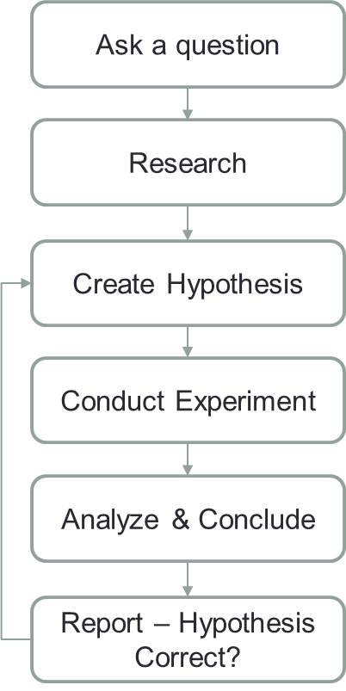
Scientific Thinking
Clear Problem Statements
No “Lack of a Solution” problems
Do the Research
Facts and data based decision making
Collect what you know
Measure if missing
Find the root causes
Solutions should fix the problem.
Solve the root cause not the symptom
No “jumping to conclusions”
Experiment to Achieve Right Result
Make sure the problem is fixed.
Notes:
[Remind]
Remind the participants of Toyota 14 principles, specifically:
#8: Use only reliable, thoroughly tested technology that serves your people and processes.
How will you know technology is reliable and tested?
#12: Go and see for yourself to thoroughly understand the situation.
Observation is a key tenet of Lean Thinking.
#13: Make decisions slowly by consensus, thoroughly considering all options; implement decisions rapidly.
How will you know you’ve considered “all” options without using a thoughtful approach, i.e. the Scientific Method.
From Spear and Bowen:
Any improvement to processes, worker/machine connections, or flow path must be made through the scientific method, under a teacher’s guidance, and at the lowest possible organizational level.
[Explain]
Everyone is responsible for their own quality, efficiency and effectiveness – therefore these basic skills should be understood and embraced by all workers.
[Breakdown the steps]
Ask a question
The scientific method starts when you ask a question about something that you observe: How, What, When, Who, Which, Why, or Where?
And, in order for the scientific method to answer the question it must be about something that can measured, preferably with a number.
Research
Rather than starting from scratch in putting together a plan for answering the question – start with what you know, e.g.
What data do I already have access to?
What other people may know about this issue?
Is there external information (e.g. the library, internet resources) that would be helpful in helping understand this question?
This will help to shorten the experimentation time and
Avoid making mistakes from the past.
Create a Hypothesis
A hypothesis is an educated guess about how things work: "If _____[I do this] _____, then _____[this]_____ will happen."
You must state the hypothesis in a way that can be easily measured, and of course, the hypothesis should be constructed in a way to help answer the original question.
Conduct Experiment
The experiment tests whether the hypothesis is supported or not.
It is important for the experiment to be a “fair” test. That is, if its possible to control for contributing factors (i.e. those things that affect the outcome – the “Xs”), then try to keep those factors from changing while the experiment is in process.
Collect the desired data – i.e. those pieces of information that will help to decide if the experiment is a “success”.
You should also repeat your experiments several times to make sure that the first results weren't just an accident.
Analyze and Conclude
Once the experiment is complete, collect the measurements and analyze them to see if they support hypothesis or not.
Practitioners often find that their hypothesis was not supported, and in such cases they will construct a new hypothesis based on the information they learned during their experiment.
This starts the entire process of the scientific method over again. Even if they find that their hypothesis was supported, they may want to test it again in a new way.
Report
If the experiment is successful – then the “new” practices must be integrated into the Lean system.
This usually is the form of a work instruction change, or an update to a process.
[Next Slide]
Be Inclusive
References:
Overview of the Scientific Method (Science Buddies) - http://www.sciencebuddies.org/science-fair-projects/project_scientific_method.shtml?gclid=CO3ujvGCiLsCFYU5QgodeF8A0Q#overviewofthescientificmethod
Francis Bacon: http://www.biography.com/people/francis-bacon-9194632

Slide 22
Designing Lean System Layouts
Line flows are recommended in lean systems layouts because they reduce the frequency of setups. When volumes are not high enough to justify the dedication of a single line of multiple workers, you can setup line-flow layouts in portions of the facility.
Two techniques to accomplish this are:
One-Worker, Multiple Machines (OWMM)
Group Technology Cells (GT)

Slide 23
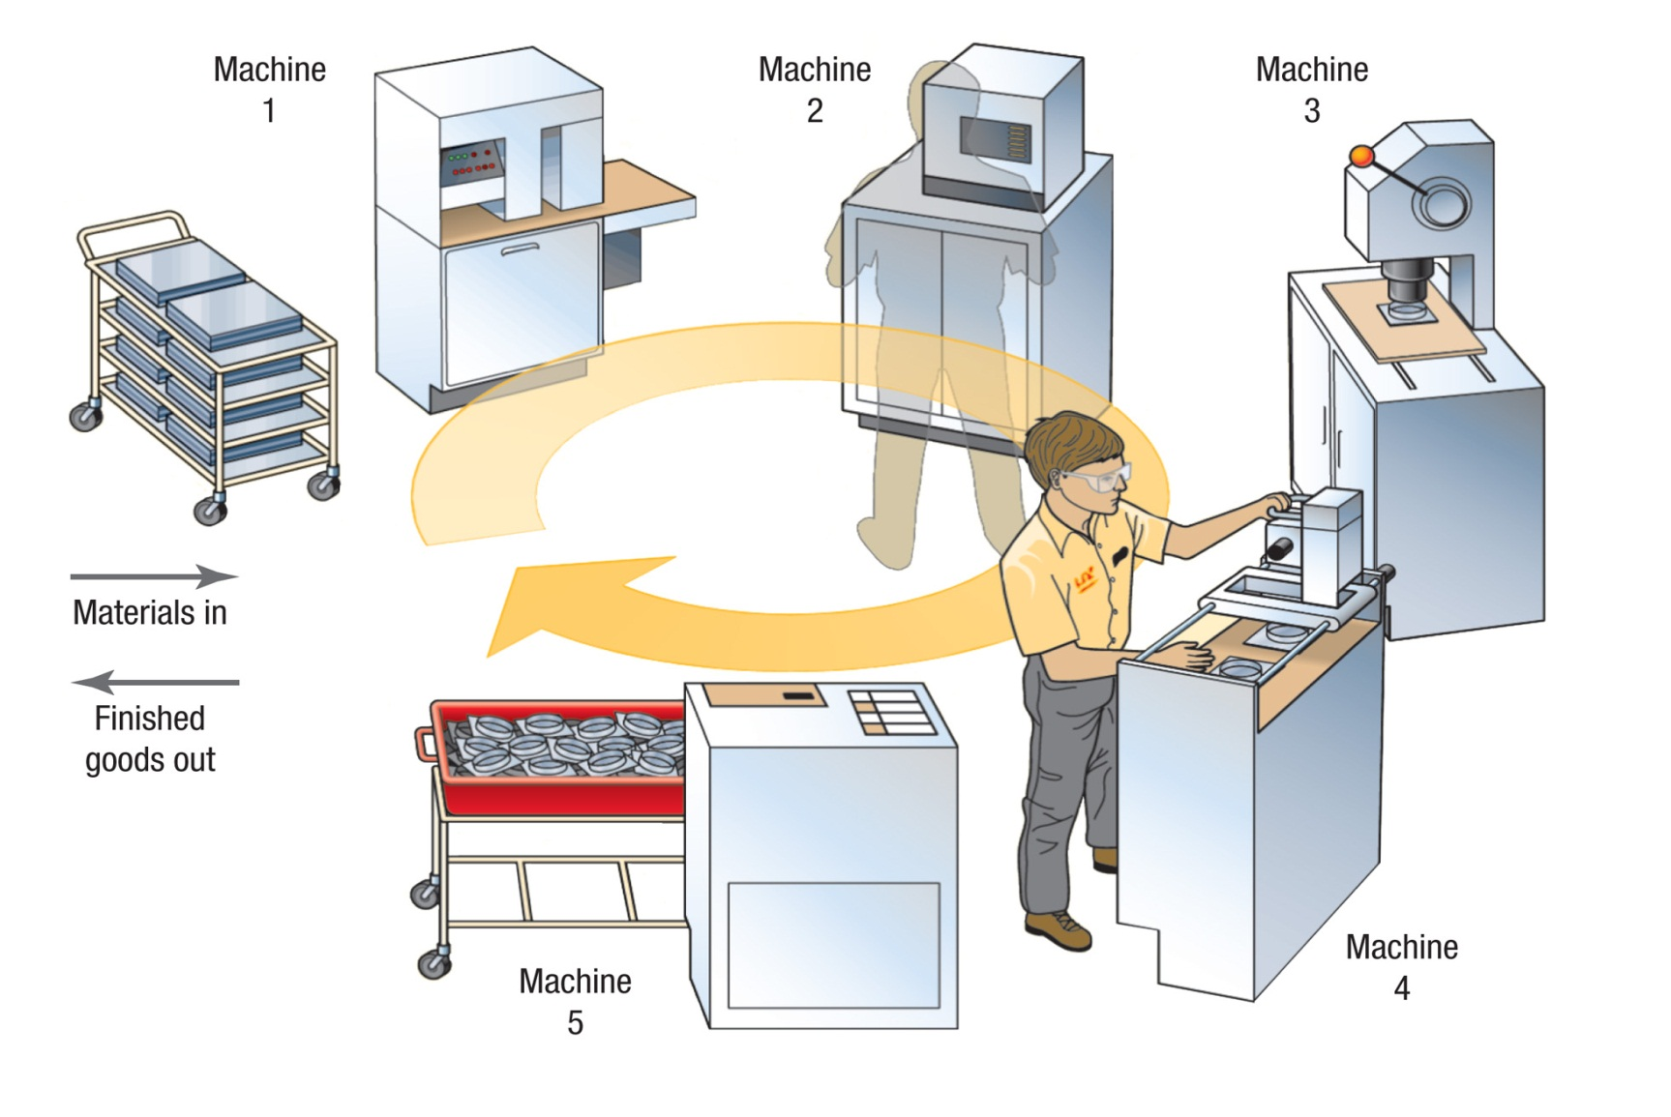
One-Worker, Multiple Machines

Slide 24
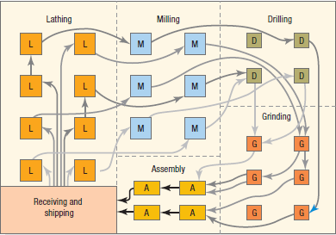
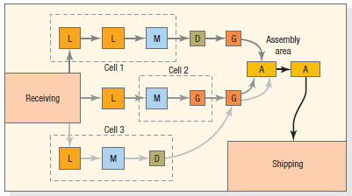
Group Technology Cells
Jumbled Flows without GT
Lines Flows with 3 GT cells

Slide 25
Kanban Systems

Slide 26
What is a Kanban?
Kanban
A Japanese word meaning “card” or “visible record.”
through a factory.
In Lean, it is a tool that refers to cards used to control the flow of production.
It facilitates flow by preventing over-production by prior steps in the process and build-up of inventory/WIP
The cell only produces the quantity needed when the Kanban signals it is time.
Examples of Kanban in everyday life:
Grocery store shelves (stock acts as Kanban)
Empty glass at a bar

Slide 27
Kanban Essentials
Kanban Essentials
Simple and visual
Nothing is created or moved without a Kanban
Process should be improved and standardized before Kanban
Kanban is not the starting point for Lean
Notes:
Kanbans do need to be overly complex as the milk bottle, bar glass, or Chula Vista’s colored piece of paper demonstrate!
Kanbans are intended to prevent push production and resulting over-production.
Take steps to minimize and eliminate defects and other forms of waste before doing Kanbans. For example, Chula Vista got rid of old, obsolete forms before instituting a re-order Kanban!
Kanban is considered a more advanced technique, so it is not something you will necessarily do right away.

Slide 28
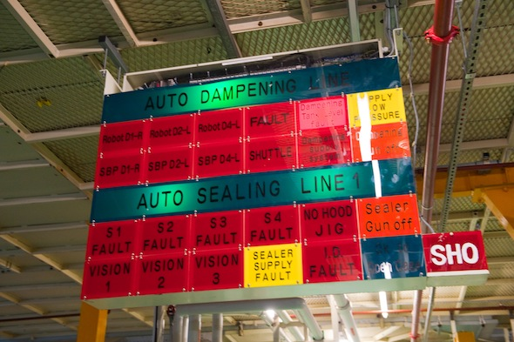
The Kanban System
Containerless System
Using visual means in lieu of containers as a signal device.

Slide 29
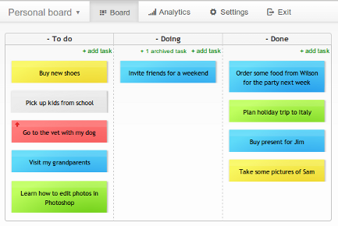
Kanban Essentials
Kanban Board
Simple and visual

Slide 30
Kanban Essentials
Kanban Board

Slide 31
Kanban Essentials
Kanban Board

Slide 32
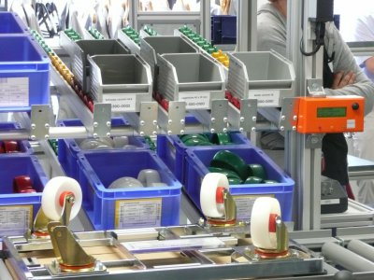
Other Kanban Signals
The Kanban System
Container System
Using the container itself as a signal device.
Works well with containers specifically designed for parts.

Slide 33
The Kanban System
Container System
Each container must have a card.
Assembly always withdraws from fabrication (pull system).
Containers cannot be moved without a kanban.
Containers should contain the same number of parts.
Only good parts are passed along.
Production should not exceed authorization.

Slide 34
The Kanban System
Receiving post
Kanban card for product 1
Storage area
Kanban card for product 2
Empty containers
Assembly line 1
O₂
Fabrication cell
O₁
O₃
Assembly line 2
Full containers
O₂

Slide 35
The Kanban System
The Kanban System
Receiving post
Kanban card for product 1
Storage area
Kanban card for product 2
Empty containers
Assembly line 1
O₂
Fabrication cell
O₁
O₃
Assembly line 2
Full containers
O₂

Slide 36
The Kanban System
The Kanban System
Receiving post
Kanban card for product 1
Storage area
Kanban card for product 2
Empty containers
Assembly line 1
O₂
Fabrication cell
O₁
O₃
Assembly line 2
Full containers
O₂

Slide 37
The Kanban System
The Kanban System
Receiving post
Kanban card for product 1
Storage area
Kanban card for product 2
Empty containers
Assembly line 1
O₂
Fabrication cell
O₁
O₃
Assembly line 2
Full containers
O₂

Slide 38
The Kanban System
The Kanban System
Receiving post
Kanban card for product 1
Storage area
Kanban card for product 2
Empty containers
Assembly line 1
O₂
Fabrication cell
O₁
O₃
Assembly line 2
Full containers
O₂

Slide 39
The Kanban System
The Kanban System
Receiving post
Kanban card for product 1
Storage area
Kanban card for product 2
Empty containers
Assembly line 1
O₂
Fabrication cell
O₁
O₃
Assembly line 2
Full containers
O₂

Slide 40
The Kanban System
The Kanban System
Receiving post
Kanban card for product 1
Storage area
Kanban card for product 2
Empty containers
Assembly line 1
O₂
Fabrication cell
O₁
O₃
Assembly line 2
Full containers
O₂

Slide 41
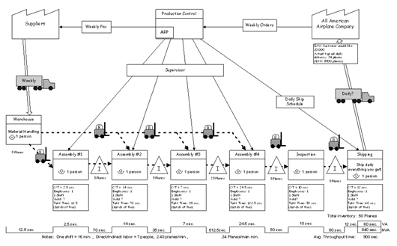
Value Stream Mapping

Slide 42
What is a Value Stream Map?
Value Stream Mapping
A qualitative lean tool for eliminating waste or muda that involves a current state drawing, a future state drawing and an implementation plan.
The value stream map is a unique flowchart because it combines the flow of material or service and the flow of information.
Product Family
Current state drawing
Future state drawing
Implementation plan

Slide 43
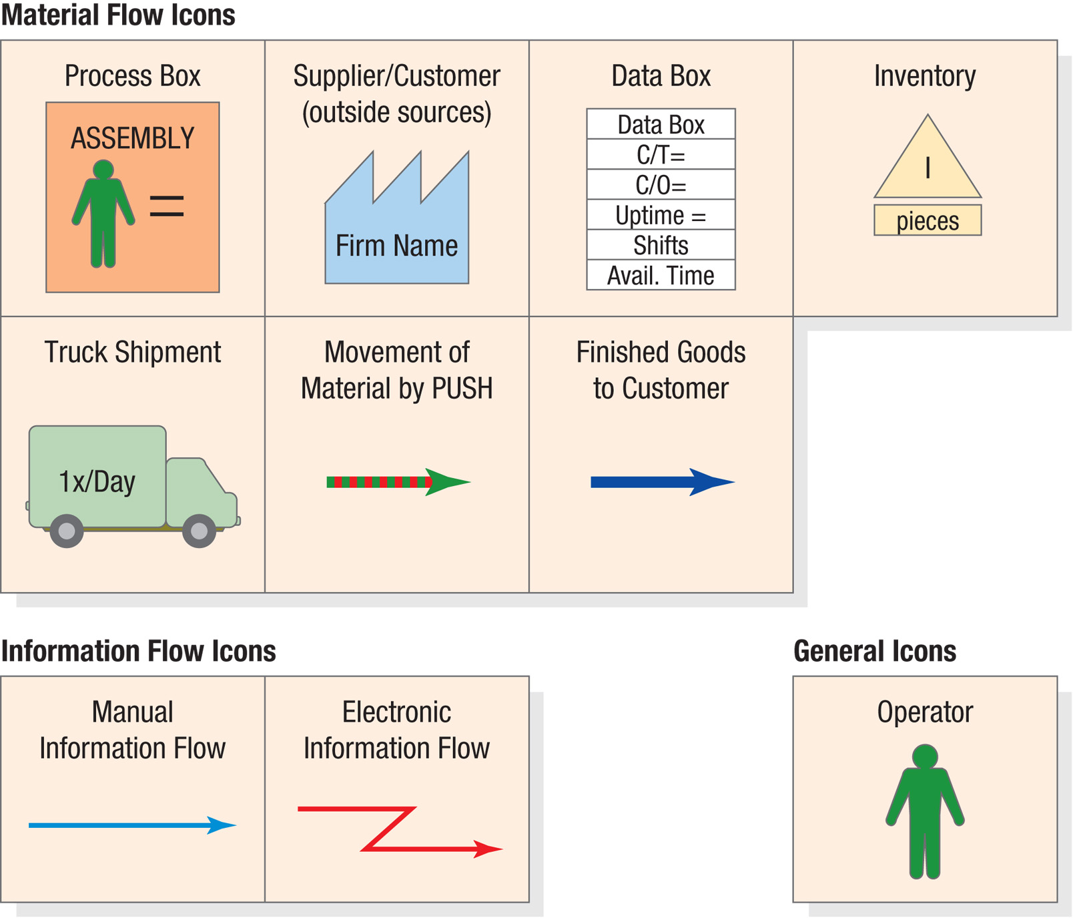
VSM Icons

Slide 44
VSM Metrics
Takt Time
Cycle time needed to match the rate of production to the rate of sales or consumption.
Daily availability/Daily Demand
Cycle Time
The average time between completed units taking into account all resources available at a process step.
Processing Time
The time to complete one unit.

Slide 45
Jensen Bearings Example
Jensen Bearings, Inc makes two types of retainers that are packaged and shipped in returnable trays with 60 retainers in each tray. The operations data is on the following slides.
Create a VSM for Jensen Bearings
What is the takt time?
What is the lead time at each cell?
What is the total processing time?
What is the capacity?

Slide 46
Data
Jensen Bearings Example – data

Slide 47
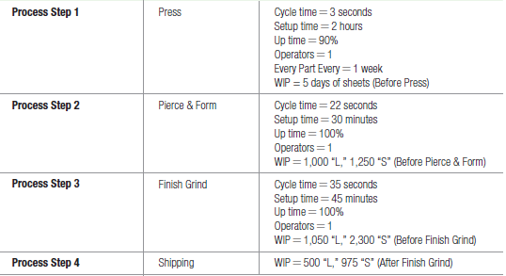
Data
Jensen Bearings Example – data cont.

Slide 48
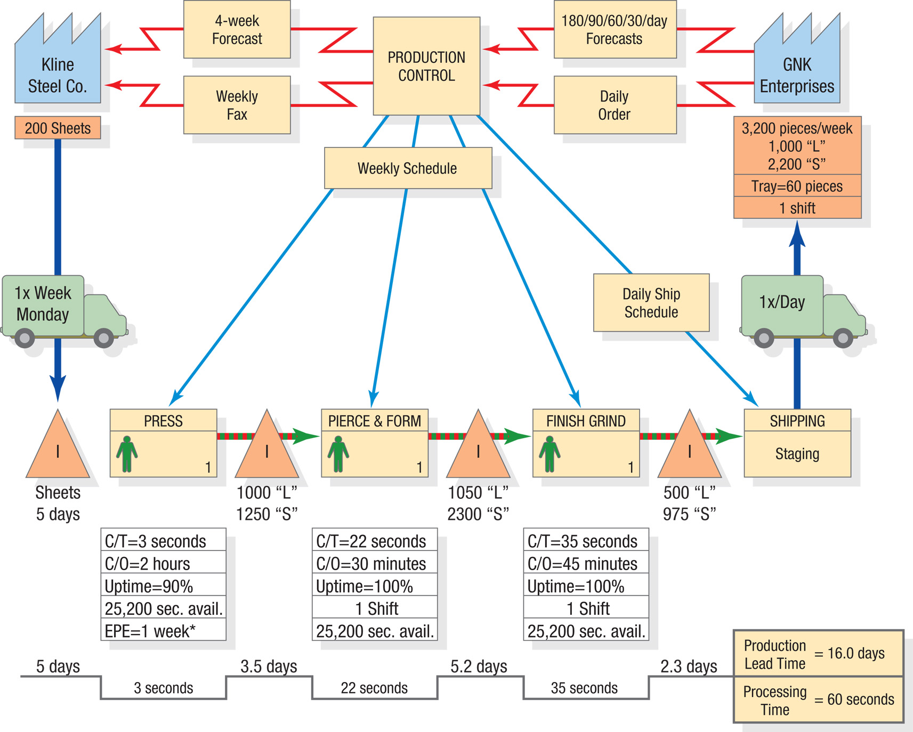
Create a VSM for Jensen Bearings

Slide 49
What is the takt time?
Daily Demand
[(1000+2200) pieces /week]/5 days =
640 pieces per day
Daily Availability
(7 hours/day) x (3600 seconds per hour) =
25,200 seconds per day
Takt Time = Daily availability/Daily Demand =
25,200/640 =
39.375 seconds per piece

Slide 50
What is the lead time at each cell?
Production Lead time = Inventory/Daily Demand
Raw Material Lead Time - 5 days
WIP between Press and Pierce/Form = (2250/640) = 3.5 days
WIP between Pierce/Form and Finish/Grind = (3350/640) = 5.2 days
WIP between Finish/Grind and Shipping= (1475/640) = 2.3 days
Total Production Lead Time = (5 + 3.5 + 5.2 + 2.3) = 16 days
Total Processing Time = Sum of the Cycle Times
(3 + 22 + 35) = 60 seconds
What is the total processing time?

Slide 51
What is the capacity?
Capacity at Press | Capacity at Pierce & Form | Capacity at finish Grind
Cycle time = 3 seconds | Cycle time = 22 seconds | Cycle time = 35 seconds
Setup time = (2hrs x 3,600 seconds per hour)/1000 units per batch = 7.2 seconds | Setup time = (30 minutes x 60 seconds per minute)/1000 units per batch = 1.8 seconds | Setup time = (45 minutes x 60 seconds per minute)/1000 units per batch = 2.7 seconds
Per Unit Processing Time = (3 + 7.2) = 10.2 seconds | Per Unit Processing Time = (22 + 1.8) = 23.8 seconds | Per Unit Processing Time = (35 + 2.7) = 37.7 seconds
Grinding is the bottleneck
Capacity = 25200/37.7 = 668 units/day

Slide 52
Organizational Considerations to Lean Implementation
Worker stress
Lean systems coupled with SPC create a need for a high level of regimentation which can stress a workforce causing productivity losses or reductions in quality.
Trust between workers and mgt
In a Lean system roles of responsibility are pushed down to the lowest level. Work relationships must be reoriented to accommodate the Lean system.

Slide 53
Organizational Considerations to Lean Implementation
Reward systems
Should be revamped to encourage organization over functional group and prevent the silo effect
Labor classifications
If unions are involved, labor classifications may need to be renegotiated to accommodate the news roles associated with the Lean system

