Slide 4
Answer: A

Slide 9
Answer: A

Slide 15
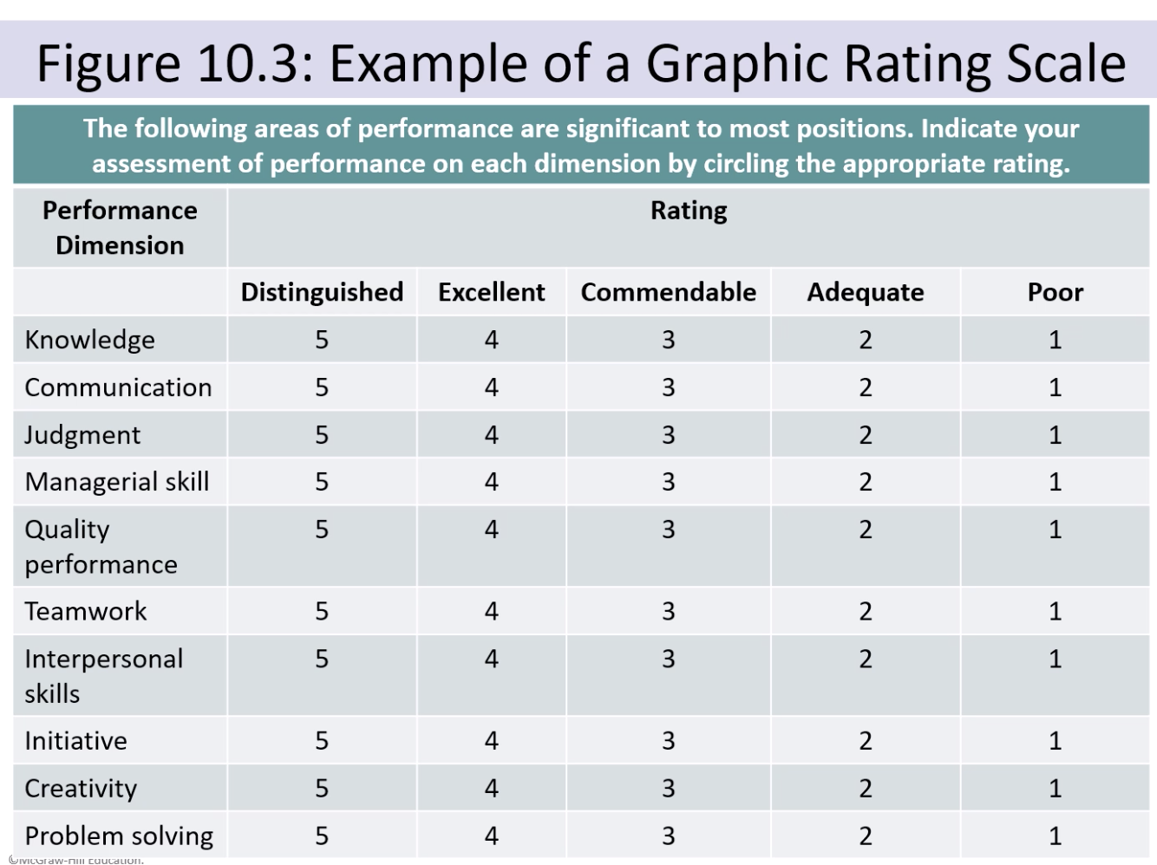

Slide 21
Answer: A

Slide 29
Answer: B

