Slide 1
Operations and Project Management BBUS 340 4 April 2018

Slide 2
Today’s Agenda
Class Administration – Littlefield, OM Explorer download
Lecture – Capacity Planning
Definitions & Concepts
Long-term Capacity Decisions
Lecture – Waiting Lines
Waiting Line Structure & Arrangements
Service Systems & Priority Rules
Probability Distributions
Single-Server Model
Multiple-Server Model
Case Study

Slide 3
50,000 Feet Overview of OPM
Managing Value Chains
Managing Processes
Using Operations to Compete
Supply Chain Strategy
Process Strategy
Location
Operations As a
Competitive Weapon
Process Analysis
Inventory Management
Operations Strategy
Process Performance & Quality
Process Performance & Quality
Forecasting
Project Management
Constraint Management
Sales & Operations Planning
Process Layout
Resource Planning
Lean Systems
Scheduling
Notes:
Service vs. Manufacturing
Small vs. Medium vs. Large Firms
Industry type: hightech, healthcare, aerospace, IT, etc ….

Slide 4
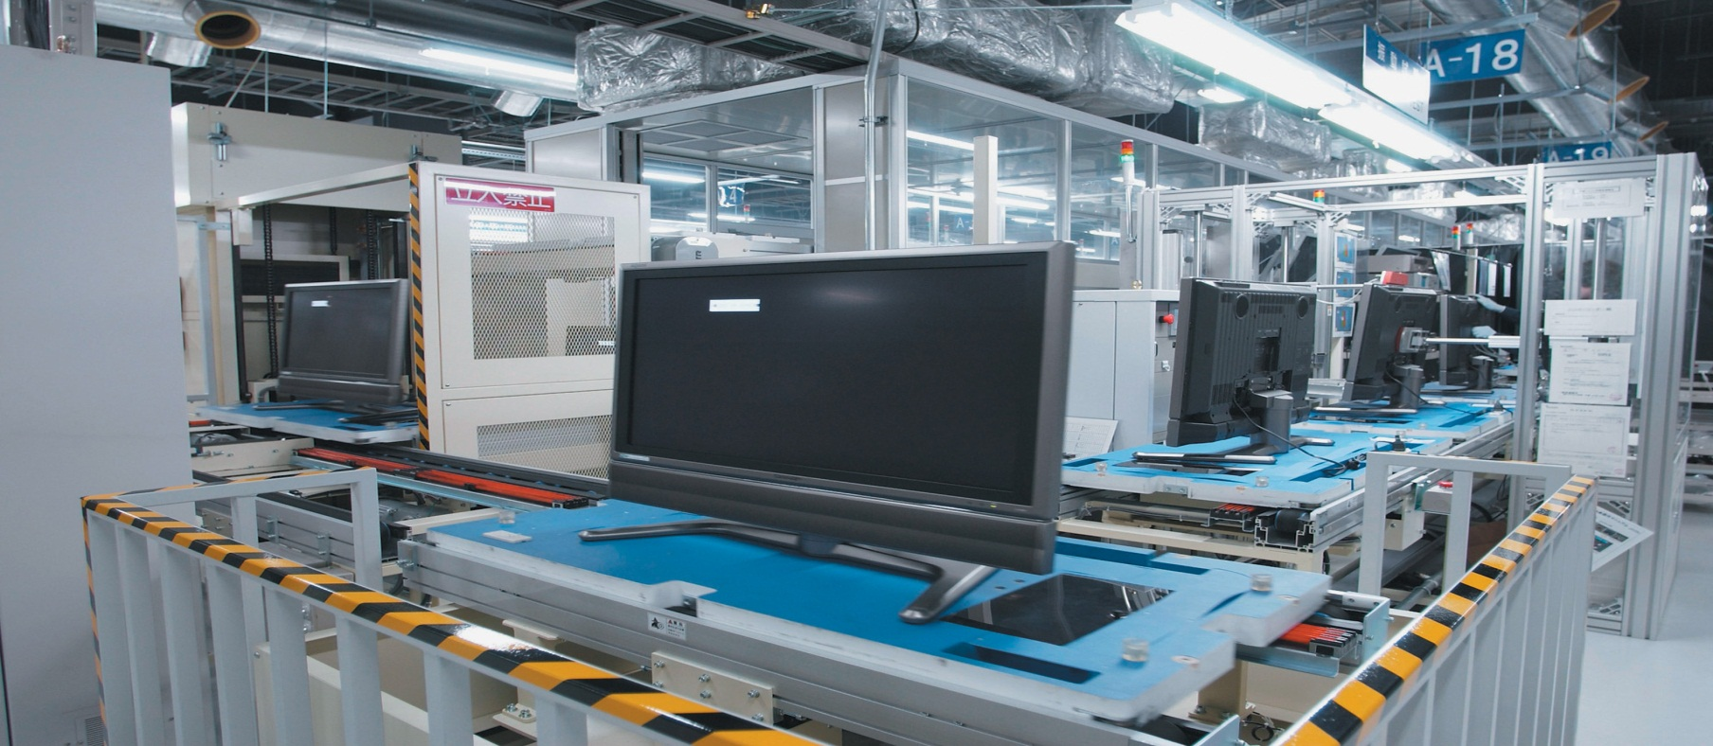
Capacity Planning

Slide 5
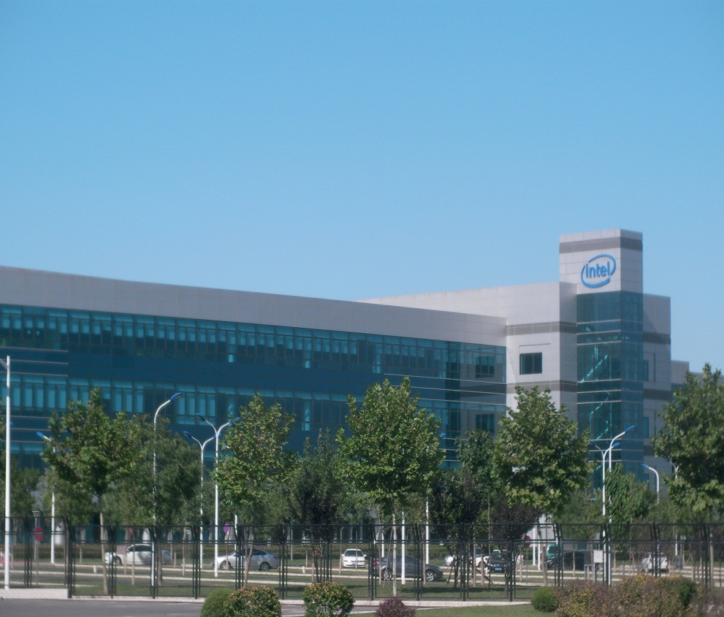
What is Capacity?
The maximum rate of output of a process or a system.

Slide 6
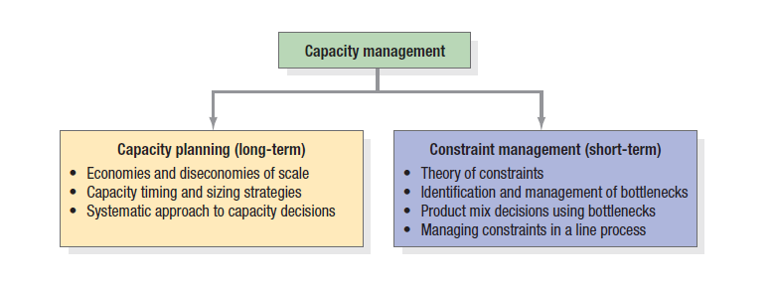
What is Capacity Management?

Slide 7
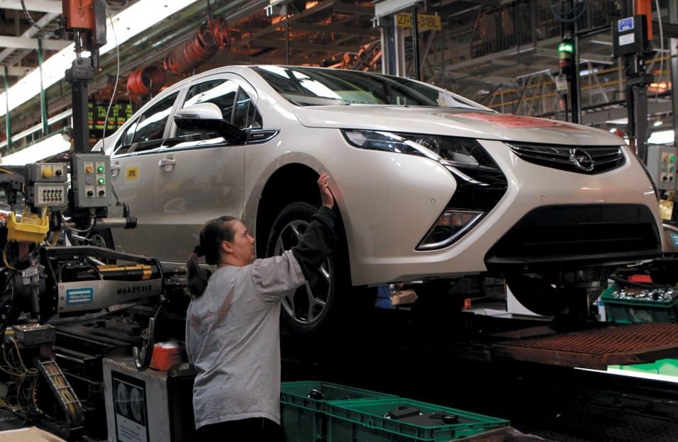
Measures of Capacity and Utilization
Utilization
Output measures
Input measures
Average output rate
Maximum capacity
Utilization = × 100%

Slide 8
Measures of Capacity and Utilization
Use Output Measures when:
Process has high volume and the firm makes a small number of standardized products
Using Input Measures when:
Product variety and process divergence is high
The product or service mix is changing
Productivity rates are expected to change
Significant learning effects are expected

Slide 9
Economies and Diseconomies of Scale
Economies of scale
Spreading fixed costs
Reducing construction costs
Cutting costs of purchased materials
Finding process advantages
Diseconomies of scale
Complexity
Loss of focus
Inefficiencies

Slide 10
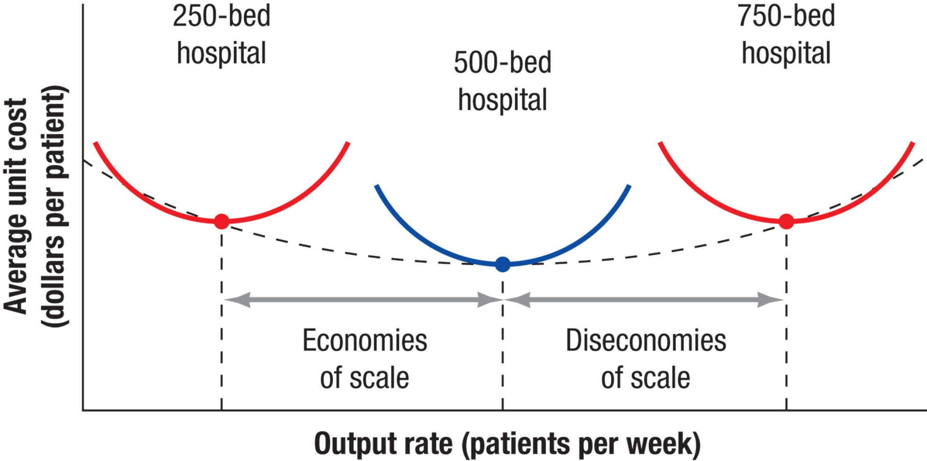
Economies and Diseconomies of Scale

Slide 11
Sizing Capacity Cushions
Capacity cushions – the amount of reserve capacity a process uses to handle sudden changes
Capacity cushion = 100% – Average Utilization rate (%)
Capacity cushions vary with industry
Capital intensive industries prefer cushions as small as 5 percent, while hotel industry can live with 30 to 40 percent cushion

Slide 12
Capacity Timing and Sizing
Planned unused capacity
Forecast of capacity required
Capacity
Capacity increment
Time between increments
Time
(a) Expansionist strategy

Slide 13
Capacity Timing and Sizing
Capacity Timing and Sizing
Planned use of short-term options
Forecast of capacity required
Capacity increment
Capacity
Time between increments
Time
(b) Wait-and-see strategy

Slide 14
Linking Capacity
Capacity decisions should be linked to processes and supply chains throughout the organization
Important issues are competitive priorities, quality, and process design

Slide 15
A Systematic Approach to Long-Term Capacity Decisions
Estimate
Estimate future capacity requirements
Identify
Identify gaps by comparing requirements with available capacity
Develop
Develop alternative plans for reducing the gaps
Evaluate
Evaluate each alternative, both qualitatively and quantitatively, and make a final choice

Slide 16
Step 1 Estimate Capacity Requirements
For one service or product processed at one operation with a one year time period, the capacity requirement, M, is
Capacity requirement
Processing hours required for year’s demand
Hours available from a single capacity unit
(such as an employee or machine) per year,
after deducting desired cushion
=
Dp
N[1 – (C/100)]
M =
Where:
D = demand forecast for the year (number of customers served or units produced)
p = processing time (in hours per customer served or unit produced)
N = total number of hours per year during which the process operates
C = desired capacity cushion (expressed as a percent)

Slide 17
For one service or product processed at one operation with a one year time period, the capacity requirement, M, is
Step 1 (cont.) Estimate Capacity Requirements
Capacity requirement
Processing hours required for year’s demand,
Summed over all services or products
Hours available from a single capacity unit
per year, after deducting desired cushion
=
T
[Dp + (D/Q)s]_{product 1} + [Dp + (D/Q)s]_{product 2} + … + [Dp + (D/Q)s]_{product n}
N[1 – (C/100)]
M =
Where:
Q = number of units in each lot
s = setup time (in hours) per lot

Slide 18
Example
Example
A copy center in an office building prepares bound reports for two clients. The center makes multiple copies (the lot size) of each report. The processing time to run, collate, and bind each copy depends on, among other factors, the number of pages. The center operates 250 days per year, with one 8-hour shift. Management believes that a capacity cushion of 15 percent (beyond the allowance built into time standards) is best. It currently has three copy machines. Based on the following information, determine how many machines are needed at the copy center.
Item | Client X | Client Y
Annual demand forecast (copies) | 2,000 | 6,000
Standard processing time (hours per job) | 0.5 | 0.7
Average lot size (copies per report) | 20 | 30
Standard setup time (hours) | 0.25 | 0.40

Slide 19
Example
Example
Where:
D = demand forecast for the year (number of customers served or units produced)
p = processing time (in hours per customer served or unit produced)
N = total number of hours per year during which the process operates
C = desired capacity cushion (expressed as a percent)
Q = number of units in each lot
s = setup time (in hours) per lot
[Dp + (D/Q)s]_{product 1} + [Dp + (D/Q)s]_{product 1} + … + [Dp + (D/Q)s]_{product n}
N[1 – (C/100)]
M =
[2,000(0.5) + (2,000/20)(0.25)]_{client X}
+ [6,000(0.7) + (6,000/30)(0.40)]_{client Y}
=
[(250 days per year)(1 shift per day)(8 hours per shift)][1.0 - (15/100)]
5,305
1,700
= = 3.12
Rounding up to the next integer gives a requirement of four machines.

Slide 20
Application Problem
You have been asked to put together a capacity plan for a critical operation at the Sugarfoot Sandal Company. Your capacity measure is number of machines. Three products (men’s, women’s, and children’s sandals) are manufactured. The time standards (processing and setup), lot sizes, and demand forecasts are given in the following table. The firm operates two 8-hour shifts, 5 days per week, 50 weeks per year. Experience shows that a capacity cushion of 5 percent is sufficient.
 | Time Standards
Product | Processing (hr/pair) | Setup (hr/pair) | Lot size (pairs/lot) | Demand Forecast (pairs/yr)
Men’s sandals | 0.05 | 0.5 | 240 | 80,000
Women’s sandals | 0.10 | 2.2 | 180 | 60,000
Children’s sandals | 0.02 | 3.8 | 360 | 120,000
a. How many machines are needed?
b. If the operation currently has two machines, what is the capacity gap?

Slide 21
Application Problem
a. The number of hours of operation per year, N, is N = (2 shifts/day)(8 hours/shifts) (250 days/machine-year) = 4,000 hours/machine-year
The number of machines required, M, is the sum of machine-hour requirements for all three products divided by the number of productive hours available for one machine:
[Dp + (D/Q)s]_{men} + [Dp + (D/Q)s]_{women} + [Dp + (D/Q)s]_{children}
N[1 - (C/100)]
M =
[80,000(0.05) + (80,000/240)0.5] + [60,000(0.10) + (60,000/180)2.2] + [120,000(0.02) + (120,000/360)3.8]
4,000[1 - (5/100)]
=
14,567 hours/year
3,800 hours/machine-year
=
= 3.83 or 4 machines

Slide 22
Application Problem
b. The capacity gap is 1.83 machines (3.83 –2). Two more machines should be purchased, unless management decides to use short-term options to fill the gap.
The Capacity Requirements Solver in OM Explorer confirms these calculations, as the figure shows, using only the “Expected” scenario for the demand forecasts.

Slide 23
Application Problem

Slide 24
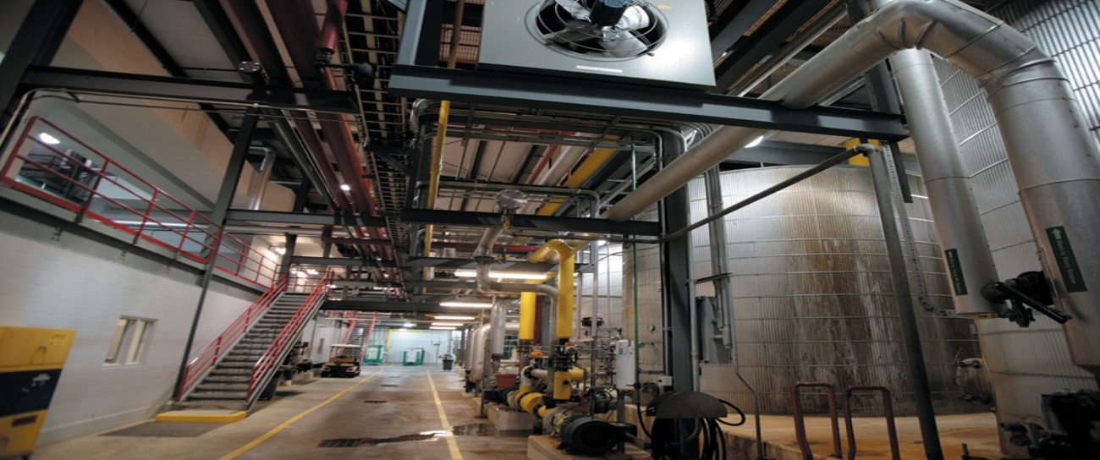
Step 2
Identify Gaps
Identify gaps between projected capacity requirements (M) and current capacity
Complicated by multiple operations and resource inputs

Slide 25
Step 3 Develop Alternatives
Base case is to do nothing and suffer the consequences
Many different alternatives are possible

Slide 26
Step 4 Evaluate Alternatives
Qualitative concerns include strategic fit and uncertainties.
Quantitative concerns may include cash flows and other quantitative measures.

Slide 27
Waiting Lines

Slide 28
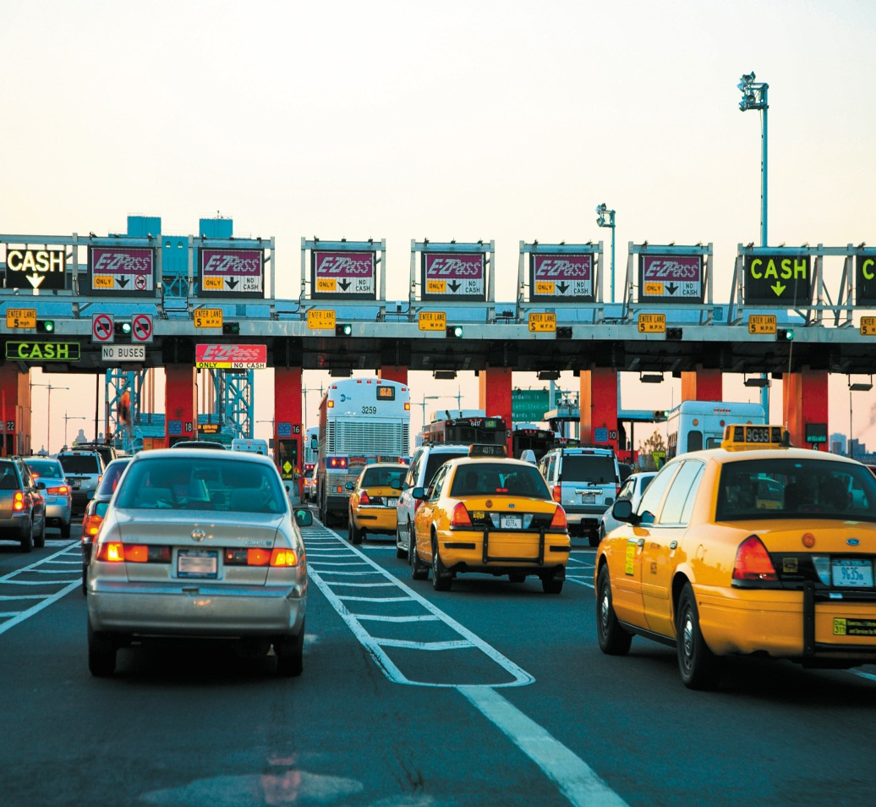
What are waiting lines and why do they form?
Waiting line
One or more customers waiting for service.
Waiting Lines form due to a temporary imbalance between the demand for service and the capacity of the system to provide the service.

Slide 29
Structure of Waiting-Line Problems
An input, or customer population, that generates potential customers
A waiting line of customers
The service facility, consisting of a person (or crew), a machine (or group of machines), or both necessary to perform the service for the customer
A priority rule, which selects the next customer to be served by the service facility
Service system: The number of lines and the arrangement of the facilities.

Slide 30
Structure of Waiting Line Problems
Customer population
Service system
Served customers
Waiting line
Service facilities
Priority rule

Slide 31
Waiting Line Arrangements
Single Line
Service facilities
Multiple Lines
Service facilities

Slide 32
The Service System
Number of lines
A single-line keeps servers uniformly busy and levels waiting times among customers
A multiple-line arrangement is favored when servers provide a limited set of services
Arrangement of service facilities
Single-channel, single-phase
Single-channel, multiple-phase
Multiple-channel, single-phase
Multiple-channel, multiple-phase
Mixed arrangement

Slide 33
Service Facility Arrangements
Service facility
Single channel, single phase
Service facility 1
Service facility 2
Single channel, multiple phase

Slide 34
Service Facility Arrangements
Service facility 1
Multiple channel,
single phase
Service facility 2
Multiple channel,
multiple phase
Service facility 1
Service facility 3
Service facility 2
Service facility 4

Slide 35
Service Facility Arrangements
Mixed arrangement
Routing for : 1–2–4
Routing for : 2–4–3
Routing for : 3–2–1–4
Service facility 1
Service facility 2
Service facility 3
Service facility 4

Slide 36
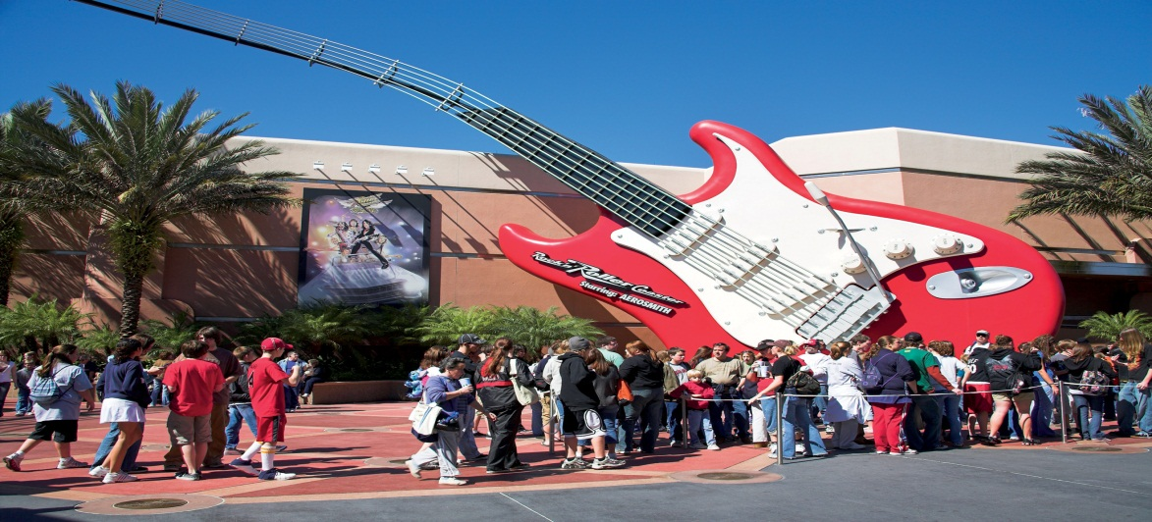
Priority Rules
First-come, first-served (FCFS) - most common
Earliest due date (EDD)
Shortest processing time (SPT)
Preemptive discipline - allows a higher priority customer to interrupt the service of another customer or be served ahead of another who would have been served first

Slide 37
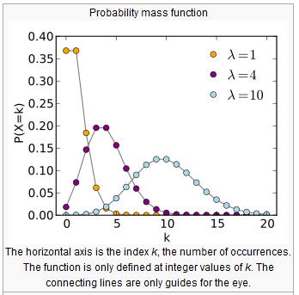
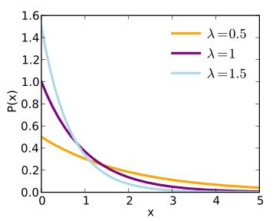
Probability Distributions
The sources of variation in waiting line problems come from the random arrivals of customers and the variations in service times. Each of these sources can be described with a probability distribution.

Slide 38
Probability Distributions
Why use the Poisson distribution?
If a mean or average probability of an event happening per unit of time/per page/per mile cycled etc., is given, and you are asked to calculate a probability of n events happening in a given time/number of pages/number of miles cycled, then the Poisson Distribution is used.
Poisson

Slide 39
Probability Distributions
Arrival Times – Poisson Distribution
(λT)^{n}
n!
P_{n} = e^{-λT} for n = 0, 1, 2,…
Where:
P_{n} = Probability of n arrivals in T time periods
λ = Average numbers of customer arrivals per period
e = 2.7183
Poisson

Slide 40
Example
Management is redesigning the customer service process in a large department store. Accommodating four customers is important. Customers arrive at the desk at the rate of two customers per hour. What is the probability that four customers will arrive during any hour?
In this case customers per hour, T = 1 hour, and n = 4 customers. The probability that four customers will arrive in any hour is:
(λT)^{n}
n!
P_{n} = e^{-λT}
[2(1)]⁴
4!
16
24
P₄ =
e^{–2(1)}
= e^{–2} = 0.090

Slide 41
Probability Distributions
Why use the Exponential distribution?
The Exponential distribution is the probability distribution that describes the time between events in a process in which events occur continuously and independently at a constant average rate.
Exponential

Slide 42
Probability Distributions
Service Time – Exponential Distribution
P(t ≤ T) = 1 – e^{-μT}
Where:
μ = average number of customers completing service per period
t = service time of the customer
T = target service time
Exponential

Slide 43
Example
The management of the large department store must determine whether more training is needed for the customer service clerk. The clerk at the customer service desk can serve an average of three customers per hour. What is the probability that a customer will require less than 10 minutes of service?
Because μ = 3 customers per hour, we convert minutes of time to hours, or T = 10 minutes = 10/60 hour = 0.167 hour.
P(t ≤ T) = 1 – e^{–μT}
P(t ≤ 0.167 hour) = 1 – e^{–3(0.167)} = 1 – 0.61 = 0.39

Slide 44
Using Waiting-Line Models
Balance costs against benefits
Operating characteristics
Line length
Number of customers in system
Waiting time in line
Total time in system
Service facility utilization

Slide 45
Single-Server Model
Single-server, single line of customers, and only one phase
Assumptions are:
Customer population is infinite and patient
Customers arrive according to a Poisson distribution, with a mean arrival rate of λ
Service distribution is exponential with a mean service rate of μ
Mean service rate exceeds mean arrival rate
Customers are served FCFS
The length of the waiting line is unlimited

Slide 46
Single-Server Model
λ
μ
ρ = Average utilization of the system =
Ρ_{n} = Probability that n customers are in the system = (1 – ρ )ρ ^{n}
L = Average number of customers in the service system =
λ
μ – λ
L_{q} = Average number of customers in the waiting line = ρ L
1
μ – λ
W = Average time spent in the system, including service =
W_{q} = Average waiting time in line = ρW

Slide 47
Single Server Model Example
The manager of a grocery store in the retirement community of Sunnyville is interested in providing good service to the senior citizens who shop in her store. Currently, the store has a separate checkout counter for senior citizens. On average, 30 senior citizens per hour arrive at the counter, according to a Poisson distribution, and are served at an average rate of 35 customers per hour, with exponential service times characteristics:
a. Probability of zero customers in the system
b. Average utilization of the checkout clerk
c. Average number of customers in the system
d. Average number of customers in line
e. Average time spent in the system
f. Average waiting time in line

Slide 48
Application
Customers arrive at a checkout counter at an average 30 per hour, according to a Poisson distribution. They are served at an average rate of 35 per hour, with exponential service times. Use the single-server model to estimate the operating characteristics of this system.
= 30 customer arrival rate per hour
μ = 35 customer service rate per hour

Slide 49
Application
1. Average utilization of system
λ
μ
30
35
ρ =
= = 0.86
2. Average number of customers in the service system
λ
μ – λ
30
35 – 30
L =
= = 6
3. Average number of customers in the waiting line
= 0.86(6) = 5.16
L_{q} = ρ L
4. Average time spent in the system, including service
W =
1
μ – λ
1
35 – 30
= = 0.20
5. Average waiting time in line
W_{q} = ρ W
= 0.86(0.2) = 0.17

Slide 50
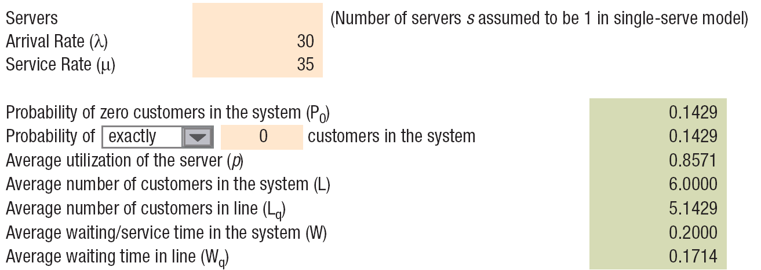
Single Server Model Example
The checkout counter can be modeled as a single-channel, single-phase system. The results from the Waiting-Lines Solver from OM Explorer are below:

Slide 51
Sunnyville Example
The manager of the Sunnyville grocery wants answers to the following questions:
What service rate would be required so that customers average only 8 minutes in the system?
For that service rate, what is the probability of having more than four customers in the system?

Slide 52
Sunnyville Example
a. We use the equation for the average time in the system and solve for μ
1
μ – λ
W =
1
μ – 30
8 minutes = 0.133 hour =
0.133μ – 0.133(30) = 1
μ = 37.52 customers/hour

Slide 53
b. The probability of more than four customers in the system equals 1 minus the probability of four or fewer customers in the system.
Sunnyville Example
4
P = 1 – ΣP_{n}
n = 0
4
= 1 – Σ(1 – ρ)ρ ^{n}
n = 0
30
37.52
ρ =
= 0.80
P = 1 – 0.2(1 + 0.8 + 0.8² + 0.8³ + 0.8⁴)
= 1 – 0.672 = 0.328
Therefore, there is a nearly 33 percent chance that more than four customers will be in the system.

Slide 54
Multiple Server Model Assumptions
Service system has only one phase, multiple-channels
Assumptions (in addition to single-server model)
There are s identical servers
The service distribution for each server is exponential
The mean service time is 1/μ
sμ should always exceed λ

Slide 55
Multiple Server Model Equations
ρ = Average utilization of the system =
P₀ = Probability that zero customers are in the system
=
P_{n} = Probability that n customers are in the system
$$=\frac{({λ/μ)}^{n}}{n!}P_{0} for n≤s$$
=
$$=\frac{({λ/μ)}^{n}}{s!s^{n−s}}P_{0} for n>s$$

Slide 56
Multiple Server Model Equations
L_{q} = Average number of customers in the waiting line
=
W_{q} = Average waiting time of customers in line =
W = Average time spent in the system, including service
=
L = Average number of customers in the service system
= λW

Slide 57
Example B.5
Multiple Server Model Example
The management of the American Parcel Service terminal in Verona, Wisconsin, is concerned about the amount of time the company’s trucks are idle (not delivering on the road), which the company defines as waiting to be unloaded and being unloaded at the terminal.
The terminal operates with four unloading bays. Each bay requires a crew of two employees, and each crew costs $30 per hour.
The estimated cost of an idle truck is $50 per hour. Trucks arrive at an average rate of three per hour, according to a Poisson distribution.
On average, a crew can unload a semitrailer rig in one hour, with exponential service times.
What is the total hourly cost of operating the system?

Slide 58
Example B.5
Multiple Server Model Example
To calculate the hourly cost of operating the system we need to know the following:
The average number of trucks in the system
The average time spent in the system
The average time spent in line
The average number of trucks in line
The probability of having zero trucks in line
The utilization
The below data is provided in the description:
4 Unloading bays Crew costs $30 per hour
2 Employees/crew Idle truck costs $50 per hour
Arrival rate = 3 per hour Service time = 1 hour

Slide 59
Multiple-Server Model
4 Unloading bays Crew costs $30/hour
2 Employees/crew Idle truck costs $50/hour
Arrival rate = 3/hour Service time = 1 hour
3
1(4)
Utilization = ρ =
= 0.75
$$={\left[\sum{c}\frac{{\left(3/1\right)}^{0}}{0!}+\frac{{\left(3/1\right)}^{4}}{4!}\left(\frac{1}{1−0.75}\right)\right]}^{−1}$$
Ρ₀ =
$$=0.0377$$
Ρ₀(λ/μ)^{s}ρ
s!(1 – ρ)²
0.0377(3/1)⁴(0.75)
4!(1 – 0.75)²
Average trucks in line = L_{q} =
=
= 1.53 trucks
L_{q}
λ
1.53
3
Average time in line = W_{q} =
=
= 0.51 hours
1
μ
1
1
Average time in system = W = W_{q} +
= 0.51 +
= 1.51 hours
Average trucks in system = L = λW
= 3(1.51)
= 4.53 trucks

Slide 60
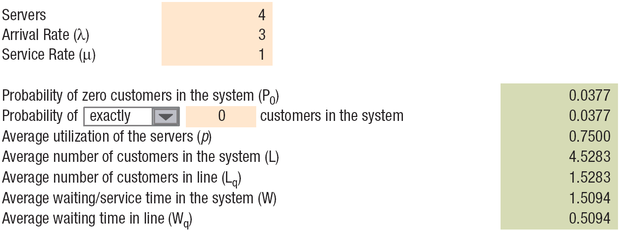
Multiple Server Model Example
What is the total hourly cost of operating the system?
4 Unloading bays Crew costs $30/hour
2 Employees/crew Idle truck costs $50/hour
Arrival rate = 3/hour Service time = 1 hour
Labor cost: | $30(s) = $30(4) | = | $120.00
Idle truck cost: | $50(L) = $50(4.53) | = | 226.50
 | Total hourly cost | = | $346.50

Slide 61
Case Study: Custom Mold’s, Inc.
Case Study: Fitness Plus, Part A
Fitness Plus is a full-service health, fitness, and sports club located in a growing market. The increase in demand on its facilities brought on by a sizable growth in membership over the past few years has led to membership’s complaints of overcrowding of club facilities and the unavailability of equipment. As with most service organizations, Fitness Plus experiences large shifts in demand both during the week and within each particular day. The owners are wondering what the existing capacity of the club is and whether it is time to think about a capacity expansion move.
Question 1: What method should be used to measure the capacity at Fitness Plus? Has Fitness Plus reached its capacity?
Question 2: Which capacity strategy would be appropriate for Fitness Plus? Justify your answer.
Question 3: How would you link the capacity decision being made by Fitness Plus to other types of operating decisions?

