Slide 1
Chapter 4:
Building Competitive advantage through
functional level strategies

Slide 2
Learning Objectives
Explain how an enterprise can use functional level strategies to increase its efficiency.
Explain how an enterprise can use functional level strategies to improve its quality.
Explain how an enterprise can use functional level strategies to increase its innovation.
Explain how an enterprise can use functional level strategies to increase its customer responsiveness.

Slide 3
Functional-level strategies
Aimed at improving the effectiveness of a company’s operations and its ability to attain superior:
  efficiency.
  quality.
  innovation.
  customer responsiveness.

Slide 4
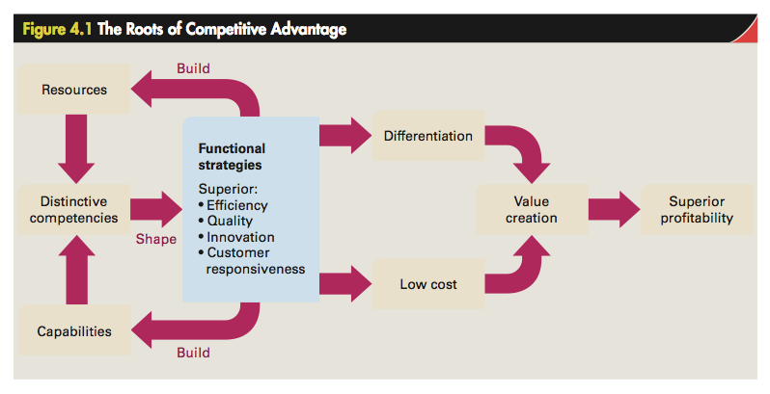

Slide 5
Efficiency and Economies of scale
Efficiency - Measured by the quantity of inputs that it takes to produce a given output.
Economies of scale - Reductions in unit costs attributed to a larger output.
  Ability to spread fixed costs over a large production volume and produce in large volumes.
    To achieve greater division of labor and specialization.
Diseconomies of scale - Unit cost increases associated with a large scale of output.

Slide 6
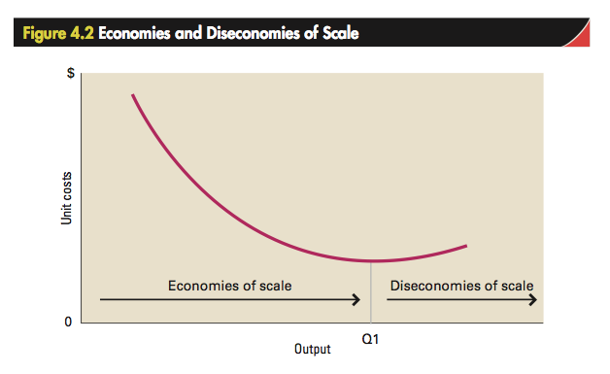

Slide 7
Learning effects
Cost savings that come from learning by doing.
More significant when a technologically complex task is repeated, as there is more to learn.
Diminish in importance after a period of time.
Triggered by changes in a company’s production system.

Slide 8
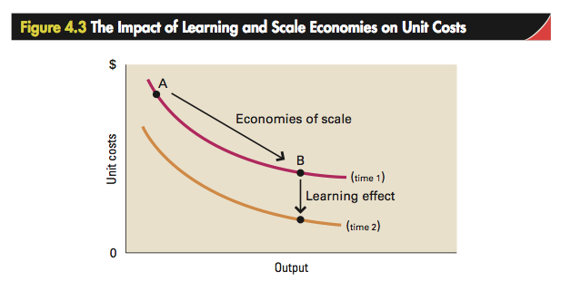

Slide 9
experience curve
Systematic lowering of the cost structure, and consequent unit cost reductions.
  Occur over the life of a product.
A product’s per-unit production costs decline each time its accumulated output doubles.
  Accumulated output - Total output of a product since its introduction.
Useful in industries that mass-produce a standardized output.

Slide 10
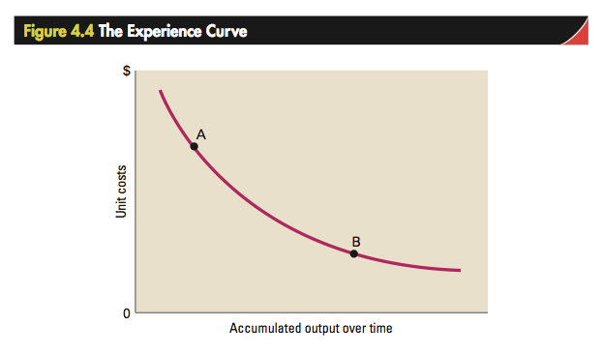

Slide 11
EFFICIENCY AND ECONOMIES OF SCALE
Managers should avoid being complacent about efficiency-based cost advantages derived from experience effects as:
  neither learning effects nor economics of scale are sustained forever.
  cost advantages gained from experience effects can be made obsolete by new technologies.

Slide 12
Flexible production technology
Reduces setup times for complex equipment.
Increases the use of individual machines through better scheduling.
Improves quality control at all stages of the manufacturing process.
Increases efficiency and lower unit costs.
Enables better customization of product offerings.

Slide 13
Mass customization
Use of flexible manufacturing technology to reconcile:
  low cost.
  differentiation through product customization.

Slide 14
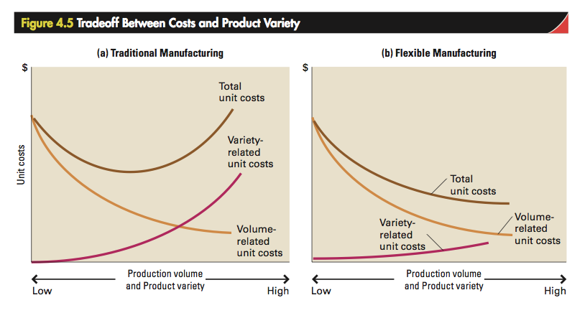

Slide 15
MARKETING AND EFFICIENCY
Marketing strategy - Position of a company with regard to pricing, promotion, advertising, product design, and distribution.
  Impacts efficiency and cost structure.
Customer defection - Rate percentage of a firm’s customers who defect every year to competitors.
  Lowering customer defection helps achieve a lower cost structure.

Slide 16
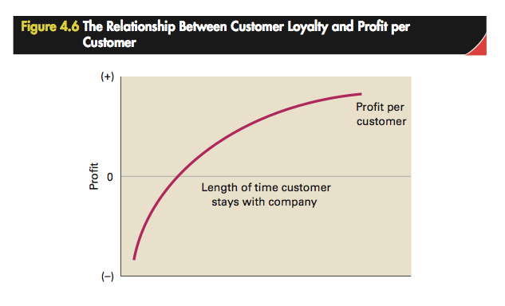

Slide 17
MATERIALS MANAGEMENT, JUST-IN-TIME systems, AND EFFICIENCY
Materials management - Activities necessary to get inputs and components:
  to a production facility.
  through the production process.
  out through a distribution system to the end-user.

Slide 18
MATERIALS MANAGEMENT, JUST-IN-TIME systems, AND EFFICIENCY
Just-in-time (JIT) inventory system
  Economizes on inventory holding costs by scheduling components to arrive:
    just in time to enter the production process.
    as stock is depleted.
  Cost savings come from increasing inventory turnover and reducing the need for working and fixed capital.
  Drawback of leaving a company without a buffer stock of inventory.

Slide 19
MATERIALS MANAGEMENT, JUST-IN-TIME systems, AND EFFICIENCY
Supply chain management - Managing the flow of inputs and components from suppliers into the company’s production processes to:
  minimize inventory holding.
  maximize inventory turnover.

Slide 20
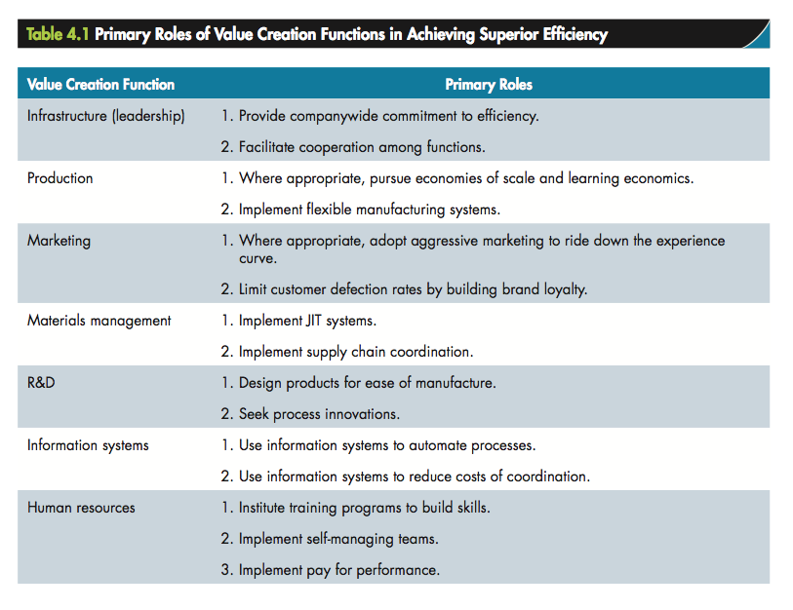

Slide 21
total quality management
Increasing product reliability to perform consistently as designed and rarely break down.
Five-step chain reaction
  Improved quality means that costs decrease
  As a result, productivity improves
  Better quality leads to higher market share, allowing the company to raise prices
  Higher prices increase profitability, allowing the company to stay in business
  Enables the company to create more jobs

Slide 22
total quality management
Steps that should be part of a quality improvement program
  Management should strive to eliminate mistakes, defects, and poor-quality
  Improve quality of supervision
  Work standard to stress on quality of work
  Train employees in new skills to remain informed in workplace changes
  Commitment from every individual in the company to achieve better quality

Slide 23
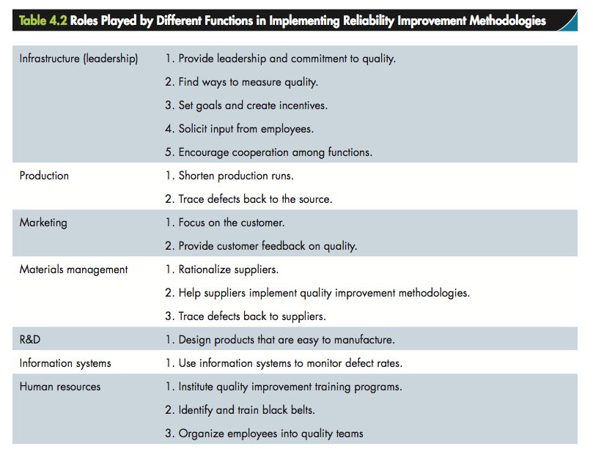

Slide 24
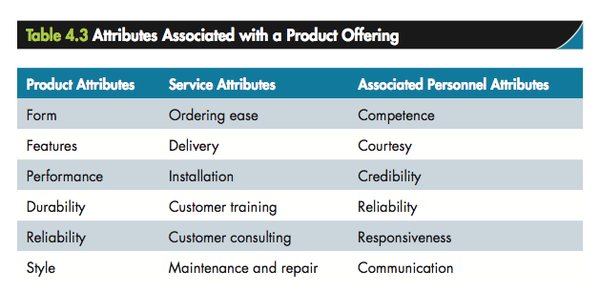

Slide 25
Improving Quality as Excellence
To achieve a perception of high quality of attributes the company should:
  collect marketing information indicating which attributes are most important to customers.
  design products in such a way that those attributes are embodied in the product.
  decide significant attributes to promote and how best to position them in the minds of consumers.
  recognize that competition is not stationary.

Slide 26
Achieving Superior Innovation
Most important source of competitive advantage.
Innovative products or processes gives a company competitive advantage that allows it to:
  differentiate its products and charge a premium price.
  lower its cost structure below that of its rivals.
Successful new-product launches are catalysts of superior profitability.

Slide 27
Reasons for High Failure Rate of Innovation
Demand for innovations is essentially uncertain.
Technology is poorly commercialized.
Poor positioning strategy
  Positioning strategy - Specific set of options adopts for a product based on price, distribution, promotion and advertising, and product features.
Marketing a technology for which there is inadequate demand.
Slow marketing of products.

Slide 28
Reducing innovation failures
Tight cross-functional integration can help a company ensure that:
  product development projects are driven by customer needs.
  new products are designed for ease of manufacture.
  development costs are reduced.
  the time it takes to develop a product and bring it to market is minimized.
  close integration between r&d and marketing is achieved.

Slide 29
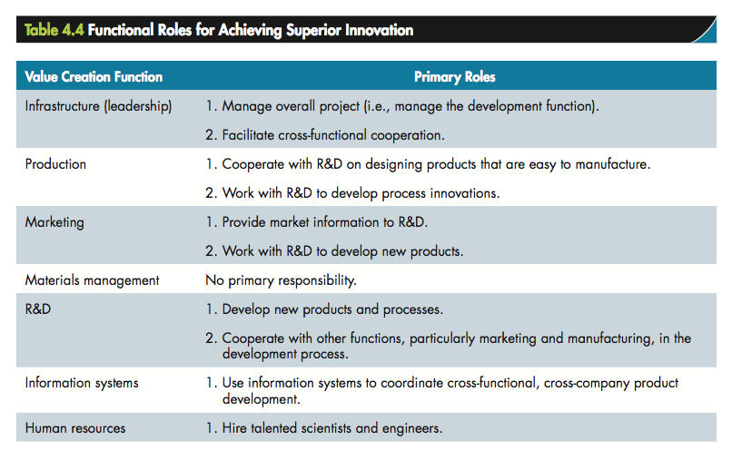

Slide 30
