Slide 1
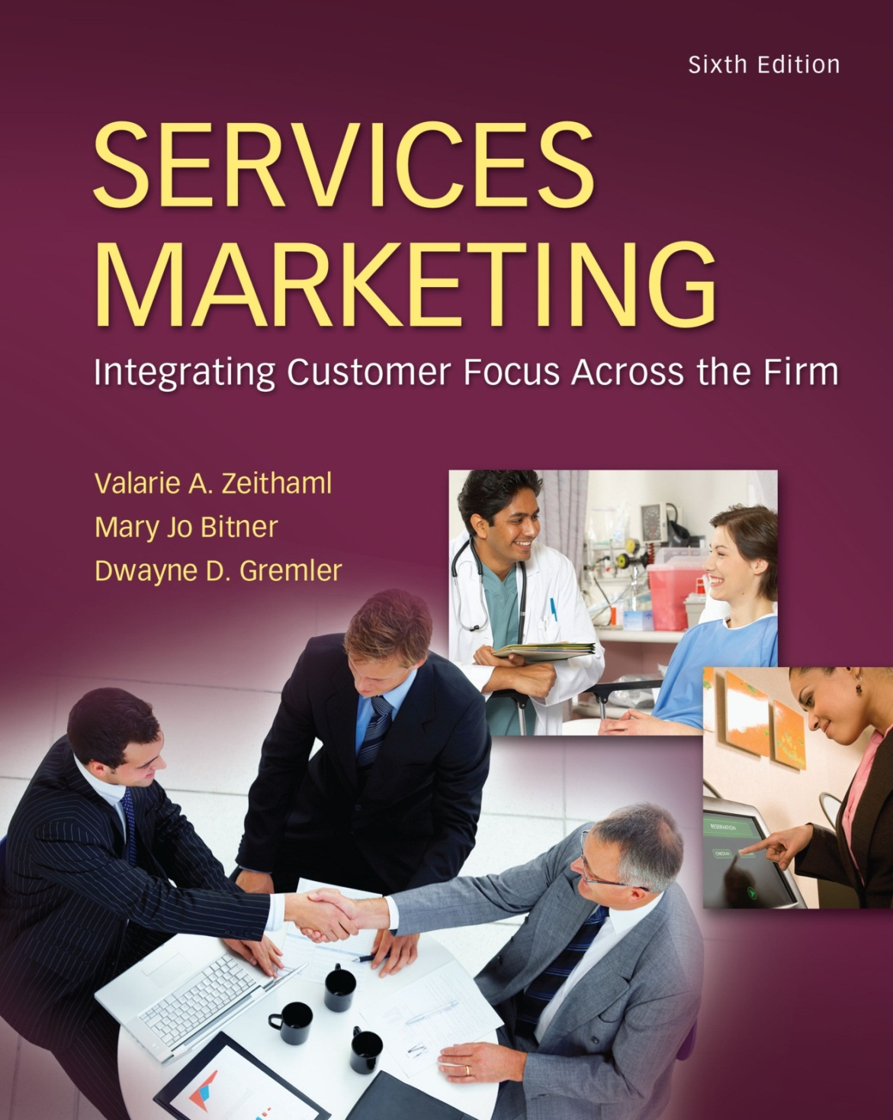
McGraw-Hill/Irwin
Copyright © 2013 by The McGraw-Hill Companies, Inc. All rights reserved.

Slide 2
Building Customer Relationships
Chapter
6
Relationship Marketing
Relationship Value of Customers
Customer Profitability Segments
Relationship Development Strategies
Relationship Challenges
6-2

Slide 3
Relationship Marketing
is a philosophy of doing business, a strategic orientation, that focuses on keeping current customers and improving relationships with them
does not necessarily emphasize acquiring new customers
is usually cheaper (for the firm)
keeping a current customer costs less than attracting a new one
thus, the focus is less on attraction, and more on retention and enhancement of customer relationships
6-3

Slide 4
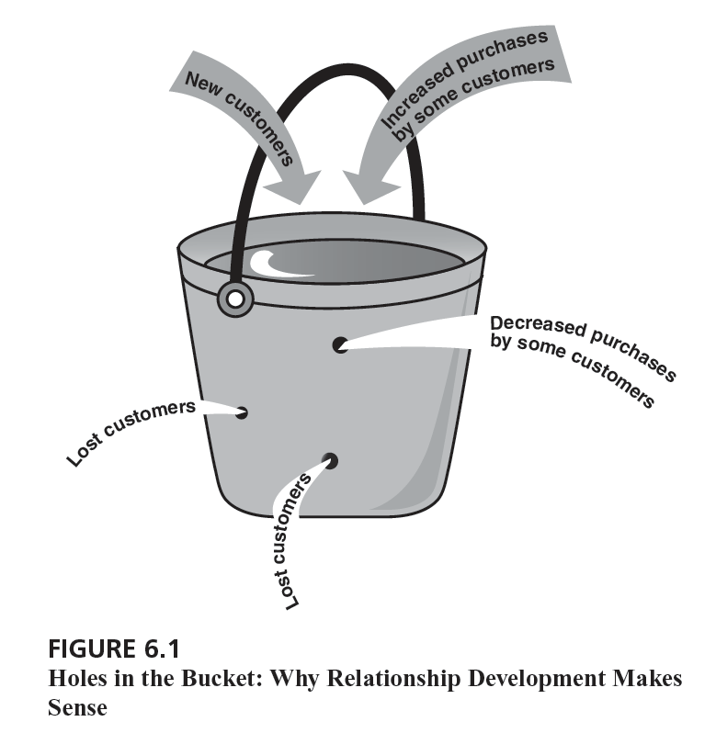
The “Bucket Theory of Marketing”
6-4

Slide 5
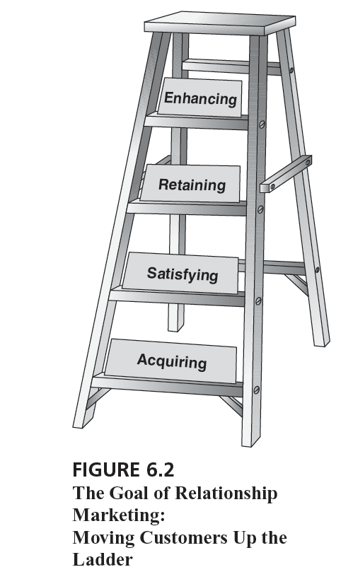
Customer Goals of Relationship Marketing
6-5

Slide 6
Exhibit 6.1: A Typology of Exchange Relationships
Customers as… | Strangers | Acquaintances | Friends | Partners
Product offering | Attractive relative to competitors | On a par with industry standards | Differentiated with adaptation to segments | Customized, individualized offerings
Source of competitive advantage | Attractiveness | Satisfaction | Satisfaction + Trust | Satisfaction + Trust + Commitment
Buying activity (what customer does) | Interest, exploration, trial | Reduced need for search | Buying without perfect information | Commitment in the form of information sharing, specific investments
Focus of selling activities (what firm does) | Encouraging trial facilitates initial selling | Familiarity and general knowledge | Specific segment knowledge | Specific knowledge, idiosyncratic investments
Relationship time horizon | None | Short | Medium: trust takes time to build | Long: detailed knowledge, interconnections
Sustainability of competitive advantage | Low: must continue to attract, induce trial | Low: must build unique value into standard product | Medium: must understand various customer needs | High: depends on uniqueness & effectiveness of interconnections
Primary relationship marketing goal | Acquire customer’s business | Satisfy customer needs | Retain customer’s business | Enhance relationship with customer
6-6

Slide 7
Benefits of Relationship Marketing
Benefits for Customers:
Receipt of greater value
Confidence benefits:
trust
confidence in provider
reduced anxiety
Social benefits:
familiarity
social support
personal relationships
Special treatment benefits:
special deals
price breaks
Benefits for Firms:
Economic benefits:
increased revenues
reduced marketing and administrative costs
regular revenue stream
Customer behavior benefits:
strong word-of-mouth endorsements
customer voluntary performance
social benefits to other customers
mentors to other customers
Human resource management benefits:
easier jobs for employees
social benefits for employees
employee retention
6-7

Slide 8
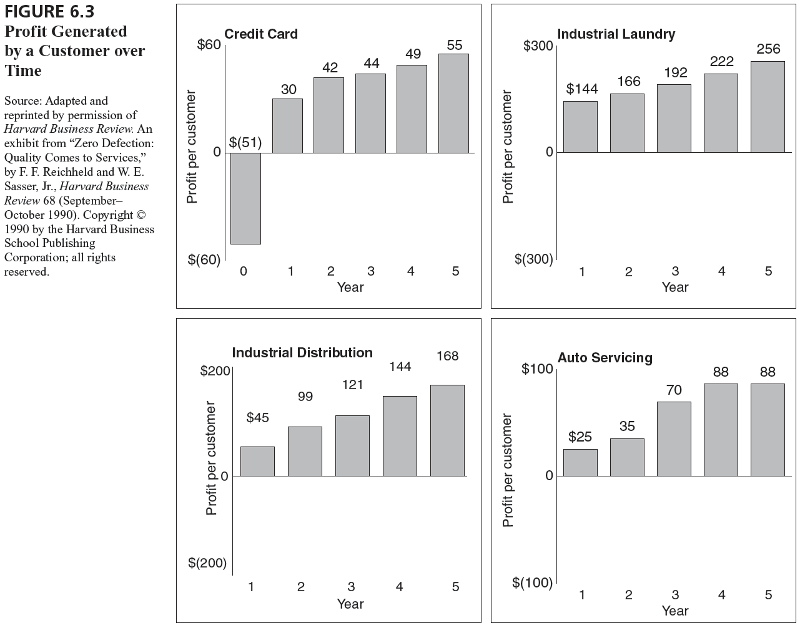
Profit Generated by a Customer over Time
6-8

Slide 9
Customer Loyalty Exercise
Think of a service provider to whom you are loyal.
What do you do (your behaviors, actions, feelings) that indicates you are loyal?
Why are you loyal to this provider?
What factors have influenced the formation of your loyalty?
6-9

Slide 10
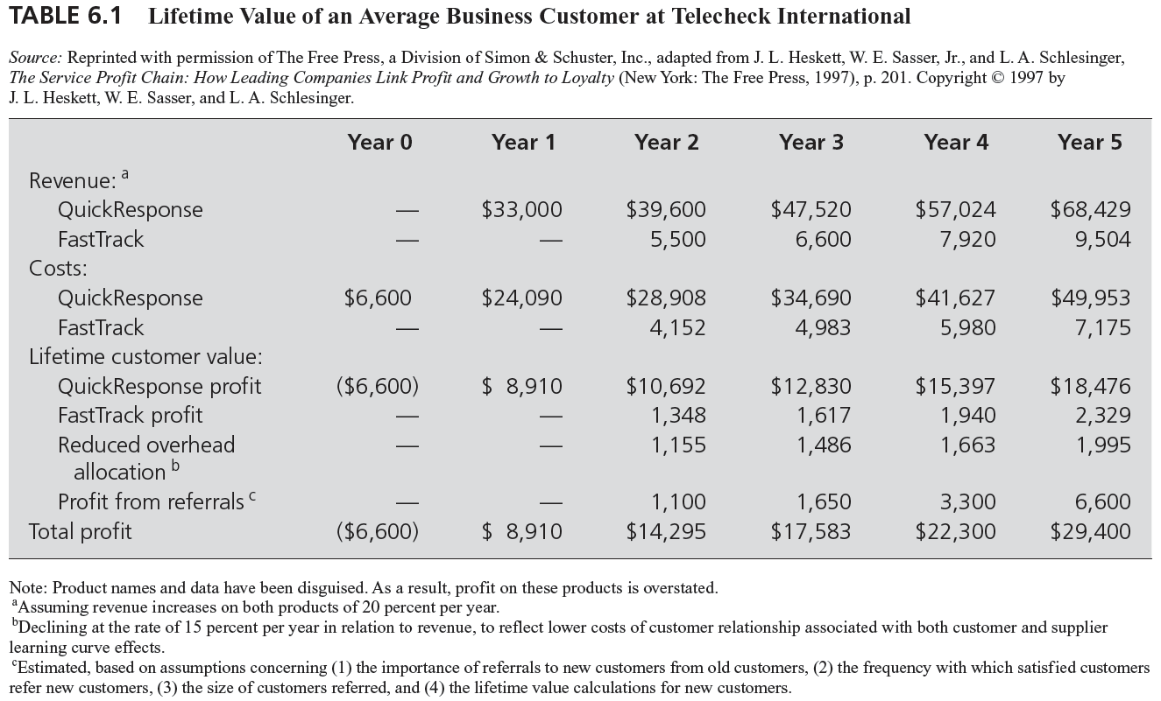
Lifetime Value of a Customer
6-10

Slide 11
Figure 6.4: The Customer Pyramid
Most Profitable
What segment spends more with
Platinum
us over time, costs less to maintain,
Customers
spreads positive word of mouth?
Not as profitable: discounts or less loyal
Gold
Utilize capacity, but do not merit special treatment
Iron
Lead
What segment costs us in
Least Profitable
time, effort and money yet
Customers
does not provide the return
we want? What segment is
difficult to do business with?
6-11

Slide 12
The Customer Pyramid
Platinum Tier | Company’s most profitable customers, typically heavy users of the product, not overly price sensitive, willing to invest in and try new offerings, and committed customers of the firm
Gold Tier | Profitability levels are not as high, perhaps because customers want price discounts that limit margins or are simply not as loyal. May be heavy users who minimize risk by working with multiple vendors.
Iron Tier | Essential customers that provide the volume needed to utilize the firm'’ capacity but their spending levels, loyalty, and profitability are not substantial enough for special treatment
Lead Tier | Customers who are costing the firm money. They demand more attention than they are due given their spending and profitability and are sometimes problem customers—complaining about the firm to others and tying up firm resources.
6-12

Slide 13
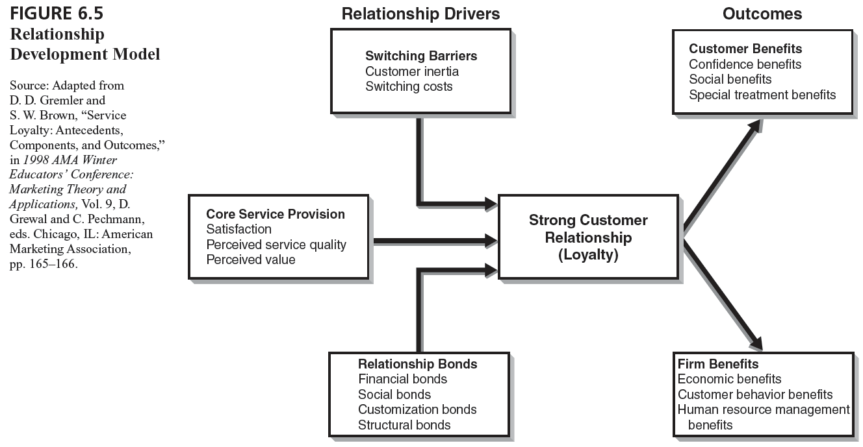
Relationship Development Model
6-13

Slide 14
Strategies for Building Relationships
Core Service Provision:
service foundations built upon delivery of excellent service:
satisfaction, perceived service quality, perceived value
Switching Barriers:
customer inertia
switching costs:
set up costs, search costs, learning costs, contractual costs
Relationship Bonds:
financial bonds
social bonds
customization bonds
structural bonds
6-14

Slide 15
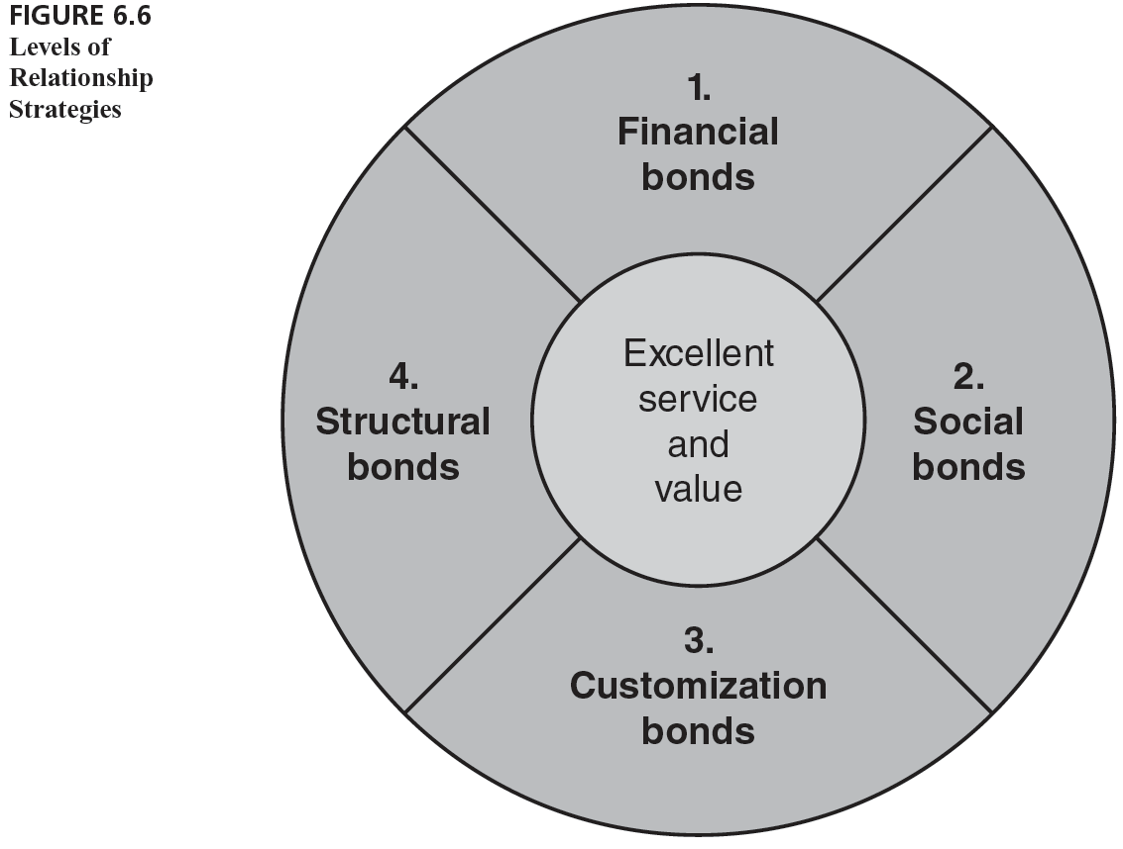
Levels of Relationship Strategies
6-15

Slide 16
“The Customer Is NOT Always Right”
Not all customers are good relationship customers:
wrong segment
not profitable in the long term
difficult customers
6-16

