Slide 1
Voting & Elections

Slide 2
Voting & Democratic Theory
Prospective/Responsible Party
principled parties stand for different choices:ideological
parties should be cohesive & unified, take clear perceptible positions, and carry out their mandates (control their representatives)
problems
positions may not match voters
in reality, American parties are not unified or cohesive, at times positions often vague or identical to other party

Slide 3
Voting & Democratic Theory
Electoral Competition
party takes the most popular position, often similar to the other party’s
purely pragmatic
problems
little voter education on issues
shifts burden to voter and thus depends on their turnout & knowledge of issues
also assumes unified parties

Slide 4
Voting & Democratic Theory
Retrospective/Electoral Reward & Punishment
voters reward or punish incumbents based on performance
assumes little voter knowledge
problems
disaster prone
emphasis on short-term benefits

Slide 5
Which One Correctly Describes American Elections?
Each emphasizes different aspects
ideological differences do exist
American parties famous for their pragmatism
Carter, Bush punished; Reagan, Clinton rewarded

Slide 6
The Vanishing Electorate
For presidential elections (the best case), turnout has dropped to ~60% (vep)

Slide 7
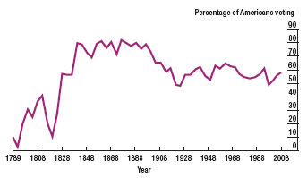
Voter turnout since 1789

Slide 8
Comparative Voter Turnout
Compare US voter turnout to other liberal democracies
International IDEA | Voter Turnout

Slide 9
Who Participates?
Figure 10.3 (p. 286)
older voters
more educated voters
European-American voters
also higher income voters
Republican voters
Whites 75%, blacks 69, Latinos 58, Asians 52

Slide 10
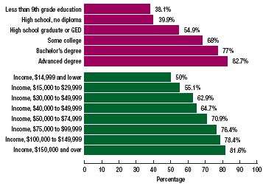
Who votes?

Slide 11
Causes of Non-Voting
Registration laws (67% of voters were registered in 2000)
waiting period
personal appearance at courthouses
purging of rolls
Election day on a work day
Single-member, plurality system
Weakness of parties
Lack of a socialist party

Slide 12
Why Is There No Socialism in the U.S.?
Werner Sombart: roast beef & apple pie (high standard of living)
Jackson Turner Main: the frontier thesis
Louis Hartz: lack of a bourgeois revolution
diversity led to disunity of workers
fragmented union movement

Slide 13
How to Increase Turnout
Ease registration laws
postcard, same-day registration
Put burden on government to register
Make voting more flexible
multiple-day/holiday/weekend voting, broaden absentee voting
Proportional representation
Strengthen parties

Slide 14
The Electoral College
How does it work?

Slide 15
The Electoral College
Advantages
encourages consideration of support from many regions
enhances status of minority groups (small #s may mean many electoral votes)
encourages a 2-party system/discourages 3rd party by winner-take-all
reinforces federalism

Slide 16
The Electoral College
Disadvantages
minority Presidents
faithless Electors
does not encourage voter turnout
distorts the popular will
over-represents rural states
In 1988, 7 smallest states had 21 electoral votes with 3.1 million people while Florida also had 21 with 9.6 million
biased against 3rd parties
exaggerates majorities

