Slide 1
Professional Summary Report
COUNS 7
Notes:
The following is a brief overview of the professional summary report for counseling seven.

Slide 2
Index
Topic |  | Slide number
Index |  | 2
Directions for Report |  | 3
Resources |  | 4-5
Professional Summary Report | Outline | 6
Professional Summary Report | Presentation | 7
Occupational Description |  | 8
Personal Characteristics |  | 9
Work Environment |  | 10
OC Career Café Content |  | 11-15
Myers-Briggs Type Indicator |  | 16-18
Summary of entire report |  | 19
Notes:
The index you see listed here is an example of how you can keep all of your information organized. Each section that you see listed along with its corresponding slide number will help you stay on track with what you need to make sure that you're turning in for your professional summary report. Obviously the exact order and the amount of information that you choose to use is going to be dependent on how you structure your final professional summary report.

Slide 3
Directions for Professional Summary Report
Using various internet websites and the Career Center, research information related to the one occupation that you are the MOST interested in at this time.
This summary report will be graded according to accuracy and thoroughness of your answers.
This Professional Summary Report will NOT be considered complete without all prompts addressed and responded to. Throughout the semester we will have " Professional Summary Report Checkins" to review progress; provide more detail for your submission process and answer your questions.
Notes:
The next three slides are slides that are provided for you to guide you for the completion of the overall professional summary report. This particular slide focuses in on the step by step process you should follow to make sure that you're on track and you will have a completed version of your professional summary report at the end of this term.

Slide 4
RESOURCES NEEDED:
Eureka – https://eureka.org/
CA Career Café - http://www.cacareercafe.com/
O*Net – www.onetonline.org
Notes:
This slide includes three specific resources that you can use as you work to populate your professional summary report. One of the resources is eureka.org it is an excellent tool to be able to use to explore different careers and different career paths. Another resource that you have here is the California Career Café, this is a more local resource that has specific information to our local region. The resource that's listed here last which is oh net on line dot org will provide you with the widest range of information and will more than likely be your primary resource in completing this professional summary report. Reminder that this particular slide does not need to be included in your final report again it is just a resource.

Slide 5
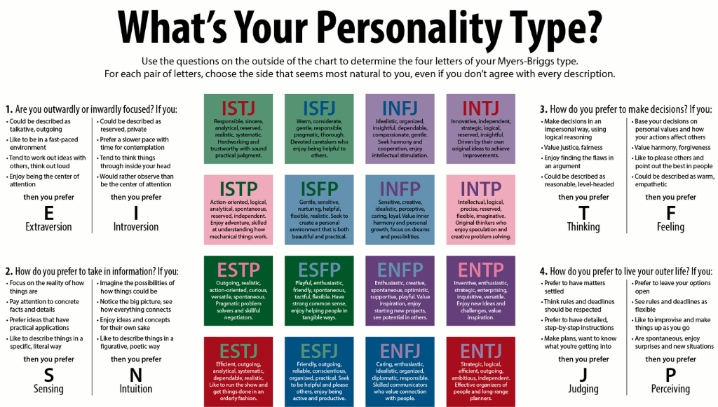
RESOURCES NEEDED:
MBTI Information Packet (completed in class)
Notes:
This slide provides you with a visual of how you can represent your Myers Briggs type indicator results. Again, this is an example of what you can use it is not intended to be used in your final professional summer report but to guide you as to how you would configure or include the information about your specific personality type.

Slide 6
Occupational Description
(Insert your detailed occupational description here)
Notes:
The content that you will put into this slide, identified as "Occupational Description," will be conveniently located or able to be accessed through the O*NETonline tool. You will want to make sure that what's included in this slide is as descriptive to the occupation that you are considering as you possibly can make it.

Slide 7
Personal Characteristics
Above Average Abilities: (Insert your responses here)
Average Abilities:(Insert your responses here)
Characteristics (Personally Enjoy):(Insert your responses here)
Notes:
This slide focuses in on 3 levels of personal characteristics that are specific to your possible career choice. The three levels of personal career characteristics include above average abilities, average abilities, and characteristics that you are going to reflect on from your personal standpoint.

Slide 8
Work Environment
Describe, in detail, the work environment that you will encounter with your selected occupation (I.e.- "As a Park Ranger, the majority of my time is spent outdoors...): (Insert your responses here)
Notes:
As you research your given career, one of the factors that you need to take into consideration is what is considered a common work environment for that career. To find this information you can use one of the three resources noted in slide four and use that detail to populate this specific slide. You can also use a wide variety of other resources that are available through the Internet and through the college's Transfer Center, available online.

Slide 9
OC Career Café Content/ONETOnline
Common Tasks
Describe and list a full set of tasks for your selected occupation indicated on O*Net: (insert here)
Notes:
For this slide what you'll be looking to put is a list it can be in bullet format or otherwise of common tasks you will need to complete in your preferred occupation. The source that you'll be able to pull this information from is either the OC Career Cafe or O*NET online.

Slide 10
OC Career Café/ONETOnline Content
Skills and Technology
Describe and list a full set of skills for your selected occupation indicated on O*Net: (insert here)
Describe and list a full set of technology for your selected occupation indicated on O*Net: (insert here)
Notes:
Using the same two resources in this slide, you want to make sure that you provide a full listing of the skills that are needed for the occupation that you're interested in, as well as a separate list of the current technology that you would either need to learn or already have learned.

Slide 11
OC Career Café Content
RIASEC
Describe and list your full set of interests, based on your RAISEC code: (insert here)
Notes:
This is the slide that you are recording all of your interest inventory information on. You'll be either pulling this information from the O*NET online resource or some other resource available on the Internet. You will record your three letter code along with a description of how your code connects directly with your occupational choice.

Slide 12
OC Career Café Content
Values
Submit your values sort report and summary (insert here):
Notes:
To populate this slide, you will need to complete your Value Sort Self Assessment, either through the occareercafe.org or through Eureka.org (please be aware that to use this tool you will need to use the login that is posted in the file folder in CANVAS). Once you have completed the Value Sort Assessment, you will be provided a summary of your top values. It is this summary along with a statement from you that explains how your values match or align with the values needed in your prospective career.

Slide 13
OC Career Café Content
Alternate Occupations
(For students considering more than one occupation or career field, insert your summaries of each of the careers under consideration here)
Notes:
The content for this slide can be researched either through O*NET online or the OC Career Café. Your goal in this slide is to: 1) identify, at least one, alternative occupation; 2) explain why you chose that occupation; and 3) how it differs or is different to your primary choice.

Slide 14
Myers-Briggs Type Indicator (MBTI) Summary
Your 4 Traits
Record your four letter type here (insert your letters-one in each box):
Provide a brief summary of the qualities and characteristics that you match with your type:
I or E | N or S | F or T | P or J
Notes:
As is indicated in the slide above, first enter your four letter type (ie.-I-N-F-J). Then, provide a brief summary of the qualities and characteristics from your type that either match completely or approximate to your career choice.

Slide 15
Myers-Briggs Type Indicator (MBTI) Summary
Now that you have reviewed your results, provide a brief summary about how your type has shaped your view of your possible career/major:
Notes:
This slide may take more than one paragraph to complete. Because of the detail in your MBTI report, you are being asked to reflect on not only the prime facets (your four letter type-ie.-INFJ), but also, to "dig-deeper" by reviewing your 5 sub-facets (there is a set of five for each facet). As an example, if your prime facet is either Extroversion or Introversion, then the respective subfacets are initiating-receiving, expressive-contained, gregarious-intimate, active-reflective, and enthusiastic-quiet. Each of your primary and sub facets will either have some direct connection to the qualities and characteristics of your future career, or will not. Find those facets/subfacets that do connect and explain how they connect to your career choice.

Slide 16
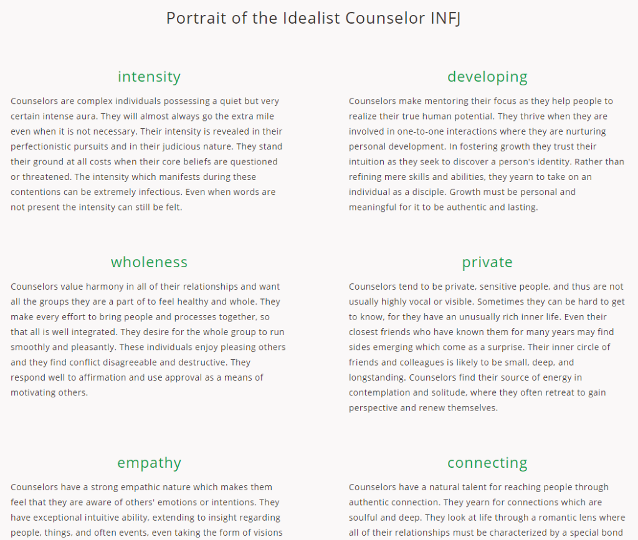
Myers-Briggs Type Indicator (MBTI) Summary
Traditional Temperament for Your Occupation
Using the following link (https://keirsey.com/temperament-overview/) list the six temperament characteristic for you as you plan to apply them to your future occupation:
Sample to be used as a guide for your own summary piece:
Notes:
The Myers-Briggs Type Indicator provides feedback on a general level, your four letter type, and on a more detailed through through the common characteristics of your temperament. Use the link above to identify your specific temperament. Once you have identified your temperament, you can either screen shot it or recreate it in your own creative detail. Above is an example of a posted screen-shot.

Slide 17
Summary of All Four Main Point(s)
Provide a summary of how you reviewed and (if) you found the connections between your personality type, interests, values and skills. Additional points that you should look to include and address in your summary are: The results of your informational interview; any additional research in the Career Center; and reflection from your report presentation. (The length of this summary is not to exceed one type written page)
Notes:
This final slide should be a one page type written summary of your learned experience from completing your Professional Summary Report, reflect on the assessments/inventories you completed; reflect on the introspection that you needed to do find the connections (or if you were not able to find the connections) between the inventory results and your prospective careers; reflect on your experiences in completing you informational interview and how it helped (or did not help) your decision making process to find your preferred career. Then finish with a "Summary of all Summary Statement." Your final summary statement can begin with, "Having completed my Professional Summary Report, I am now able to …..(you complete this statement)."

