Slide 1
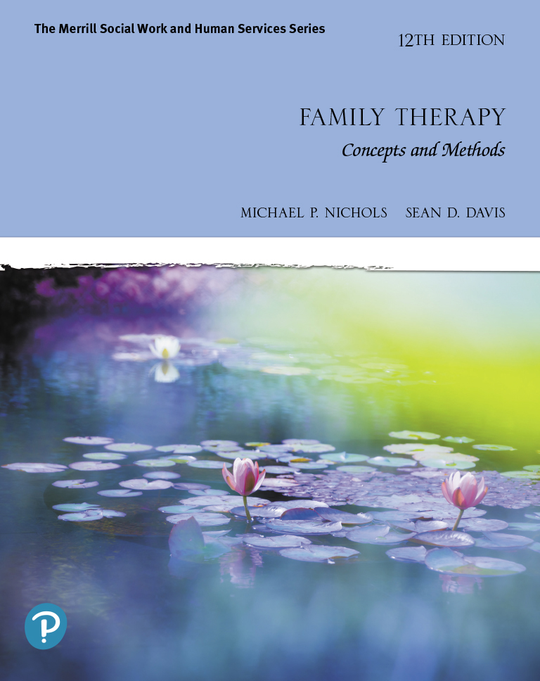
Family Therapy: Concepts and Methods
Twelfth Edition
Chapter 11
Tailoring Treatment to Specific Populations and Problems
Copyright © 2021, 2017, 2013 Pearson Education, Inc. All Rights Reserved
Notes:
If this PowerPoint presentation contains mathematical equations, you may need to check that your computer has the following installed:
1) MathType Plugin
2) Math Player (free versions available)
3) NVDA Reader (free versions available)

Slide 2
Learning Outcomes
11.1 Describe how treatment is tailored to diverse families and contexts.
11.2 Describe the unique needs of minority families.
11.3 Describe clinical approaches for working with specific presenting problems.

Slide 3
Population-Based Approaches
Theories can’t do it all – knowledge of the unique needs of specific populations and problems is often required to deliver effective treatment

Slide 4
Single-Parent Families (1 of 2)
Goals
Strengthen hierarchical position in relation to child(ren)
Become more fulfilled in parent’s own life

Slide 5
Single-Parent Families (2 of 2)
Treatment involves…
Addressing the presenting complaint
Helping parent take more effective charge of child(ren)
Increasing sources of support

Slide 6
African-American Families
“Family” may include kinship network
Search for strength; enlist support
Recognize
Enmeshment with community
Potential anger caused by decades of racism
Potential importance of religion and spirituality

Slide 7
Gay and Lesbian Families (1 of 2)
Unique challenges
Homophobia
Relational ambiguities
Developing support
Probe for signs of belief in cultural stereotypes (including instability)
Legalization of Marriage and obtainment of equal rights

Slide 8
Gay and Lesbian Families (2 of 2)
Requires sensitivity to issues of:
Extreme jealousy
Anger
Coming out (to family)
Create atmosphere of safety to explore shame about needs for affection/intimacy

Slide 9
Transgender Individuals and Their Families
Coming to terms with being transgender can be challenging for the individuals and their families
Appropriate psychoeducation is crucial

Slide 10
Home-Based Services
Involves meeting the family in their home, work, or daily life
Contains four components:
Family support
Therapeutic intervention
Case management
Crisis intervention

Slide 11
Psychoeducation and Schizophrenia
Early beliefs that family dynamics caused schizophrenia have been disproven
Family therapy remains a treatment of choice for helping those struggling with schizophrenia
Approaches focus on providing psychoeducation and support to the family
Achieved by…
Removing blame
Reinforcing family strengths
Sharing information

Slide 12
Medical Family Therapy
Family therapists frequently work in hospitals as part of a collaborative team of other health professionals
Goal is to address family dynamics that may interfere with their overall health
Preparation for dealing with illness
Gain perspective on effects
Examine available resources

Slide 13
Relationship Enrichment Programs
Aimed at proactively helping healthy couples avoid problems
Expressive (Owning) Skill
Empathic Responding (Receptive) Skill
Conversive (Discussion-Negotiation/ Engagement) Skill
Prevention and Relationship Enhancement Program (P R E P)

Slide 14
Discernment Counseling
Mixed agenda couples in which one partner is “leaning out” of the marriage, the other is “leaning in”
Developed as an approach to help couples navigate this dilemma thoughtfully

Slide 15
Recommended Readings
Anderson, C. M., D. Reiss, and B. Hogarty. 1986. Schizophrenia and the Family: A Practitioner’s Guide to Psycho Education and Management. New York: Guilford Press.
Avis, J. M. 1992. Where Are All the Family Therapists? Abuse and Violence within Families and Family Therapy’s Response. Journal of Marital and Family Therapy 18:225–32.
Fontes, L. A. 2008. Interviewing Clients across Cultures. New York: Guilford Press. Fowers, B., and F. Richardson. 1996. Why Is Multiculturalism Good? American Psychologist 51:609–21.
McDaniel, S., J. Hepworth, and W. Doherty. 1992. Medical Family Therapy. New York: Basic Books.
Rolland, J. 1994. Helping Families with Chronic and Life-Threatening Disorders. New York: Basic Books.

Slide 16
Copyright
This work is protected by United States copyright laws and is provided solely for the use of instructors in teaching their courses and assessing student learning. Dissemination or sale of any part of this work (including on the World Wide Web) will destroy the integrity of the work and is not permitted. The work and materials from it should never be made available to students except by instructors using the accompanying text in their classes. All recipients of this work are expected to abide by these restrictions and to honor the intended pedagogical purposes and the needs of other instructors who rely on these materials.

