Slide 1
Implementation and Evaluation of a Health Communication Program
KINE 4355
Dr. Green

Slide 2
Lesson Objectives
Prepare SMART objectives from formative research
Describe workflow and quality factors necessary for content strategy
Develop metrics to monitor program elements
Evaluate the role of evaluation frameworks
Identify the major communication program evaluation designs

Slide 3
An Effective Communication Plan Includes:
An in-depth logic model
Creative concepts
Targeted messages
Media dissemination plans
An operational plan including:
Timeline
Budget
Assignment of responsibility
Criteria to judge the plan’s effectiveness (evaluation)

Slide 4
Planning Tools
The logic model suggests certain activities lead to specific outcomes which leads to projected results
If…then…If…then…If
RE-AIM criteria for planning
Reach: # of individuals willing to participate
Effectiveness: The impact of an intervention
Adoption: # willing to initiate the program
Implementation: fidelity to intervention protocol and use of strategies
Maintenance: Long-term

Slide 8
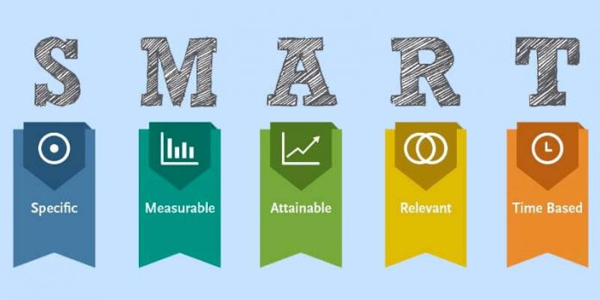
Planning Tools Continued
SMART Objectives
Specific: Objective in concrete terms
Measurable: Quantifiable indicators of objective
Achievable: Are there sufficient resources? Is their adequate time for the target audience to adopt change?
Realistic/Relevant
Time Bound: Reasonable time frame

Slide 9
The Creative Brief
Elements of a Creative Brief
Overview of Project: Short summary of goals
Target audience segment: Detailed description of one unique segment
Objectives: “call to action”
Obstacles: Structural barriers, beliefs, cultural practices, social pressure, or misinformation
Benefit/key promise: important reward, secondary reward
Support statements/reasons: Explains why the target audience should believe the promise
Tone: The feeling or personality. Set by communication strategy
Distribution opportunities: Reaching the audience
Creative considerations: Elements writes and designers should keep in mind
Other elements: Approved routing, timelines, etc.
Notes:
A short document prepared to brief the creative team on the communication plan/project
Takes into consideration the communication channel, activity, and medium

Slide 10
From the Creative Brief to Concepts
Message- the final intended behavior sought of target audiences
The message with all the other information gathered about the audience leads to the concept
The concept grabs the main idea and gives it personality
MAKE SURE TO TEST YOUR CONCEPT!!!
This includes learning what ideas the audience has, whom they see as credible, what media channels they prefer, and if your message has the same meaning to the general audience (can use focus groups, on-line surveys, captive audiences, etc.)

Slide 11
Moving from Concepts to Messages and Materials
Create bundles of words, images, and/or sounds that carry your idea
Match your content to your media channels
Make a realistic plan based on objectives, budget, and staffing limitations
Use Content-Focused Components
Substance: What kind of content do we need?
Structure: How is the content organized?
People-focused components
Workflow: Processes, tools, human resources
Governance: How are key decisions about content made?

Slide 12
Preparing the Work Plan, Timetable and Budget
Defining Partner Roles
Partnering with other organizations to offer additional resources
Budgeting
Trading time for money, direct costs (personnel, vendors, equipment, production services) and indirect costs (time, space, equipment)
Marketing Aspects
Measurement and Evaluation
Include a set of metrics used to evaluate your plan and explain how they will be collected

Slide 13
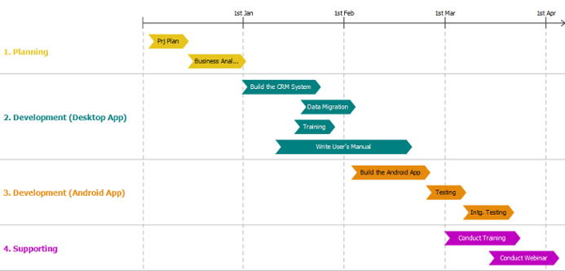
Summary Implementation Plan
Your plan should include these key points:
Background, justification, SWOTE
Audience and communication objectives
Messages, settings, and channels for conveying information
Activities
Available partners and resources
Tasks, timeline, and budget

Slide 14
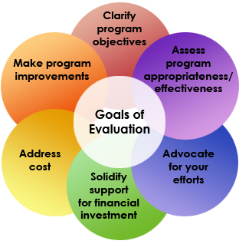
Program Evaluation
Program evaluations have a fixed deadline and discuss the verdict on the value of the program
Can examine the potential for using the program as a model in the future
Can be designed to improve the program over time
The program evaluation process is divided into
Formative
Process
Outcome

Slide 15
Three Central Evaluation Questions
1. Outcome
Are you doing the right things?
Use your input from your audience (pretesting and local community input) and your formative research to increase the likelihood that your efforts are headed in the right direction
Clarify your logic model and your SWOTE analysis
2. Implementation
Are you doing them right?
Evaluation check points throughout (fidelity monitoring)
Measure exposure
3. Impact
Are you doing enough of them to make a difference?
Appropriate sample size
Making sure your audience is diverse
Take into account participant attrition
Having a measure of success

Slide 16
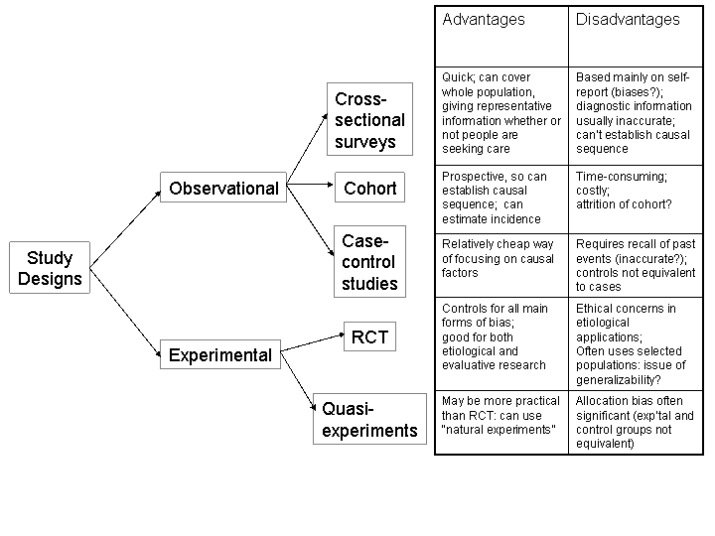
Study Designs
Evidence-based interventions/programs are the most effective
Set limits on conclusions that can be drawn
The choice of qualitative, quantitative, or mixed methods should be driven by the study question
Study Designs Include:
Randomized controlled trials
Quasi-experiments
Correlation studies
Cross-sectional
Longitudinal/cohort

Slide 17
Evaluation Frameworks
The CDC Evaluation Framework
Begins with engaging stakeholders
Choose evaluation outcomes and outcome measures
User-focused
Treats evaluation as an ongoing process
Other Evaluation Frameworks:
RE-AIM- Reach, effectiveness, adoption, implementation, and maintenance
Precede-Proceed: A planning model for communities to set and address public health priorities
Inform/Persuade: Sets out to deliver new information and to motivate the audience

Slide 18
Conclusions
Recommendations for the CDC
Always look for new low-cost data collection strategies
Cognitive test your interview or questionnaire
If there is not an efficacious model program- test it!
Quantify program outputs
Determine when it is time to refresh a campaign or a communication plan
Track intended and unintended campaign effects

