Slide 1
Strategic Games
15
PowerPoint Slides
© Luke M. Froeb,
Vanderbilt 2014

Slide 2
A Nash equilibrium is a pair of strategies, one for each player, in which each strategy is a best response against the other.
When players act rationally, optimally, and in their own self-interest, it’s possible to compute the likely outcomes (equilibria) of games. By studying games, we learn not only where our strategies are likely to take us, but also how to modify the rules of the game to our own advantage.
Equilibria of sequential games, where players take turns moving, are influenced by who moves first (a potential ﬁrst-mover advantage, or disadvantage), and who can commit to a future course of action. Credible commitments are difﬁcult to make because they require that players threaten to act in an unproﬁtable way—against their self-interest.
In simultaneous-move games, players move at the same time.

Slide 3
continued
In the prisoners’ dilemma, conﬂict and cooperation are in tension—self-interest leads to outcomes that reduce both players’ payoffs. Cooperation can improve both players’ payoffs.
In a repeated prisoners’ dilemma, it is easier for players to learn to cooperate. Here are some general rules of thumb:
  Be nice: No ﬁrst strikes.
  Be easily provoked: Respond immediately to rivals.
  Be forgiving: Don’t try to punish competitors too much.
  Don’t be envious: Focus on your own slice of the proﬁt pie, not on your competitor’s.
  Be clear: Make sure your competitors can easily interpret your actions.

Slide 4
Blu-ray
In February 2002, nine electronics companies, led by Sony, announced plans for the next big video recording format: Blu-Ray
By August of that same year, Toshiba and NEC announced plans for a rival technology: HD-DVD
A common standard among all competitors (rather than two rival technologies) would have best benefited consumers.
  With a common standard, demand for the new technology would have grown more rapidly and all producers would have benefitted.
  But some producers would benefitted more than others: Sony would have profited from the choice of Blu-ray while Toshiba would have preferred HD-DVD.
Both sides waged a “standards” war, recruiting big name entertainment groups (such as Disney, Paramount Pictures, HBO, etc.) to take sides. In the end, Blu-Ray won after Walmart announced it would sell only Blu-Ray disc players.

Slide 5
Blu-ray (cont’d)
In a standards war, the profit of one firm depends on the actions of other firms, rivals, consumers, and suppliers.
This type of interdependence is characteristic of games, and we analyze it using game theory.
A “game,” has three elements: players, options/moves available and the payoffs resulting from each combination of moves.
Assuming that each player acts optimally, rationally and selfishly, the likely outcomes, or equilibria, of the game can be computed.

Slide 6
Introduction: Game theory
Aside from telling firms where competition is likely to lead them, game theory can also offer advice to change the rules of the game to one or both player’s advantage.
For Sony and Toshiba, both realized there were two potential equilibria to their game (Blu-ray vs. HD-DVD):
  Consumers, retailers, manufacturers, content providers, etc. would coordinate on one of these standards
  The standards war was the result of each firm attempting to convince the market participants and public that their respective technology would become the standard (competition “for the market”)
Game theory also suggest strategies to reduce competitive intensity to increase profit (“strategy” from ch. 11)

Slide 7
Sequential-move games
In game theory, there are two types of games. The first of which is known as sequential-move games.
  For a sequential-move game, players take turns.
  Each competitor is given the opportunity to evaluate their rival’s move before selecting how to proceed.
To analyze sequential games, use the “extensive-” or “tree-form” of a game, and look ahead and reason back.
  For example, a two-move, two-player game. Player One (moving first) must anticipate the reaction of Player Two to each of One’s possible moves to determine One’s best move
  Equilibrium is when each player chooses a best available move, anticipating how the other will react.

Slide 8
Nash Equilibria
Named for John Nash, mathematician and Nobel laureate in economics.
  Nash is known as the “father” of non-cooperative game theory
  He proved the existence of equilibrium in all well-defined games in his doctoral dissertation at Princeton.
Definition
  A set of strategies, one for each player, such that no player has incentive to unilaterally change her action.
  Players are in an equilibrium if a change in strategies by any one of them would lead that player to earn less than if she remained with her current strategy.

Slide 9
Entry “game”
Suppose a potential entrant is deciding whether to enter an industry in competition with an incumbent firm/monopoly.
If the entrant decides to enter the industry, the incumbent has two paths of action:
  Accommodate the entry; or
  Fight the entry.
By modeling the situation using game theory, we find that accommodating an entrant leads to profits while fighting an entrant leads to losses.

Slide 10
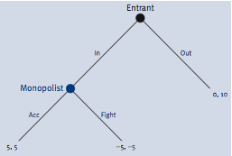
Modeling entry decision

Slide 11
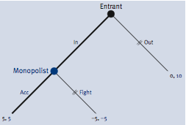
Modeling entry decision (cont’d.)
To find the best strategy in a sequential game put two lines through the paths that present suboptimal choices.
In this game, equilibrium is {In, Acc}:

Slide 12
Deterring Entry
Part of game theory is figuring out how to change the game to your own advantage.
  In the current game, if the incumbent firm can deter entry, it would earn $10 profit, instead of only $5.
One way of deterring entry is to threaten (in such a manner as to be truly believable) to “commit” to fight the entry and price low.
  To model this commitment, take away one of the incumbent’s options, the ability to accommodate entry.
By committing to fight entry, the incumbent can benefit, even though the incumbent would be worse off if entry did occur, and the incumbent had to fight.
  In other words, the best threat is one you do not have to use.

Slide 13
Types of games: Simultaneous-move
The second type of game is simultaneous-move. In this type of game players move simultaneously.
  This does not literally require players moving at same time, just that each player plans a move without knowing the other player’s move in advance
To analyze a simultaneous-move game we use a matrix or “reduced-form” of the game.
Again the likely outcomes are Nash equlibria, where no player has an incentive to change, i.e., each player is doing the best they can.

Slide 14
Simultaneous-move games (cont’d.)
In a two-player game, each player’s payoffs can be modeled in a table/matrix by assigning player One to choose row strategies and player Two to choose column strategies.
If player one’s strategy payoffs are in rows 1,2,3,4,5 and player two’s strategy payoffs are in columns A,B,C,D,E then the actual payoff can be found by locating the cell in which the two strategy decisions (row, column) meet.
Compute Nash Equilibrium by finding pairs of strategies where both players are choosing the best possible response to their competitor’s strategy

Slide 15
Modeling simultaneous-move games
Player Two
 | A | B | C | D | E
1 | 9, 9 | 7, 1 | 5, 6 | 3, 4 | 1, 1
2 | 7, 8 | 5, 2 | 3, 6 | 1, 4 | 3, 3
3 | 5, 6 | 3, 3 | 1, 8 | 9, 7 | 1, 5
4 | 3, 9 | 1, 9 | 9, 4 | 7, 9 | 5, 9
5 | 1, 2 | 9, 8 | 7, 7 | 5, 6 | 3, 7
Player One

Slide 16
Analyzing simultaneous-move games
For player one:
  For each of player Two’s strategies (each column), select the row (underline it) that maximizes One’s profits.
  For example if Two plays column A, One would do best to use strategy 1, which earns a nine dollar payoff. For each column underline player one’s best response.
For player two:
  Examine each of player One’s strategies (each row) and select the column strategy that maximizes player Two’s profits
  For example on row 4, player Two would be indifferent between A,B,D, and E because each earns a $9 payoff. Underline all four best responses.
To find the game equilibria, locate the cell (or cells) in which both numbers have been underlined—these are best responses to each other.

Slide 17
Finding Equilibria
Player Two
 | A | B | C | D | E
1 | 9, 9 | 7, 1 | 5, 6 | 3, 4 | 1, 1
2 | 7, 8 | 5, 2 | 3, 6 | 1, 4 | 3, 3
3 | 5, 6 | 3, 3 | 1, 8 | 9, 7 | 1, 5
4 | 3, 9 | 1, 9 | 9, 4 | 7, 9 | 5, 9
5 | 1, 2 | 9, 8 | 7, 7 | 5, 6 | 3, 7
Player One
This game has three equilbria, where each player is responding optimally to their rival, i.e., neither player has incentive to change strategy

Slide 18
The prisoners’ dilemma game
The police suspect that Frank and Jesse robbed a bank, but they have no direct evidence. They picked them up in their car, a parole violation which carries a sentence of two years. The US attorney offers both the same deal:
  If only one confesses, the one who confesses goes free, while the other one receives ten years in jail.
  If they both confess, each receives five years in jail.
  If neither confesses, they both serve two years for violating parole.
Frank
Jesse
 | Confess | Say nothing
Confess | -5 , -5 | 0 , -10
Say nothing | -10 , 0 | -2 , -2

Slide 19
Why the PD is interesting
The only equilibrium is for both to confess and serve five years
But BOTH would be better off if neither confessed
By following self interest, the players thus make the group worse off
The tension between conflict (self interest) and cooperation (group interest) is inherent in the prisoners’ dilemma game.
If the players/prisoners could cooperate, they make themselves better off.
  Prosecutors separate defendants for precisely this reason, i.e., to make cooperation more difficult.

Slide 20
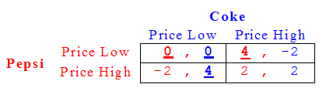
The Prisoners’ Dilemma in business
A pricing dilemma frequently faced by businesses selling substitute products has the same logical structure as the prisoners’ dilemma
  Two competing firms would both be better off if they could price high
    BUT that outcome is not an equilibrium
  If the competing firms could “coordinate” pricing, they would make themselves better off.
    BUT beware of violating antitrust laws

Slide 21
Don’t break the antitrust laws
Advice from an antitrust prosecutor:
  Do not discuss prices with your competitors. That is one of those “black-and-white,” areas. The enforcement authorities can be counted on to bring a criminal prosecution if they learn that you have met with you competitors to fix prices or any other terms of sale. Jail time is increasingly common.
Other illegal solutions to the prisoners’ dilemma are to allocate customers, rig bids, or agree not to compete in each other’s areas. Again the advice is:
  Do not agree with your competitor to stay out of each other’s markets. It may be tempting to seek freedom of action in one part of the country by agreeing with a competitor not to go west if he will not come east. Avoid that temptation. The consequences of the discovery of such behavior by the enforcement authorities are likely to be the same as the unearthing of a price-fixing conspiracy.

Slide 22
A (potentially) legal solution
One way to break the prisoners’ dilemma pricing (low, low) is for the two competing firms to merge.
HOWEVER, if the only incentive to merge is to eliminate competition, the merger may violate antitrust laws.
The Clayton Act outlaws any merger that substantially lessens competition, and a merger to get firms out of a prisoners’ dilemma could be viewed as anticompetitive.
Rule of thumb: Your merger is not likely to be challenged by the competition agencies if (i) there is a pro-competitive justification for it; (ii) if it is not likely to result in higher prices; and (iii) if customers are not complaining about its anticompetitive effects

Slide 23
The price discrimination dilemma
Price discrimination by one firm is always profitable. However, when competing against other firms, price discrimination sometimes becomes a prisoners’ dilemma
Example
  Supermarkets and pizza delivery joints will circulate coupons to customers who live close to their competitors. Many other businesses use similar techniques
  In each case, rivals would likely react by offering lower prices to the customers living near rivals, and the resulting price is much lower than if they had not begun to discriminate in the first place

Slide 24

Price discrimination dilemma (cont’d.)
This table shows the resulting equilibrium between two competing grocery stores that are discriminating by geography (offering discounts to consumers who live near rivals).
The Nash equilibrium {price discriminate, price discriminate} is for both to earn zero.

Slide 25
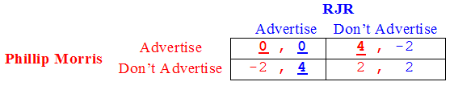
Advertising dilemma
In advertising too, there is a dilemma firms face that can be modeled after the prisoners’ dilemma.
For these two cigarette companies, both could make more money by not advertising, BUT given the share-stealing nature of the advertisements (structured to steal market share from rivals rather than increase demand) the {don’t advertise, don’t advertise} cell is not an equilibrium – either firm does better by advertising

Slide 26
The free-riding dilemma
An MBA study group is assigned a project. Each member can work hard or shirk. If both work hard, they get A’s; if both shirk they get C’s; if only one works hard they both get B’s.
Suppose their preferences are identical:
  Shirk and a B is preferred to
  Work and an A which is preferred to
  Shirk and a C, which is preferred to
  Work and a B.

Slide 27
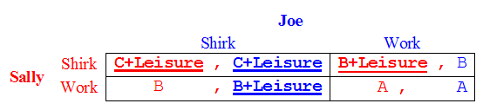
The free-riding dilemma (cont’d.)
Given the preferences of each student, we see that this game has the same logical structure as a prisoners’ dilemma.
The Nash equilibrium is (shirk, shirk) – BUT, as any student will verify, this outcome is inefficient, the students would jointly prefer {work, work} outcome (and the resulting “A”).
This outcome is not an equilibrium though, once your partner is working hard, the best response is to shirk.
A successful study group finds a way to manage this conflict and avoid the {shirk, shirk} equilibrium

Slide 28
Lessons of Prisoners’ Dilemma
Don’t get caught in one
  Change the payoff structure of game so your profits are not dependent
  on others’ actions
    Differentiate the product so that it can’t be easily imitated
    Find a way to lower cost
How to get out of repeated one (based on Axelrod’s Tournament)
  Be nice: no first strikes
  Be forgiving: don’t punish competitors too much if they defect from
  the cooperative outcome
  Be easily provoked: respond immediately to rivals.
  Don’t be envious: focus on your strategy and market share
  Be clear: make sure your competitor can easily interpret your actions.
Control competition LEGALLY!!

Slide 29
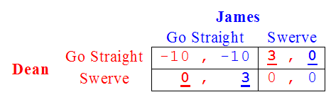
The game of chicken
The classic game of “chicken” has two equilibria:
Dean can make himself better off by committing to going straight (which changes a simultaneous-move game into a sequential move game with a first-mover advantage).
Coordination is REALLY important in this game.

Slide 30
Game of Chicken (cont’d.)
By committing to going straight, Dean exploits the inherent first-mover advantage. If James moves first and selects “straight,” Dean is forced to swerve.
But convincing your competitor that you have committed to a position can be difficult
Do you have to hit him to convince him you are going straight?

Slide 31
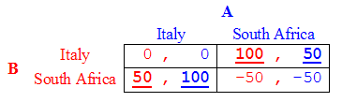
The game of chicken in business
In 2000, a company (A) was deciding between Italy and South Africa as locations for which to develop a new strain of hybrid grapes.
The Italian market was bigger so A preferred Italy as a growing site, but A’s only competitor (B) was facing the same choice for the same strain of grapes.
Both would prefer to be the sole entrant, and both would prefer Italy to South Africa.
This is essentially a game of chicken.

Slide 32
Growing grapes (cont’d.)
If A can find a way to move first and go into Italy, B will choose S. Africa

Slide 33
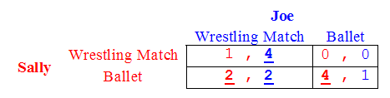
The dating game
The dating game is motivated by the following story: Sally likes ballet. Joe likes wrestling. They both like each other. They would prefer to be together regardless of event. But the equilibrium is for them to attend separate events
To increase payoffs, Sally and Joe could agree to rotate event attendance. Ballet one week, wrestling the next – this would allow for a higher group payoff (sum of their individual payoffs), but this solution is possible only if the game is repeated.

Slide 34
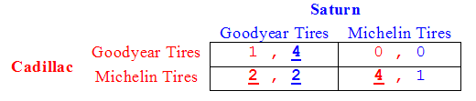
The dating game (cont’d)
Using the dating game firms can also analyze the tension between different divisions of a corporation.
For example: Saturn and Cadillac, both divisions under General Motors.
Both receive a volume discount when buying tires from a single supplier. BUT each has their own preference: Saturn, Goodyear tires; Cadillac, Michelin. This conflict will end up negatively affecting the entire corporation and will be re-examined later (in a chapter devoted to divisions of firms)

Slide 35
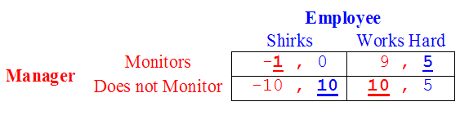
Shirking/Monitoring Game
How to manage workers can be seen as a game between the employer and employee.
This game has no equilibrium in “pure strategies”
  Instead, players randomly choose actions, called “mixing”
  Idea is to keep your opponent guessing
  The employer could combine random monitoring with an incentive based compensation scheme – such as rewarding the employee with a bonus when/if the employer finds her hard at work.
  Or if found shirking, the employer could dismiss, demote or fine the employee

Slide 36
Title?
In 1992, America Airlines (AA) announced a new pricing strategy - Value Pricing.
  American narrowed the number of fares possible from 500,000 to 70,000 by classifying each into one of four classes (first class, coach, discounted 7 and 21 day purchase) and began pricing based on flight length.
  Changes resulted in lower list prices for both business and leisure travelers.
According to AA, Value Pricing was to create “simplicity, equity, and value” in their prices
Company expectations
  Demand would be stimulated
  Volume on AA planes would increase
  Overall growth in market share and profitability would follow
What really happened??
  Competitors responded aggressively by cutting prices
  Industry profits plummeted
  Value Pricing initiative abandoned within months of its launch

