Slide 1
© 2018 Cengage Learning®. May not be scanned, copied or duplicated, or posted to a publicly accessible website, in whole or in part.

Slide 2
Social Media
13
© 2018 Cengage Learning.® May not be scanned, copied or duplicated, or posted to a publicly accessible website, in whole or in part.

Slide 3
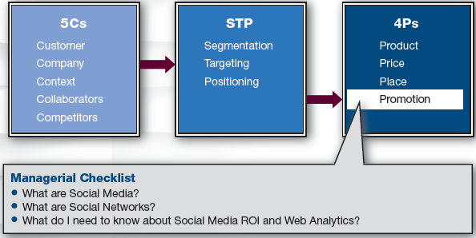
Marketing Framework

Slide 4
Discussion Question #1
Describe a social media campaign in which you have participated.

Slide 5
What Are Social Media?
Social media
  People interacting and connecting with others via online software or alternative electronic access technologies
Traditionally, customers were recipients
With social media, customers now have dialogue with brands
    Customers post endorsements and vent
    Marketers have less control

Slide 6
Media Trends
Social media and mobile marketing are growing
Newspapers and magazines are declining
The number of radio stations is growing,
but consumers listen less
The number of TV channels is growing
  Fragmented audience facilitates targeting

Slide 7
Social Media Properties/Types
Some social media
  Offer very rich, vivid sensory experiences: e.g., Virtual worlds, video games
  Are simple: e.g., Blogs, forums
  Are primarily social: e.g., Facebook
  Are industrious: e.g., Wiki, LinkedIn
  Vary in commerciality: e.g., Facebook has social content and ads for revenue

Slide 8
Discussion Question #2
Given the previous slides and a limited budget, how might you promote the launch of a new designer clothing label?

Slide 9
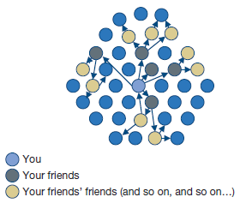
Word-of-Mouth
(slide 1 of 2)
Social media facilitates word-of-mouth
  Word-of-mouth is powerful and credible
    Going viral; creating buzz

Slide 10
Word-of-Mouth
(slide 2 of 2)
Word-of-mouth works well with
  Exciting products
  Clever ad campaigns
    Humor, free give-aways, social causes
      e.g., Geico Gecko has Facebook friends
  Extraverted consumers
    Consumers with large social networks

Slide 11
Social Networks
Sociogram: networks in graphical form
  The set of actors and relational ties
  Actors may be customers, firms, brands, etc.
  Ties can be symmetric
    e.g., Joe and Sally are coworkers
  Ties can be directional
    e.g., Joe likes Sally
  Ties vary in strength
  Network analysis requires tabular representation (sociomatrix)

Slide 12
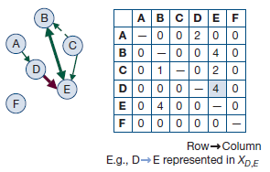
Social Network Example
Strong mutual link between actors B and E
Weak unidirectional link from C to B
F is isolated
B, C, and E form a group

Slide 13
Identifying Influentials
(slide 1 of 3)
In social networks, some members are more connected & influential than others
  Goal is to locate highly influential members, induce their trial of products, and propel the diffusion process
Locating central members
  Centrality indices are computed for each actor in the network to describe the position of that actor relative to the others

Slide 14
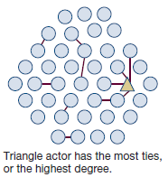
Identifying Influentials
(slide 2 of 3)
Centrality: Number of connections each actor has with the others
Centrality index
  Central = many links
  Peripheral = fewer links

Slide 15
Identifying Influentials
(slide 3 of 3)
Cliques
  Groups of people in the network
  Common in brand communities, affinity groups, cell phone friend networks, etc.

Slide 16
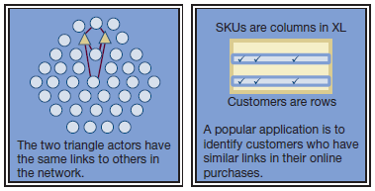
Recommendation Systems
(slide 1 of 2)
Structural equivalence
  Two customers are equivalent if their purchase patterns are the same
    Used in recommendation agents

Slide 17
Recommendation Systems
(slide 2 of 2)
Result of social media
  Data of purchase patterns or ratings are aggregated over many people
    Customers trust online recommendations
    It is more authentic than advertising
Resistance
  Conservative, older CEOs don’t spend money on something they don’t understand

Slide 18
Social Media ROI
Social media seems free but is not
  Main cost may be salaries for thought and labor
Key performance indicators (KPIs)
  Reach, frequency, monetary value of customers, customers’ behaviors, attitudes, memory, etc.

Slide 19
Social Media ROI: Awareness
Pre-purchase: awareness
  Reach can be achieved via
    Traditional media and measured online
      e.g., Magazine tells reader to learn more by going to a particular Web page
    Online and measured online
      e.g., Web ads, search engine status
  Media that optimize reach
    Twitter, Facebook, YouTube

Slide 20
Social Media ROI: Brand Consideration
(slide 1 of 3)
Pre-purchase: brand consideration
  Offer more information to build knowledge and persuade
  Use media that give more content
    e.g., Search engine ad placement, podcasts, post information in brand community, give customer testimonials

Slide 21
Social Media ROI: Brand Consideration
(slide 2 of 3)
Pre-purchase: brand consideration (continued)
  Search engine optimization (SEO)
    Consumers search when they don’t have a preferred brand
    Keywords depend on customer knowledge
  To improve SEO
    Put meaningful keywords in Web page title
    Order the words with most important first

Slide 22
Social Media ROI: Brand Consideration
(slide 3 of 3)
Pre-purchase: brand consideration (continued)
  Key Web analytics
    Frequency: number of visits and number of unique visitors
    Duration: time spent per page and overall time spent on the site
      Bounce rates: percent of one page visits
      Conversion rates: when a visitor transitions from a looker to a doer

Slide 23
Social Media ROI: Purchase/Behavior
(slide 1 of 3)
Purchase/behavioral engagement
  Induce any action that engages the prospective customer
    What do they open, what do they download?
    Do they watch demos that may be available?
    How much time are they spending on which purchase-related pages?
    Do they register to subscribe to newsletters?
  Instead of “Contact Us” marketers prefer forms that capture specific information

Slide 24
Social Media ROI: Purchase/Behavior
(slide 2 of 3)
Purchase/behavioral engagement (continued)
  KPIs may include
    Number of posts about the brand
    Audience build as measured by incoming links and the speed of that growth
    Conversion rates: frequencies of Web visitors to engage in the focal behavior relative to the number of visitors who come to the website

Slide 25
Social Media ROI: Purchase/Behavior
(slide 3 of 3)
  Costs of the actions depend on goals
    Estimates of acquisition costs; payment for placement in search engines or banner ads, sending emails from a rented address database, etc.
  Effectiveness of actions can be assessed by frequencies, rates, and durations

Slide 26
ROI for Social Media: Post-Purchase
Post-purchase
  Satisfied customers
    Customers may post positive reviews, give
    endorsements, etc.
  Dissatisfied customers
    Company can read complaints, address issues, give incentives, etc.

Slide 27
How to Proceed
(slide 1 of 3)
Engaging in all social media is not desirable
Some media fit marketing goals and target market better than others
Social media require maintenance and constant activity

Slide 28
How to Proceed
(slide 2 of 3)
Companies can learn by lurking or Web crawling
  Monitoring tweets, blogs, and discussions
  Analyzing text on Facebook to understand customers’ opinions about brands
    Search brand’s page or search for brand name on other postings
  Analyzing content to detect consumer trends
  Checking websites for misinformation

Slide 29
How to Proceed
(slide 3 of 3)
Companies can actively create interventions
  Enter online communities and ask for volunteers for beta testing
  Experiment to measure the effect of changes in the marketing mix
  Measure attitudes, click-through rates, sign-up rates, etc.
  Use GPS data to track customers and give offers

Slide 30
Discussion Questions #3
You are a marketing manager for Nike. Discuss a social media plan to
  Learn about your customers.
  Encourage trial.

Slide 31
Managerial Recap
(slide 1 of 2)
Social networks are an important and provocative channel
Social media are Web-based means of interacting with others by posting opinions, pictures, and videos
Social networks are the structures of interconnections among customers that propagate word-of-mouth

Slide 32
Managerial Recap
(slide 2 of 2)
Networks can be analyzed
Social media ROI and KPIs can be computed with the help of online analytics after the marketing goals are understood

