Slide 1
Family Therapy: Concepts and Methods
Twelfth Edition
Chapter 2
The Fundamental Concepts of Family Therapy
Copyright © 2021, 2017, 2013 Pearson Education, Inc. All Rights Reserved
Notes:
If this PowerPoint presentation contains mathematical equations, you may need to check that your computer has the following installed:
1) MathType Plugin
2) Math Player (free versions available)
3) NVDA Reader (free versions available)

Slide 2
Learning Outcomes
2.1 Describe the main tenets of cybernetics.
2.2 Describe the main tenets of systems theory.
2.3 Describe the main tenets of social constructionism.
2.4 Describe the main tenets of attachment theory.
2.5 Describe contemporary working concepts of family therapy.

Slide 3
Cybernetics (1 of 5)
“Study of machines that regulate themselves”
Behavior in families is consistent
Change in families is very difficult
Feedback loops
How a system gets information necessary to maintain a steady state

Slide 4
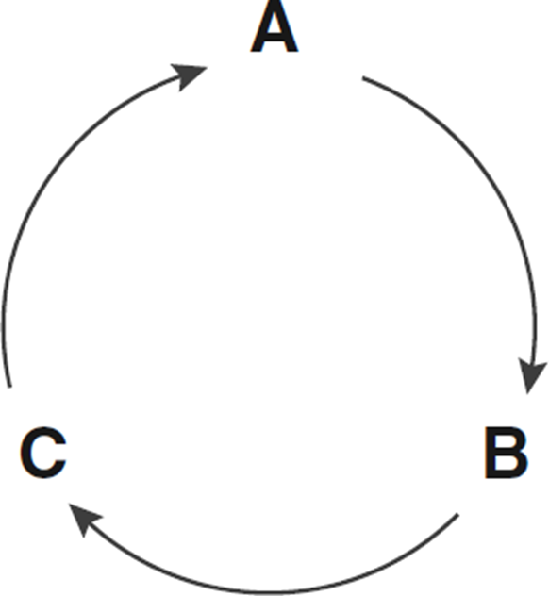
Figure 2.1 Circular Causality of a Feedback Loop

Slide 5
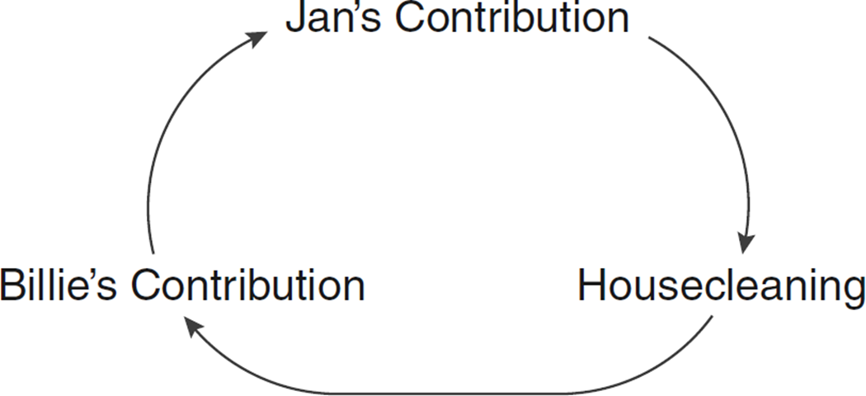
Figure 2.2 Feedback Loop in Couple’s Housecleaning
Notes:
Jan’s contribution to housecleaning informs how much Billie contributes to housecleaning, which in turn affects how much Jan contributes to housecleaning.

Slide 6
Cybernetics (2 of 5)
Introduced by Gregory Bateson
Cybernetics focuses attention on:
Family rules that govern the family’s homeostatic range
Negative feedback/mechanisms that families use to enforce those rules

Slide 7
Cybernetics (3 of 5)
Cybernetics also focuses on:
Sequences of family interaction around a problem; characterize system’s reaction to it
What happens when the system’s negative feedback is ineffective
Triggering positive feedback loops

Slide 8
Cybernetics (4 of 5)
Examined negative feedback
Mechanisms used to enforce family rules
And positive feedback loops (when negative feedback is ineffective).
Positive feedback loops destroy a system or can help it adjust to changed circumstances

Slide 9
Cybernetics (5 of 5)
Oriented-Therapists strive for:
Second-order change, distinguishing it from first-order change
Second-order change – change in the family rules
First-order change – family changes behavior, but is still governed by the same rules

Slide 10
Systems Theory (1 of 2)
System
“An organized group of elements that function as a single entity”
Family is more than a collection of individuals;
It is an organized network of relationships

Slide 11
Systems Theory (2 of 2)
Systems can be understood by looking at process and structure
Process: patterns of interaction
Structure: the arrangement of the interacting components
Linear versus circular causality

Slide 12
General Systems Theory (1 of 2)
Developed by Ludwig von Bertalanffy
Critical of cybernetics
Believed science had become reductionistic
i.e., looking at a machine’s parts without examining its relationship to other parts

Slide 13
General Systems Theory (2 of 2)
Many of his ideas include:
Concept of a system as more than the sum of its parts.
Emphasis on systems as subsystems of larger systems.
Thinking interaction and studying whole systems.
Open systems.

Slide 14
Constructivism (1 of 2)
Epistemological paradigm according to which knowledge is:
Actively construed by the observer.
Implications for family therapy are:
Greater emphasis on cognition.
Greater emphasis on the subjective experience of individual family members.

Slide 15
Constructivism (2 of 2)
Moved family therapy in direction of individuals’ cognitive experience
And away from traditional emphases of family therapy.
Emphasis on reframing:
Relabeling behavior to shift how family members respond to it.

Slide 16
Social Constructivism
Expands constructivism
Takes into account the way we perceive & relate to the world
Shaped by our social context
Deconstructing unhelpful narrative
Helping people reconstruct more promising ways of looking at things

Slide 17
Attachment Theory (1 of 5)
Explains how even healthy adults need to depend on one another
Attachment means seeking closeness in the face of stress
Infants use their attachment figure (usually their mother) as a secure base for:
Exploration of the world

Slide 18
Attachment Theory (2 of 5)
Attachment theory is applied to clinical treatment by linking:
Symptomatic expressions of fear and anger to disturbances in attachment relationships.
Infant relationships with caregivers and attachment behavior.

Slide 19
Attachment Theory (3 of 5)
Attachment Styles
Secure Attachment
Confident in their interactions with the world.
Comfortable expressing needs.
Insecure Attachment
Anxious : fear of abandonment, clingy.
Avoidant : cut-off, distant, aloof.

Slide 20
Attachment Theory (4 of 5)
Successful in outlining treatment for couples.
Implemented in E F T.
Used to deconstruct the dynamic in which one partner criticizes and complains while the other gets defensive and withdraws.
Attachment theory views complaints and criticism as protests against disruption of the attachment bond.

Slide 21
Attachment Theory (5 of 5)
Using attachment theory to understand patterns in couples.
Pursue/withdraw pattern
Typically seen with anxious/avoidant partners.
Attachment theory makes connection between person’s pursuing and distancing behavior to the underlying desire for connection and security.

Slide 22
Concepts of Family Therapy (1 of 5)
Complementarity:
Refers to the reciprocity which is defining feature of every relationship
Interpersonal context: a person’s behavior is influenced by interactions with the family

Slide 23
Concepts of Family Therapy (2 of 5)
Circular causality
Accounts for communication and relationships in explanation of causality
Family structure: idea that families can be understood by assessing the
Boundaries between various subsystems within them.

Slide 24
Concepts of Family Therapy (3 of 5)
Triangles: when two people cannot solve a problem between themselves
They will pull in a third party;
Understanding triangular nature expands the therapist’s lens; intervention possibilities
Process/Content
Family Structure

Slide 25
Concepts of Family Therapy (4 of 5)
Family Life Cycle
Family Narratives
Help people identify oppressive stories
And co-create with them new, more empowering accounts of their lives

Slide 26
Table 2.1 Stages of the Family Life Cycle (1 of 4)
Family Life-Cycle Stage | Emotional Process of Transition: Key Principles | Second-Order Changes in Family Status Required to Proceed Developmentally
Leaving home: single young adults | Accepting emotional and financial responsibility for self | a. Differentiation of self in relation to family of origin b. Development of intimate peer relationships c. Establishment of self in respect to work and financial independence
The joining of families through marriage: the new couple | Commitment to new system | a. Formation of martial system b. Realignment of relationships with extended families and friends to include spouse

Slide 27
Table 2.1 Stages of the Family Life Cycle (2 of 4)
Family Life-Cycle Stage | Emotional Process of Transition: Key Principles | Second-Order Changes in Family Status Required to Proceed Developmentally
Families with young children | Accepting new members into the system | a. Adjusting martial system to make space for children b. Joining in childrearing, financial and household tasks c. Realignment of relationships with extended family to include parenting and grandparenting roles
Families with adolescents | Increasing flexibility of family boundaries to permit children’s independence and grandparents’ frailties | a. Shifting of parent-child relationships to permit adolescent to move into and out of system b. Refocus on midlife marital and career issues c. Beginning shift toward caring for older generation

Slide 28
Table 2.1 Stages of the Family Life Cycle (3 of 4)
Family Life-Cycle Stage | Emotional Process of Transition: Key Principles | Second-Order Changes in Family Status Required to Proceed Developmentally
Launching children and moving on | Accepting multitude of exits from and entries into the family system | a. Renegotiation of martial system as a dyad b. Development of adult-to-adult relationships c. Realignment of relationships to include in-laws and grandchildren d. Dealing with disabilities and death of parents (grandparents)

Slide 29
Table 2.1 Stages of the Family Life Cycle (4 of 4)
Family Life-Cycle Stage | Emotional Process of Transition: Key Principles | Second-Order Changes in Family Status Required to Proceed Developmentally
Families in later life | Accepting the shifting generational roles | a. Maintaining own and/or couple functioning and interests in face of physiological decline: exploration of new familial and social role options b. Support for more central role of middle generation c. Making room in the system for the wisdom and experience of the elderly, supporting the older generation without overfunctioning for them d. Dealing with loss of spouse, siblings, and other peers and preparation for death

Slide 30
Concepts of Family Therapy (5 of 5)
Gender
Culture: feminist critique in 1980s helped turn the impact of family to:
Culture’s attitude towards women, people of other races, different lifestyles, and the poor
Resistance: human systems are reluctant to make changes they perceive as risky

Slide 31
Recommended Readings (1 of 2)
Bateson, G. 1971. Steps to an Ecology of Mind. New York: Ballantine.
Bateson, G. 1979. Mind and Nature. New York: Dutton.
Bertalanffy, L. von. 1950. An Outline of General System Theory. British Journal of the Philosophy of Science 1:134–65.
Bertalanffy, L. von. 1967. Robots, Men and Minds. New York: Braziller.
Bowlby, J. 1988. A Secure Base: Clinical Application of Attachment Theory. London: Routledge.
Carter, E., and M. McGoldrick, eds. 1999. The Expanded Family Life Cycle: A Framework for Family Therapy, 3rd ed. Boston, M A: Allyn & Bacon.

Slide 32
Recommended Readings (2 of 2)
Davidson, M. 1983. Uncommon Sense: The Life and Thought of Ludwig von Bertalanffy. Los Angeles, C A: Tarcher.
Dell, P. F. 1985. Understanding Bateson and Maturana: Toward a Biological Foundation for the Social Sciences. Journal of Marital and Family Therapy 11:1–20.
Haley, J. 1985. Conversations with Erickson. Family Therapy Networker 9 (2):30–43.
Hoffman, L. 1981. Foundations of Family Therapy. New York: Basic Books.
Meadows, D. H. Thinking in Systems: A Primer. White River Junction, V T: Chelsea Green.
Wiener, N. 1948. Cybernetics or Control and Communication in the Animal and the Machine. Cambridge, M A: technology press.

Slide 33
Copyright
This work is protected by United States copyright laws and is provided solely for the use of instructors in teaching their courses and assessing student learning. Dissemination or sale of any part of this work (including on the World Wide Web) will destroy the integrity of the work and is not permitted. The work and materials from it should never be made available to students except by instructors using the accompanying text in their classes. All recipients of this work are expected to abide by these restrictions and to honor the intended pedagogical purposes and the needs of other instructors who rely on these materials.

