Slide 1
Indirect Price Discrimination
14

Slide 2
When a seller cannot identify low- and high-value consumers or cannot prevent arbitrage between two groups, it can still discriminate, but only indirectly, by designing products or services that appeal to groups with different price elasticities of demand, who identify themselves based on their purchasing behavior.
Metering is a type of indirect discrimination that identiﬁes high-value consumers by how intensely they use a product (e.g., by how many cartridges they buy). In this case, charge a big markup on the cartridges and a lower markup on the printer.
If you offer a low-value product that is attractive to high-value consumers, you may cannibalize sales of your high-price product.

Slide 3
continued
When pricing for an individual customer, do not bargain over unit price. Instead, you should
Offer volume discounts;
Use two-part pricing; or
Offer a bundle containing a number of units.
Bundling different goods together can allow a seller to extract more consumer surplus if willingness to pay for the bundle is more homogeneous than willingness to pay for the separate items in the bundle.

Slide 4
Airlines
Airlines cater to both business and leisure travelers
Business travelers have less elastic demand
Don’t pay for own ticket, more time sensitivity
Airlines can’t determine between these two groups of customers, but can analyze their buying habits
Leisure= vacation, planned well in advance
Business= last-minute, often on short notice
Airlines price tickets higher as the date of travel gets closer
How could businesses take advantage of this?

Slide 5
Hewlett-Packard printers
HP identifies high- and low-value consumer groups by the number of ink cartridges purchased
To charge high-value customers higher prices, HP charges a 50% markup over MC on ink cartridges while only charging a 15% markup on printers.
In 2003, HP sold $10 billion worth of printers and $12 billion in ink cartridge sales, HP’s actual profit off of ink cartridges was three times greater than the profit from printer sales.
The low margin on printers and high margin on ink cartridges is similar to pricing schemes used for many complementary products: razor blades and razors, movies and popcorn, etc.

Slide 6
Complementary pricing
 | Low-Value Consumers $100 value, 1 cartridge | High-Value Consumers $200 value, 2 cartridges | Total Revenue
Strategy 1: $50 printer + $50 cartridge | $100 | $150 | $250
Strategy 2: $0 printer + $100 cartridge | $100 | $200 | $300
This strategy works because high-value costumers use more cartridges than low-value costumers.
“Metering” schemes, such as this, are used to identify high-value consumers and allow for indirect price discrimination.

Slide 7
Indirect price discrimination
When arbitrage cannot be prevented; OR when high- and low-value groups cannot be identified, sellers can still use price discrimination by designing products or services that appeal to different consumer groups.
Discount coupons: grocery stores allow more price sensitive consumers (shoppers with a lower income) to use coupons to receive lower prices, high-income/value shoppers are less price sensitive and less likely to clip coupons.
This pricing scheme can be dangerous, though. High-value customers have the option of clipping coupons, and if too many do the scheme will become unprofitable.
A second risk is creating profitable entry opportunities for rivals. For example, HP’s ink cartridges, unless HP can prevent rivals from selling lower-priced ink cartridges or refills, HP will lose sales.

Slide 8
Indirect price discrimination (cont’d)
In some cases, businesses can increase profit by “tying” the sales of one product to another, e.g., new ink cartridges to sale of printers.
BUT such ties may violate antitrust laws.
In fact, a former antitrust prosecutor advises:
“Do not tie the sale of one product to another. Such arrangements are only legal in a few rare instances—to ensure effective functioning of complicated equipment, to name one. But they are generally against the law.”

Slide 9
Price discrimination in software
Software manufacturers discriminate between high- and low-value consumers by offering different versions of software designed, and priced, to appeal to different groups.
For example, the software MINITAB, sold an “academic” version (aimed at students) for $50 in March 2009, while selling a full-featured model (aimed at businesses) for $1,195.
Here the threat of cannibalization is clear and to avoid losing money the manufacturer must price and/or design the two versions so that high-value customers really do prefer the more expensive version.
For MINITAB this meant putting limits on the number of observations and omitting some statistical tests in the academic version

Slide 10
Price discrimination in software (cont’d)
Software Version | Home Users | Commercial Users
Full-featured version | $175 | $500
Disabled version | $150 | $200
Strategy | Implementation | Total Profit
1. Sell only to commercial users at a single high price. | Price full-featured version at $500, do not sell home version | $500
2. Sell to all users at a single low price. | Price full-featured version at $175. | $175 + $175 = $300
3. Price discriminate: Price high to the commercial users; price low to the home users | Price disabled version at $150; price full-featured version at $449. | $150 + $449 = $599

Slide 11
More pricing schemes
In 1990, IBM released the LaserPrinter E – a lower-price alternative to the popular LaserPrinter
The LaserPrinter E printed at a speed of 5 pages per minute while the LaserPrinter could print at 10 ppm.
IBM added chips to the LaserPrinter E (increasing the MC) to slow the printing speed and ensure the LaserPrint was still the preferred model.
This pricing scheme is known as the “damaged goods” strategy
Frequently, successful price discrimination attracts competition.
Between 1997 and 2005 competition drove United Airlines to reduce prices on its business class tickets on the Philadelphia to Chicago flight.
In 1997, the highest-priced tickets were 3 times higher than the lowest priced tickets. By 2005, the highest-price was less than twice the low price.

Slide 12
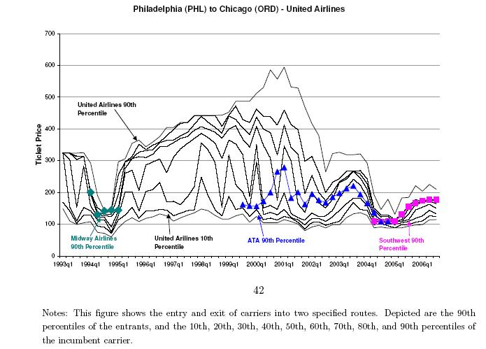
UA: PHX to ORD

Slide 13
Volume discounts
Volume of purchase can also be used to discriminate between buyers.
For example: a single customer willing to pay $7 for the first unit purchased, $6 for the second, $5 for the third, etc.
A price of $7 means the consumer will buy only one unit. But a price of $6 means the consumer will buy two units.
The price represents the value the consumer places on each unit consumed. This is known as an individual demand curve.

Slide 14
Volume discounts (cont’d)
If a seller sets a single price, she will sell all units where MR > MC.
For this example, 3 units at a price of $5 – but if MC is just $1.50 this leaves unconsummated wealth-creating transactions (the remaining three units valued at $4, $3, and $2).
To increase profitability the seller must find a way to sell the additional units at a lower price without lowering the price of the first three units sold.

Slide 15
Volume discounts (cont’d)
This can be done in a number of ways:
Offer volume discounts; for example, price the ﬁrst good at $7, the second at $6, the third at $5, and so on.
Use two-part pricing (ﬁxed price plus a per-unit price). Charge a per-unit price low enough to consummate all wealth-creating transactions (set it at MC ¼ $1.50).
The consumer’s total value for six units is $27 ( ¼ $7 þ $6 þ $5 þ $4 þ $3 þ $2), and six units cost just $9 (¼ 6*$1.50) to produce. Bargain over how to split the remaining surplus ($18 ¼ $27 – $9) created by the transaction. This is the “ﬁxed price” part of the transaction.
Bundle the goods. The consumer’s total value for six units is $27. With enough bargaining power, the entire consumer surplus can be capture, if not, then bargain over how to split it.

Slide 16
Bundling
When selling bundled goods don’t forget: When bargaining with a customer, do not bargain over unit price; instead, bargain over the bundled price.
Sellers can bundle like items where consumer value decreases with each additional unit OR sellers can bundle different items with different consumer demands.
For example: a movie theatre – two group of customers prefer two different types of film (romantic comedy and SciFi). The theatre owner cannot directly price discriminate but in bundling the two picture together into a double feature, the problem is avoidable.
Suppose there are 50 customers willing to pay $3 for the SciFi film but only $2 for the romantic comedy, and 50 willing to pay $3 for the chick flick but only $2 for the SciFi.

Slide 17
Bundling (cont’d)
If the theatre sets a single price for a ticket to any movie, it must face the pricing trade-off – sell to all consumers at $2 (total revenue $200 per film) or sell to half the movie goers at $3 (total revenue $150 per film). Pricing low is more profitable, earning $400 on the two films combined.
BUT if the theatre combines the movies into a double feature it can sell to all customers at a price of $5 increasing total revenue for the two films to $500
Bundling in this way makes consumers more homogeneous (both consumer groups are now willing to pay the same price).
This also allows sellers to earn more if willingness to pay is more homogeneous for the bundled good than separate goods
For cable TV, providers make 65% more selling bundled packages than if each channel were sold separately.

