Slide 1

Principles of Incident Response and Disaster Recovery, 2nd Edition
Chapter 10
Disaster Recovery: Operation and Maintenance
Notes:
1

Slide 2
Objectives
Describe the key challenges an organization faces when engaged in DR operations
Discuss what actions organizations should take to prepare for the activation of the DR plan
List the critical elements that comprise the response phase of the DR plan
Explain what occurs in the recovery phase of the DR plan
Describe how an organization uses the resumption phase of the DR plan

Slide 3
Objectives (cont’d.)
Discuss how an organization resumes normal operations using the restoration phase of the DR plan

Slide 4
Introduction
When disaster occurs organizations need
  Meticulous preparation and ongoing diligence
  Quick and decisive reaction to restore operations
  To prepare to promptly reestablish operations at a new permanent location
Each area of the world has its own challenges and risks of disaster
  Natural or man-made
DR plans and procedures are similar to those undertaken for IR and BC actions

Slide 5
Facing Key Challenges
Widespread disasters frequently affect:
  Departments and various organization levels
  Communities encompassing the organization
  Vendors and suppliers
Outside help may be unavailable for days or weeks
  Emergency services, public services, grocers and other suppliers, utility services, private services, telecommunications services, and air and surface transportation
Worst-case scenario
  Seemingly routine event quickly spins out of control

Slide 6
Facing Key Challenges (cont’d.)
Most disaster-related losses cause:
  Inability to react properly to the disaster
  A need to improvise, adapt, and overcome obstacles
Most disasters last hours or a few days
DR plan phases
  Preparation
  Response
  Recovery
  Resumption
  Restoration

Slide 7
Preparation: Training the DR Team and the Users
No prevention phase in DR planning
  Reason: majority of disasters cannot be prevented
Can minimize disaster probability by planning
Preparation
  Being ready for possible contingencies that can escalate to become disasters
    Develop BIA and DR plans
    Organize and staff various DR teams
    Train various stakeholders and practice the plan

Slide 8
Plan Distribution
Must distribute plan to those who need it most
Ensure that all personnel:
  Have access to the plan
  Have fully read the plan
  Understand the plan
IR, DR, or BC plan storage
  Physical copy easy to misplace
  Online storage locations
    Electronic disruptions could prevent access

Slide 9
Plan Distribution (cont’d.)
Store password-protected plans where employees can access them
  At the office
  Away from the office
  Online (anytime, anywhere)
Password-protecting all electronic files
Store physical copies in secure locations

Slide 10
Plan Triggers and Notification
Preparation phase: continuous
Other phases: activated by triggers
  Management notification
  Employee notification
  Emergency management notification
  Local emergency services
  Media outlets

Slide 11
Disaster Recovery Planning as Preparation
Cornerstone of preparation
  Developing an effective DR plan
DR plan primary goals
  Eliminate or reduce
    Potential for injuries, loss of human life, damage to facilities, loss of assets and records
  Immediately invoke DR plan emergency provisions
    Stabilize disaster effects
    Allow appropriate assessment; begin recovery efforts
  Implement procedures contained in the DR plan

Slide 12
Disaster Recovery Planning as Preparation (cont’d.)
CP team engages in scenario development and impact analysis
  Categorizes threat level each potential disaster poses
Generating DR scenario
  Start with most important asset: people
Must test DR plan regularly
  Ensure DR team can lead recovery effort quickly and efficiently

Slide 13
Disaster Recovery Planning as Preparation (cont’d.)
Key features of the DR plan
  Clear delegation of roles and responsibilities
  Execution of the alert roster and notification of key personnel
  Use of employee check-in systems
  Clear establishment and communication of business resumption priorities
  Complete and timely documentation of the disaster
  Preparations for alternative implementations
  DR team members should know their disaster duties
    Key personnel may include external groups

Slide 14
Disaster Recovery Planning as Preparation (cont’d.)
Key features of the DR plan (cont’d.)
  During a disaster response
    Verify status of employees, contractors, consultants using manual or automatic procedures
    First priority: preservation of human life
    Carefully record disaster from the onset
  Mitigation of impact
    Action steps to minimize damage associated with the disaster on operations

Slide 15
Disaster Recovery Planning as Preparation (cont’d.)
Additional preparations
  Two types of emergency information employees need
    Personal emergency information
    Snapshot of the DR plan
  Emergency information often encapsulated into a wallet-sized, laminated card
  Crisis management
    Focused steps dealing primarily with the safety and state of the people involved in the disaster
    DR team works closely with crisis management team

Slide 16
DR Training and Awareness
Training involves different approaches
Training should focus on roles individual expected to execute during an actual disaster
Disaster preparation limited to awareness training
  Part of annual or semiannual security education, training, and awareness (SETA) program
  Make employees aware of general procedures for responding to disasters

Slide 17
General Training for All Teams
Best crisis preparation
  Ensure employees trained and comfortable in completing normal tasks
Training and rehearsals purpose
  Identify individuals with rusty technical skills
  Provide opportunity to brush up on responsibilities
Vertical and horizontal job rotation
  Allows preparation for normal personnel shortages or outages
Practice degraded mode operations

Slide 18
Disaster Management Team Training
Command and control group
  Responsible for all planning and coordination activities
Training, rehearsal, and testing
  Predominantly communicative in nature
Must quickly and effectively communicate resources needed for subordinate teams to function
Must communicate directives from higher teams and peer teams

Slide 19
Communications Team Training
Information-dissemination group
  Responsible for interacting and communicating with the external environment
Training, rehearsal, and testing
  Prepares information notices, news releases, and internal memorandums and directives
  Sends communications to all groups and teams
  Informs people of their tasks and responsibilities
Should be involved in routine rehearsal and testing

Slide 20
Computer Recovery (Hardware) Team Training
Hardware recovery and reconstitution team
Ideally practices and trains during normal operation
Training requirements
  Advanced training to rebuild systems by scavenging parts
  Knowledge in how to deal with systems damaged by water, heat, and dust
Team should work closely with other technology teams

Slide 21
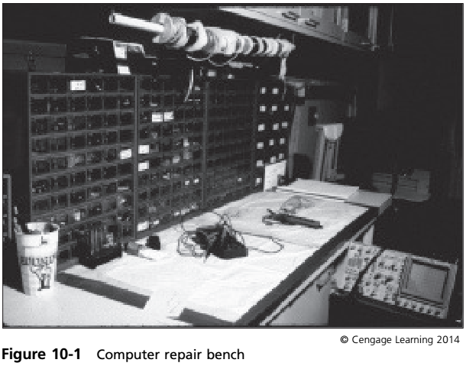

Slide 22
Systems Recovery Team Training
Responsible for recovering and reestablishing operating systems (OSs)
May rehearse DR duties during normal operations
Train to quickly recover system’s operating system
Responsibilities may be combined with other IT teams

Slide 23
Network Recovery Team Training
Responsible for reestablishing
  Connectivity between systems and to the Internet
  Voice communication networks
Focus of training
  Establishing ad hoc networks quickly but securely
  Wireless technology
Team requirements
  Stash of wireless networking components stored outside the organization
Difficult internet connectivity may need vendor interaction

Slide 24
Storage Recovery Team Training
Responsible for information recovery and reestablishment of operations
  In storage area networks or network attached storage
Training needs
  Rebuilding damaged systems
  Recovering data from off-site locations

Slide 25
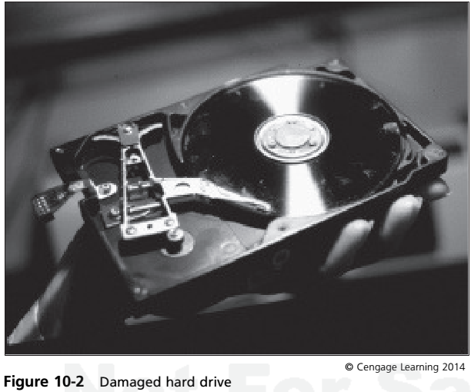

Slide 26
Applications Recovery Team Training
Responsible for recovering and reestablishing critical business applications operations
Requirements
  Skills performed during normal operations
  Coordination and training in operating under adverse circumstances
Team will have user representation
Team effectiveness
  Heavily influenced by ability to create an effective liaison with application business units

Slide 27
Data Management Team Training
Responsible for data restoration and recovery
Focus of training
  Quick and accurate restoration of data from backup
  Should include data recovery from damaged systems
May need vendor help to extract data

Slide 28
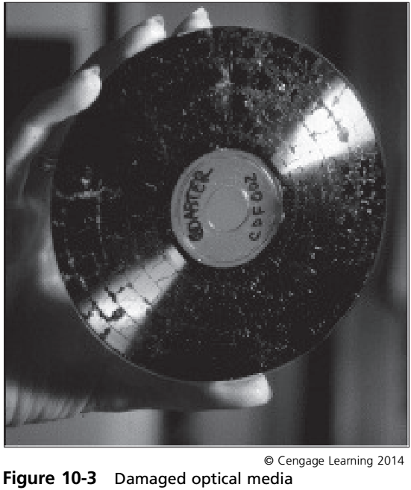

Slide 29
Vendor Contact Team Training
Responsible for working with suppliers and vendors
  Need to replace damaged or destroyed equipment or services determined by other teams
Training best obtained through normal work in equipment procurement
Focus of training
  Methods of obtaining resources quickly as possible
  Familiarity with preferred vendors
Vendor relationships: crucial during a disaster

Slide 30
Damage Assessment and Salvage Team Training
Provides assessment for:
  Initial damage to equipment and systems on-site
  Physically recovering equipment transported to location where other teams evaluate it
Requires basic background in hardware repair
May need to outsource the function

Slide 31
Business Interface Team Training
Works with remainder of the organization
  Assists in recovery of nontechnology functions
Training
  Combines technical and nontechnical functions
  Involves interfacing with various business groups to determine routine needs
Help desk representatives well suited for this team

Slide 32
Logistics Team Training
Provides needed supplies, space, materials, food, services, or facilities needed at the primary site
Require basic training in local purchasing
Primary function
  Serve as health, welfare, and morale support for the other teams doing their jobs

Slide 33
DR Plan Testing and Rehearsal
Testing DR plan elements
  Can overlap with plan training and rehearsal
Rehearsal
  Occurs when organization practices steps performed during a disaster
Testing involves assessment (internal or external)
Before performing in a large-scale exercise
  Provide classroom-style, structured training
Plan rehearsal
  Start small and escalate to larger-scale exercises

Slide 34
DR Plan Testing and Rehearsal (cont’d.)
Rehearsal and testing strategies
  Desk check
  Structured walk-through
  Simulation
  Parallel testing
  Full-interruption
  War gaming

Slide 35
Rehearsal and Testing of the Alert Roster
Alert roster
  Used in IR and BC planning, and crisis management
Alert roster document
  Contains contact information on individuals notified in the event of an actual incident or disaster
  Must be tested frequently because it is subject to continual change
Two activation methods: sequential and hierarchical

Slide 36
Rehearsal and Testing of the Alert Roster (cont’d.)
Alert message
  Scripted disaster description
  Consists of just enough information so that each responder knows what portion of the DR plan to implement
  Does not impede notification process
Auxiliary phone alert and reporting system
  Information system with a telephony interface
  Used to automate the alert process
“I’m okay” automated emergency response line
  Employees call a predetermined number

Slide 37
Disaster Response Phase
Response phase
  Associated with implementing initial reaction to a disaster
  Focus
    Controlling or stabilizing the situation, if possible
Response phase designed to:
  Protect human life and well-being (physical safety)
  Attempt to limit and contain the damage to the organization’s facilities and equipment
  Manage communications with employees and other stakeholders

Slide 38
Recovery Phase
Recovery of the most time-critical business functions
Get back up and running as quickly as possible
  Even if operations limited to some degree
Less critical operations wait until resumption phase
Primary goals of the recovery phase
  Recover critical business functions
  Coordinate recovery efforts
  Acquire resources to replace damaged or destroyed materials and equipment
  Evaluate the need to implement the BC plan

Slide 39
Resumption Phase
Focuses on non-critical functions
BIA: guiding document for creating list of primary and secondary functions
Goals of the resumption phase
  Initiate implementation of secondary functions
  Finalize implementation of primary functions
  Identify additional needed resources
  Continue planning for restoration
Complex interaction exist between DR plan and BC plan

Slide 40
Restoration Phase
Formally begins once:
  All damage assessments accomplished
  Rebuilding of primary site has commenced
Restoration phase primary goals
  Repair damage or select or build replacement facility
  Replace primary site damaged or destroyed contents
  Coordinate relocation from temporary offices to primary site or to new replacement facility
  Restore normal operations at the primary site
  Stand down the DR teams and conduct the after-action review

Slide 41
Repair or Replacement
Two possibilities in the restoration phase
  Reestablish operations at the primary site
  Establish operations at a new permanent site
Reestablish operations at the primary site
  Organization can rebuild facilities at the primary site
    Continue partial operations while repairs made
    Best to temporarily relocate the administrative function

Slide 42
Repair or Replacement (cont’d.)
Move to a new permanent site
  Occurs if primary site becomes uninhabitable
  Bulldoze and rebuild
    Good if organization owns the land
    May be months before the organization can relocate
  Select a new location
    Necessary when organization cannot relocate for an extended stay at temporary locations
    Selection of new permanent site: complex decision
    Staff may not be available to relocate families

Slide 43
Restoration of the Primary Site
Occurs once physical facilities rebuilt
  Must replace office furniture, desktop computers, photocopying equipment, filing systems, office supplies
  Determine what insurance will and will not cover
  Examine service contracts
    Determine if damage or destruction to leased equipment is covered by the provider

Slide 44
Relocation from Temporary Offices
Movement back to the primary site
  Signals beginning of the end of disaster operations
  Must be carefully coordinated: not simple
    Must relocate people and administrative paperwork
    Must restore data functions and associated computing equipment
Data management practices
  More crucial before and after moves
  May require movement coordinator

Slide 45
Resumption at the Primary Site
Recover day-to-day operations to stabilize organization and keep it running efficiently
  Management of employee benefit packages
  Employee training and awareness programs
  Organizational planning retreats and meetings
  Routine progress meetings and reports
  Long-term planning activities
  Research and development activities
Business now reconstituted and functioning as it did before the disaster

Slide 46
Standing Down and the After-Action Review
Standing down
  Deactivation of DR teams
    Releasing individuals back to their normal duties
  After-action review (AAR)
    Last activity before declaring disaster officially over
    Management obtains input and feedback from teams
    Information combined with official disaster log
    Official log: legal and planning record and training tool
  Last step: creation and archiving of the official report
    Legal document for insurance, parent organization
    Once archived, disaster over

Slide 47
Summary
Matter of time until a disaster strikes
  Meticulous preparation and ongoing diligence needed to properly respond
DR plan implementation involves five phases
  Preparation, response, recovery, resumption, restoration
DR and business resumption planning goals
  Eliminate or reduce potential injuries or loss of human life, facility damage, loss of assets and records
  Stabilize the effects of the disaster
  Implement DR and BR procedures

Slide 48
Summary (cont’d.)
Recovery phase
  Quick critical business function recovery
Resumption
  Focuses on remaining unrestored functions
Restoration phase primary goals
  Repair damage or select or build replacement facility
  Replace primary site damaged or destroyed contents
  Coordinate relocation from temporary offices to primary site or to new replacement facility
  Restore normal operations at the primary site
  Stand down the DR teams; conduct the AAR

