Slide 1
Chapter 5 Aging and Late-Life Mobility

Slide 2
Introduction
Definition of full mobility
The role of full mobility in the epidemiology of aging from the perspective of measurement

Slide 3
Aging in the Last Century
Chronic conditions are the leading cause of death and disability in the US
Communicable diseases were the leading cause of death in the early 20th century
Recent development of the shift to chronic diseases as a key concern

Slide 4
Mobility and Aging
Almost 50% of older adults self-identified as having mobility limitations
Medical Expenditure Panel Survey (1996)
13.5 million people over 65 reported a disability with physical limitations
Institute of Medicine (2007)

Slide 5
Consequences of Mobility Limitations
Limited access to nutritional options and preventive health services
Limitations in physical and social activity
Worse health outcomes
Limitations walking and driving

Slide 6
Risk Factors for Mobility Loss
Age
Female sex
Socioeconomic status
Injuries
Diseases and chronic conditions
Sedentary behavior
Environmental barriers

Slide 7
Mobility Measures Focused on Older Adults
Recent work by the Centers for Disease Control and Prevention to develop a set of measures to support research and practice
A conceptual framework developed by the International Classification of Functioning, Disability, and Health
Includes individual, social, and environmental factors

Slide 8
Three Approaches to Measure Mobility
Self-report
Utilizes survey methods to elicit a respondent or proxy’s assessment of his or her mobility
Performance-based
Requires an examiner to directly observe performance of a standardized mobility task
Instrumented measures
Applies electromechanical devices to translate movement into estimated performance

Slide 9
Confusion over Disability and Related Concepts
Conceptual uncertainty of mobility hindered research progress and disability intervention
Necessary to include socioeconomic and psychosocial factors into a framework for disability

Slide 10
A Biopsychosocial Framework in Determining Disability
International Classification of Functioning, Disability, and Health is a biopsychosocial model
Characterizes the relationships among individual characteristics, health conditions, and social and environmental factors
Considered an ecological model because it addresses social and environmental influences

Slide 11
Model of the International Classification of Functioning, Disability, and Health (ICF)
Two classes of factors that contribute to health and disability
Health conditions such as diseases, disorders, and injuries
Contextual factors such as age, sex, physical features of the environment, and social attitude

Slide 12
ICF Model (1 of 2)
Describes human functioning at three levels
Body functions and structures
Activity
Participation
Highlights the difference between capacity and performance

Slide 13
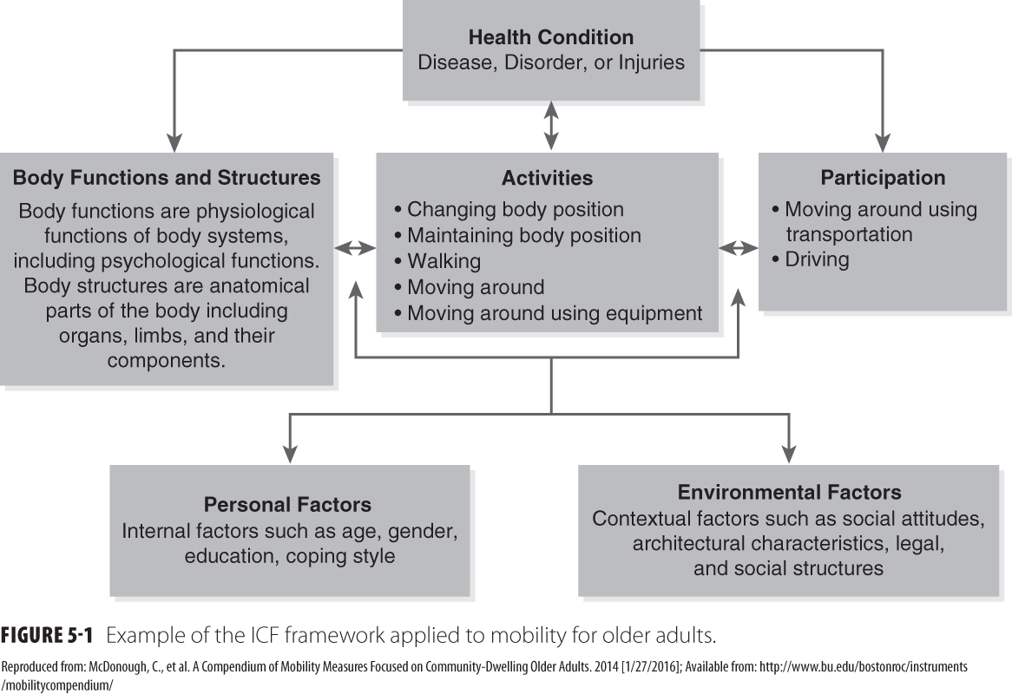
ICF Model (2 of 2)

Slide 14
Definition and Measurement of Mobility
Text’s definition of mobility
Not included in the text’s definition of mobility
Physical functioning
Physical health
Health-related quality of life
Well-being

Slide 15
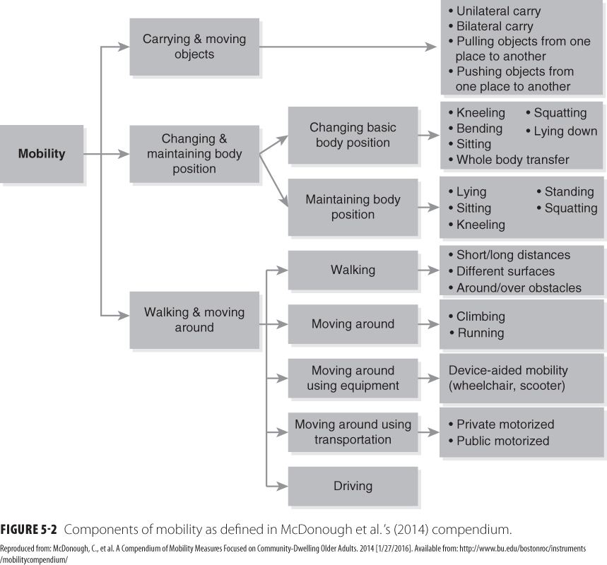
Components of Mobility

Slide 16
Self-Report Measures of Mobility
Two main approaches
Traditional fixed-form methods
Instruments developed using item response theory
Advantages and disadvantages of both

Slide 17
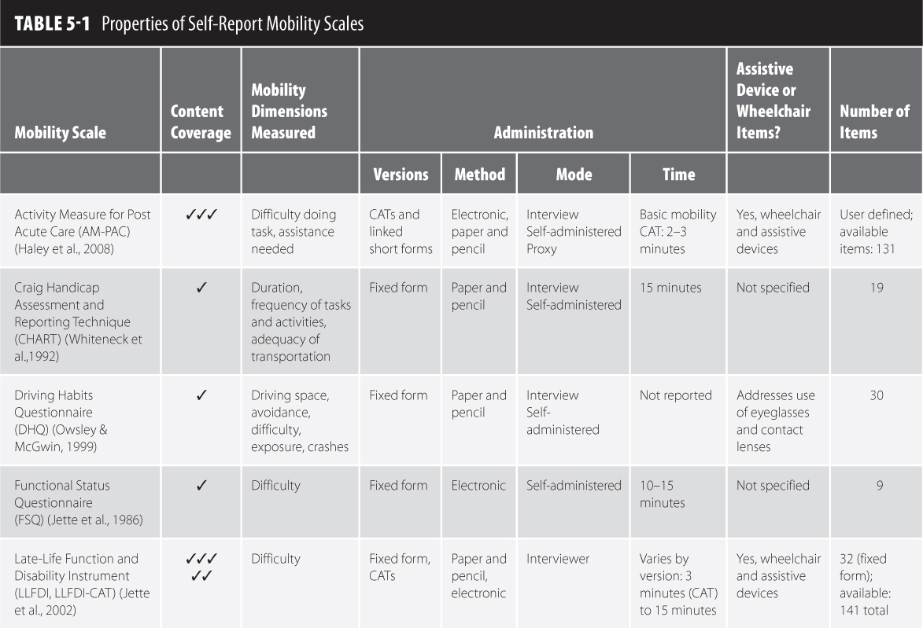
Properties of Self-Report Mobility Scales (1 of 2)

Slide 18
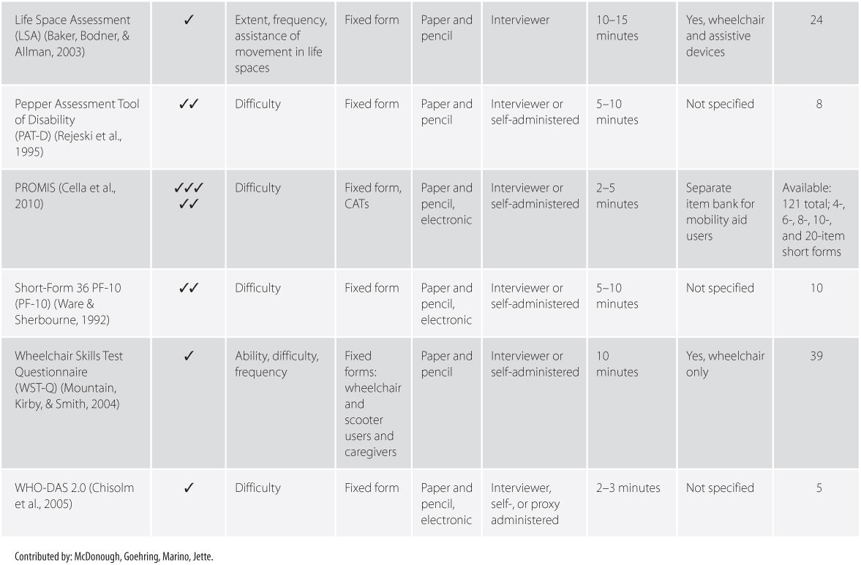
Properties of Self-Report Mobility Scales (2 of 2)

Slide 19
Performance-Based Measures of Mobility
Focuses on walking activities
Requires some training of the tester
Tests can be performed in less than 15 minutes with minimal equipment
Advantages include relative standardization of administration
Disadvantages include the administrative burden of in-person testing

Slide 20
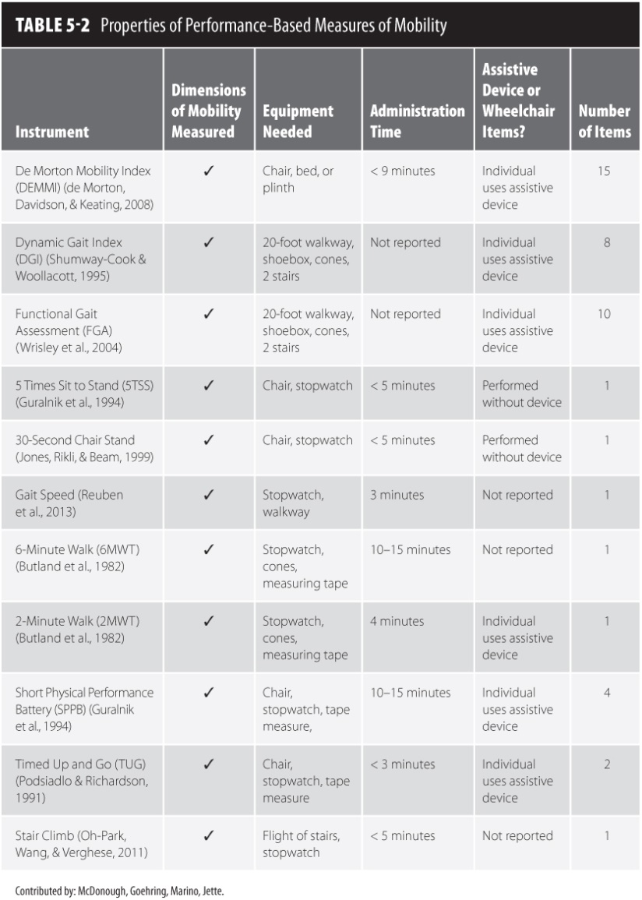
Properties of Performance-Based Measures of Mobility

Slide 21
Instrumented Measures of Mobility
Wide range of choices in level of cost, complexity, activities to be measured, and technical considerations
Provides direct measurement of behavior in free-living conditions
High degree of ecologic validity
Disadvantages include challenges with movement throughout the community

Slide 22
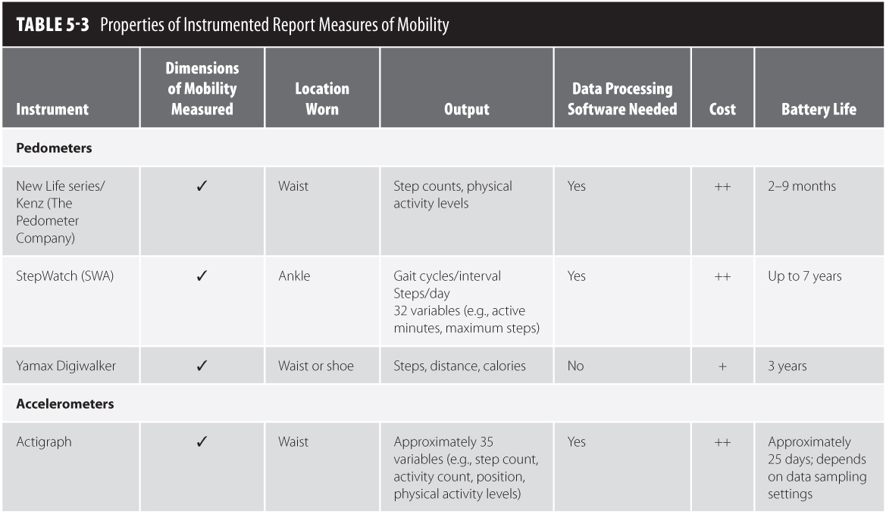
Properties of Instrumented Report Measures of Mobility (1 of 2)

Slide 23
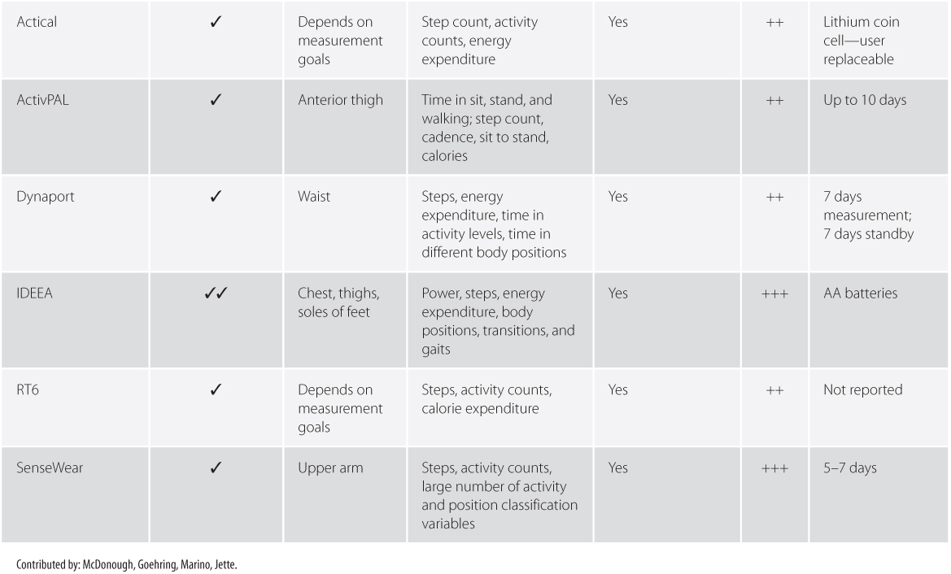
Properties of Instrumented Report Measures of Mobility (2 of 2)

Slide 24
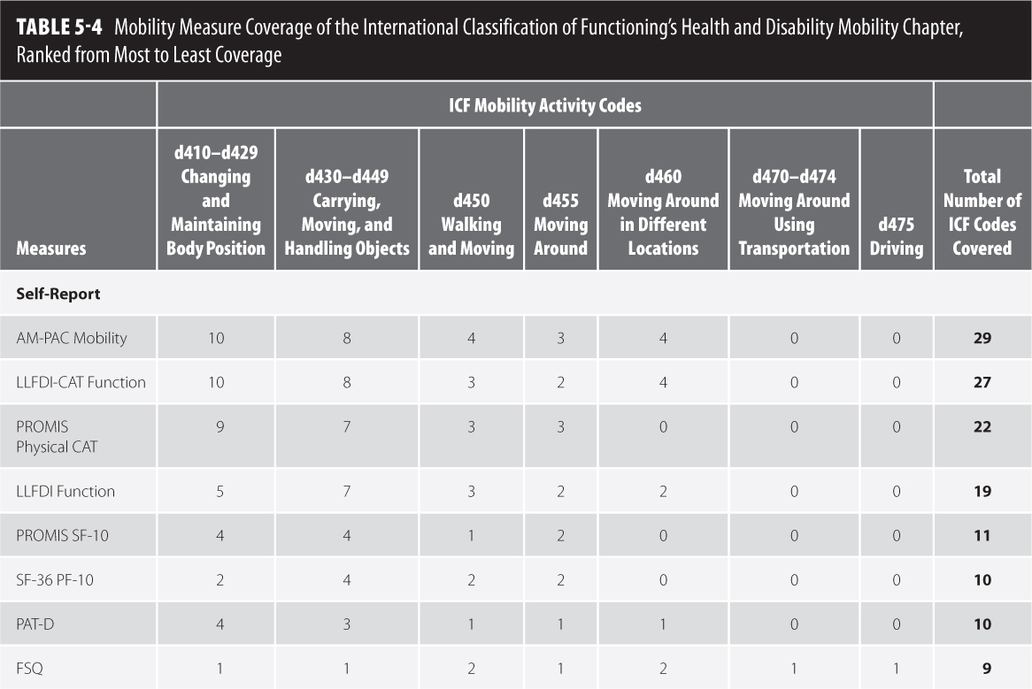
Comparisons Across Types of Measures (1 of 3)

Slide 25
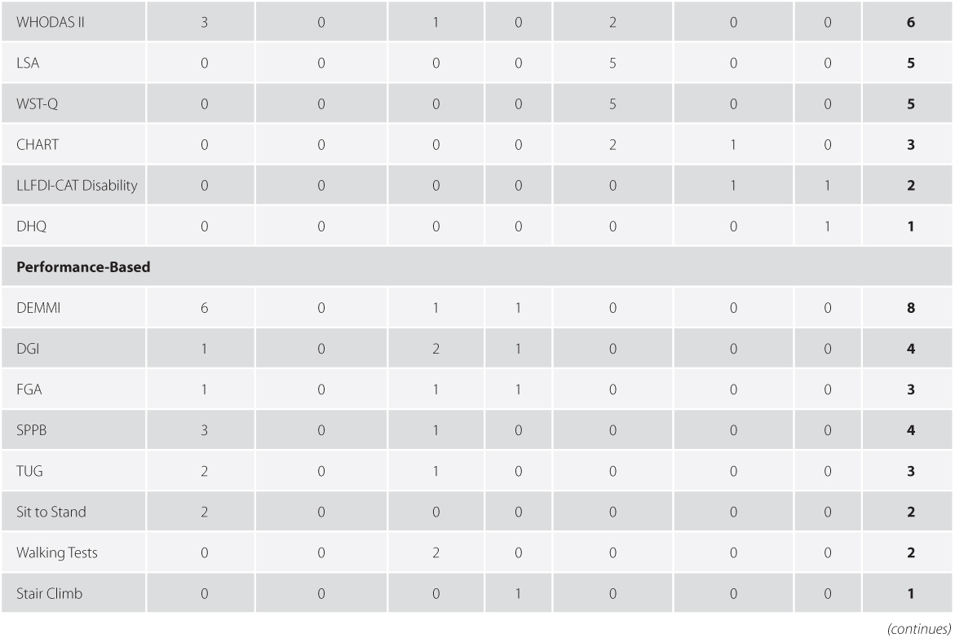
Comparisons Across Types of Measures (2 of 3)

Slide 26
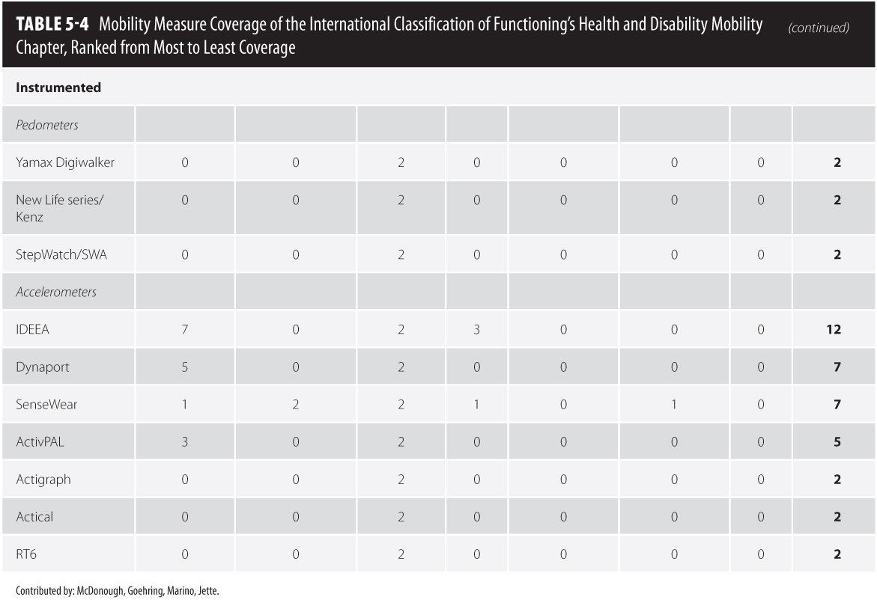
Comparisons Across Types of Measures (3 of 3)

Slide 27
Conclusions and Future Directions
No one superior approach to measure mobility in older adults
Strengths and weaknesses of each approach
Recommendations include using a multifactorial approach to the measurement of mobility

