Slide 1
Chapter 4 Survival, Mortality, and Cause of Death

Slide 2
Introduction
Mortality data are typically more valid and extensive
A distinction between causes of death and predictors of mortality
Non-modifiable vs. potentially modifiable factors

Slide 3
Definitions and Measurements
Mortality
Population
Survival
Cause of Death

Slide 4
Methodological Issues in the Epidemiology of Mortality
Centuries long collection of birth and death statistics
Role of cause-specific mortality statistics in public health policies and priorities
Various uses for population registers

Slide 5
Crude and Age-Adjusted Mortality Rates
Crude death rate vs. age-adjusted death rate
Necessity of age adjustment

Slide 6
Person-Time and Censoring
Person-time
A measurement
Most often used denominator in mortality rates
Censoring
Necessary when time to death is unavailable
Various reasons for unavailable information

Slide 7
Hazard Ratio
A measure of death frequency between groups over time
Not an absolute value
Hazard ratio of 1
Hazard ratio greater than 1
Hazard ratio less tan 1

Slide 8
Premature Mortality vs. Infant Mortality
Premature mortality
Draws attention to preventable deaths
Years of potential life lost
No consensus about age criterion
Infant mortality
Widely used indicator of population health
Decreased globally
Dramatic effect on average life expectancy, especially in developing world

Slide 9
Selective Mortality and Mortality Risk Factors
The process of selective mortality
Factor in consequences of selective mortality

Slide 10
Changing Causes of Death
Incomplete cause-of-death-data in many middle-and low-income countries
Critical uses of cause-of-death-data
The role of the Global Burden of Disease consortium and their findings

Slide 11
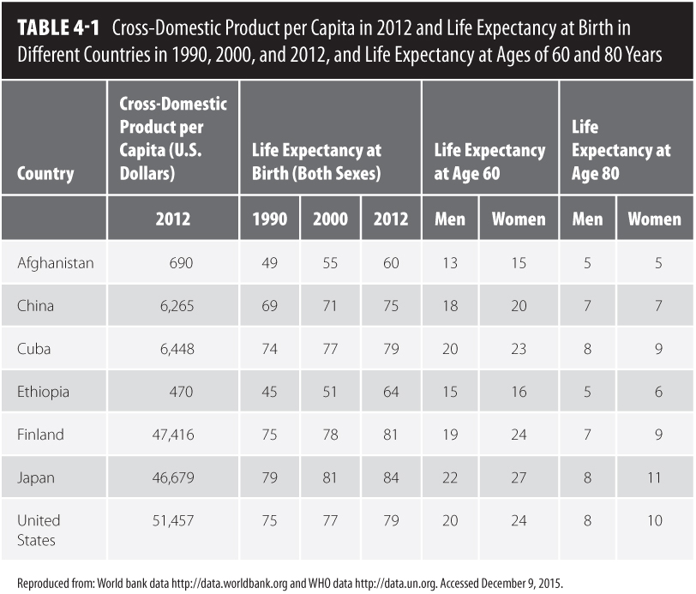
Socioeconomic Disparities in Mortality
Health disparities vs. health differences
Socioeconomic status and its many factors
Social position affects exposure to risk factors
Socioeconomic disparities and global life expectancy rates

Slide 12
Other Disparities in Mortality
All-cause mortality
Global variations in the magnitude of health disparities
Age-specific mortality
Socioeconomic mortality disparities among older adults is drawing more research interest
Differences in mortality rates are usually in the “oldest of old”

Slide 13
Biomarkers of Aging
Should meet several criterion
Ongoing discussion about the possibility to distinguish indicators of aging from indicators of disease process
Currently, various biomarkers of aging are under investigation

Slide 14
Categories of Functional Capacity Tests
Tests measuring the functioning of an organ system
Tests measuring the functioning of the entire body
Tests describing the ability of the person to function

Slide 15
Measures of Functional Capacity as Predictors of Mortality
Reflects the combined influences of
Genetic predisposition
Acquired modifications of physical constitution
Aging process
Chronic diseases

Slide 16
Life Course Epidemiology of Mortality
Considers health in adulthood and old age to be partly a consequence of development and growth during sensitive periods of early life
The developmental origins of health and disease paradigm is multidisciplinary
The fetal origins of adult disease hypothesis is an example

Slide 17
Male-Female Survival Paradox
Research suggests that men are stronger, report fewer diseases, and have fewer physical limitations
In contrast, female death rates are substantially lower

Slide 18
Explanations for the Male-Female Survival Paradox
Biological endowments
Hormonal origin hypothesis
X-chromosome hypothesis
Risks acquired through social roles and behaviors
Physicians’ diagnostic patterns
Differential healthcare access, treatment, and use

Slide 19
Lifestyle vs. Genetic Risk Factors
Shared familial factors may underlie longevity
Addressed in the Long Life Family Study
Members of the same family might share socioeconomic status or eating and exercise habits
May be addressed by twin studies

Slide 20
Compression of Morbidity
Suggests that the burden of a lifetime illness may be compressed into a shorter period of time nearer to the age of death
Currently debatable whether this is really taking place
The differing definitions of morbidity and disability make it challenging to draw conclusions

Slide 21
Last Year of Life
Important to understand predictors of care needs in the last period of life in order to understand compression of morbidity
Administrative databases with vital status and hospital care use need to be linked with research data for a decedent cohort

Slide 22
Conclusion
Many unknown factors when predicting mortality
Risk factors tend to change over time
An ongoing increase in the human lifespan
Life histories of future cohorts will differ from the current cohorts

Slide 23
Future Directions
New cohorts assessed with more up-to-date methodologies and new conceptual approaches will produce new knowledge
Knowledge about biomarkers, effect modifications, interactions, additive effects, and selection biases is still lacking

