Slide 1
Notes:
Based in Los Angeles and California. We are an independent nonprofit organization and a partner of the National Endowment for the Humanities. Since 1975, we have been promoting the humanities as relevant, meaningful ways to understand the human condition and connect us to each other in order to help strengthen California. We produce, fund, create, and support humanities-based projects and programs, eye-opening cultural experiences and meaningful conversations. During the past 40 years, California Humanities has awarded over $29 million in grants across the state, reaching every Congressional district.

Slide 2
CALIFORNIA HUMANITIES:
Our Mission:
To connect Californians to ideas and one another in order to understand our shared heritage and diverse cultures, inspire civic participation, and shape our future.
Our Vision:
Californians possess the knowledge, understanding, respect, and empathy to create a more thoughtful, open, and just state.

Slide 3
What Are the Humanities Anyway?

Slide 4
What Are the Humanities Anyway?
We hear this question a lot. The question is, in itself, a complicated one. Often we think about them as academic subjects or fields of inquiry that produce knowledge about human activities, ideas, values, norms, and cultural products: history, literature, jurisprudence, philosophy, religious studies, art history and criticism, anthropology, sociology, as well as newer disciplines such as ethnic, cultural, and gender studies.

Slide 5
What Are the Humanities Anyway?
But there are other ways to think about them, too. One way might be to see them broadly as a range of activities and practices revolving around cultural life, whatever the setting might be. In this sense, anyone who reads a book or listens to a story, appreciates a work of art, reflects upon the meaning of life, records their memories or chronicles an event, passes on a tradition or wonders where it came from, or asks questions about the values and motivations of human actors (past, present, or future) is “practicing” the humanities.

Slide 6
What Are the Humanities Anyway?
To others, the humanities are skills and abilities that enable us to exchange ideas and impressions, listen as well as speak, read as well as write, and expand our understanding through the use of active imagination and empathy — seeing the world through the eyes of another person or the lens of another set of experiences. They are “tools for conviviality.” The humanities are tools for passing on traditions, values, stories, and accumulated wisdom, but they can also be employed as tools for reflection, analysis, critique, and change.

Slide 7
What Are the Humanities Anyway?
What is clear is that the humanities mean – and have meant – many things to many people, in different times and places. What is common is the shared focus on knowing, understanding, and communicating about the human experience — our own as well as others.

Slide 8
CALIFORNIA HUMANITIES:
California. A state of almost 40 million people, with millions of stories to share.
A state of writers, filmmakers, storytellers and artists. A state of innovators and thinkers.

Slide 9
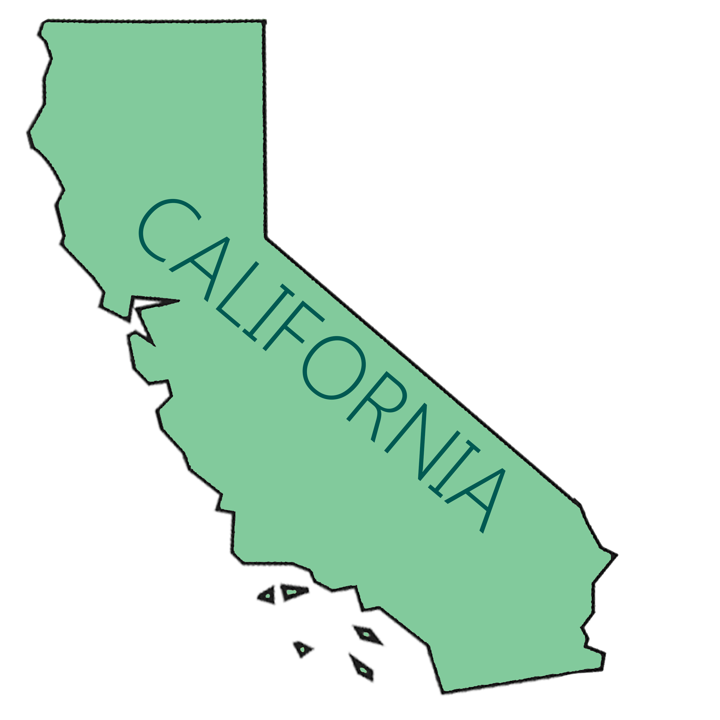
A state of open mind.

Slide 10
hu·man·i·ty
(h)yo͞oˈmanədē/
noun
plural noun: humanities
1.
the human race; human beings collectively.
2.
humaneness; benevolence.
3.
learning or literature concerned with human culture, especially literature, history, art, music, and philosophy.

Slide 11
hu·man·i·ty
Middle English: from Old French humanite, from Latin humanitas, from humanus (see human).
Humanities are academic disciplines that study aspects of human society and culture.

